Slide 1
Introduction to Number and Counting:
Birth–8 Years
Notes:
Talking Points
Welcome, everyone. Today, we will explore how children develop an understanding of number and counting.
Facilitator Notes
Adjust talking points to include relevant introductions, “housekeeping,” and other important information for your participants.
We recommend providing collections of small objects (for example, paper clips, shells, cotton balls, counting chips) that participants can use to engage in counting experiences throughout this session. If your agency implements Counting Collections (Franke et al., 2018), you might provide some of these collections or invite educators to bring their own counting manipulatives from their learning setting. Consider providing enough manipulatives so each table group has their own set of small objects.

Slide 2

Count Play Explore Professional Learning Resources is a product of the Fresno County Superintendent of Schools developed by WestEd in collaboration with FCSS and AIMS Center for Math and Science Education. They are not intended for commercial redistribution, unauthorized modification, or use outside the scope of professional education.
Notes:
Talking Points
The Count Play Explore Professional Learning Resources were made possible by Count Play Explore, an early math, science and computer science initiative led by the Fresno County Superintendent of Schools, Early Care and Education Department. This initiative is generously funded by the California Department of Education and the California State Board of Education. These resources, developed by WestEd in collaboration with FCSS and AIMS Center for Math and Science Education, are intended to be used as a guide for implementing evidence-based strategies, promoting active learning, and encouraging developmentally appropriate practices in early education settings. They are not intended for commercial redistribution, unauthorized modification, or use outside the scope of professional education.

Slide 3
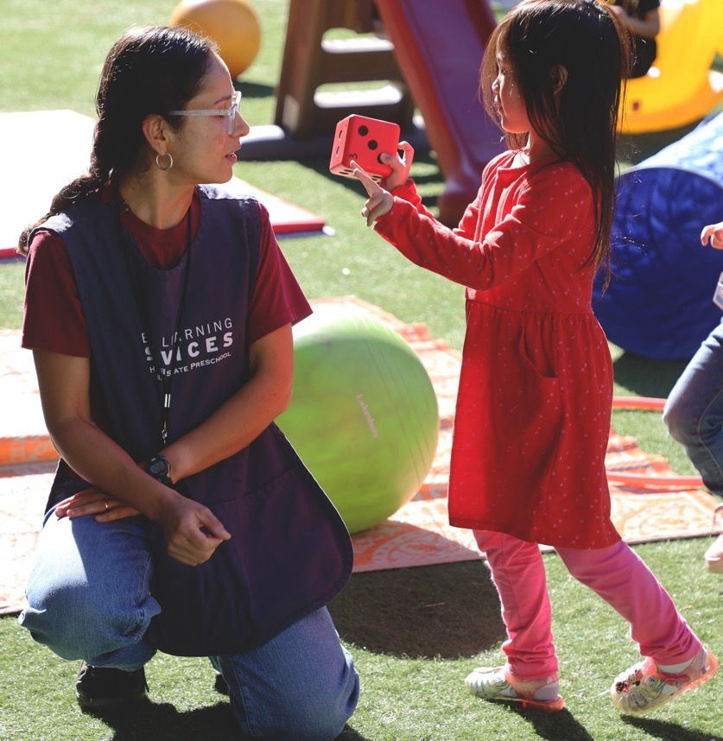
Session Goals
Explore and play with numbers.
Describe four components of number and counting.
Review how children develop knowledge and skills in number and counting.
Notes:
Talking Points
In this session, we will start by exploring and playing with numbers.
Next, we will describe four key components of number and counting.
We will also review the ways children develop knowledge and skills in number and counting.
The ways we will learn together are similar to the ways children learn. We will play, observe, explore, and reflect.
Facilitator Notes
Adjust slide content and talking points to reflect what you plan to address in your professional learning session.

Slide 4
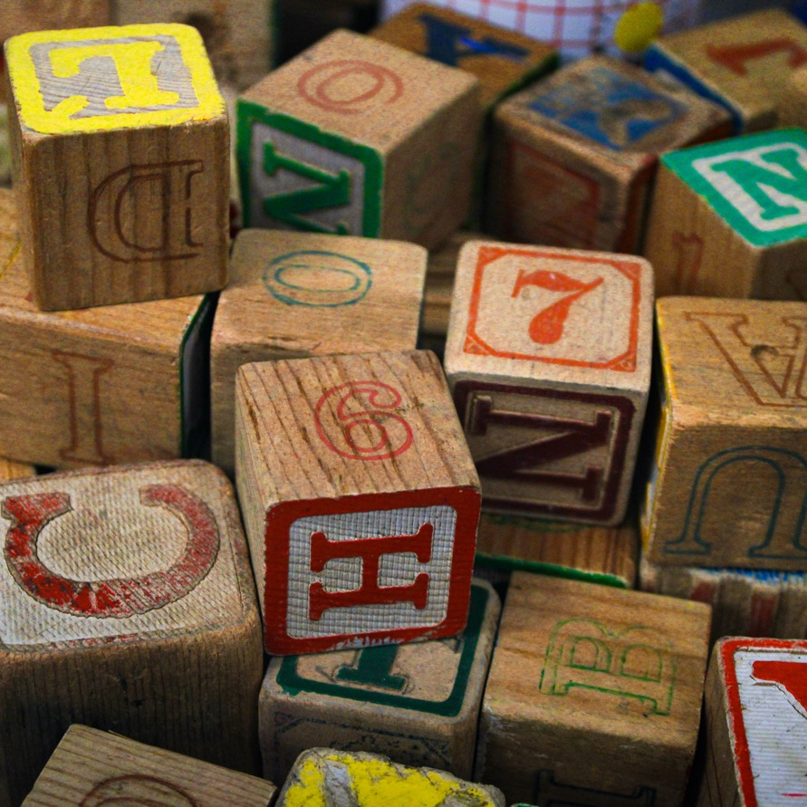
Play:
Alphabet Counting
Notes:
Time: 15–30 minutes (including the debrief on slide 5)
Materials: Alphabet Counting handout, small items to count, containers, paper, and pencils
Talking Points
Let’s play a counting activity specially designed for adults.
Take out the Alphabet Counting handout.
The purpose of this activity is to experience what it feels like to learn how to count for the first time. [Use the instructions on the handout as talking points and guide the educators through the different sections.]
Facilitator Notes
The Alphabet Counting activity has multiple parts. Depending on the amount of time you have in your session, you may choose to engage in the entire activity or just the first and second part (“Learning About Alphabet World” and “Counting Fingers and Toes”).
Math is playful. This principle is key to the Count Play Explore professional development approach. This activity invites adults to explore counting through play.
Math mindsets matter. This experience may activate a variety of feelings for participants. Some may enjoy this experience, while others may find it stressful.
Allow participants to engage in ways that they feel most comfortable. Some may think through these problems independently, while others prefer to work in pairs or small groups.
The goal of this activity is to experience counting as a beginner would. This experience is likely to be challenging for participants. Remind them that it is okay if they do not get the correct answers.
When inviting participants to share, consider their comfort level. Some participants may not feel comfortable sharing with the whole group. Adapt how you facilitate this activity based on participant needs and session length.

Slide 5
Discuss: Alphabet Counting
What strategies or materials did you use to solve the alphabet math problems?
How did the strategies resemble those that children use when they learn to count?
How might this experience affect your engagement with children as they learn to count?
How does this experience relate to your work with multilingual learners who may be learning to count in more than one language?
Notes:
Time: 15–30 minutes (including slide 4)
Materials: Small items to count, containers, paper, and pencils
Talking Points
Let’s discuss this experience of learning the alphabet counting system. At your table, discuss the following questions:
What strategies or materials did you use to solve the alphabet math problems?
How did the strategies resemble those children use when they learn to count?
How might this experience affect your approach with children as they learn to count?
How does this experience relate to your work with multilingual learners who may be learning to count in more than one language?
[After some time for small group discussion, invite participants to share with the whole group. Then, summarize some key points. For example, “I noticed you used different strategies to solve these problems. Some of you used your fingers to count, others used small items, and some made an alphabet number line. These are the types of strategies and materials children often use when they learn to count.”]
This activity demonstrated that learning to count can be challenging. Children need to learn many things at once. For example, they have to learn number words, number order, and how counting works. In this session, we will explore how children learn about number and develop counting skills.
Facilitator Notes
Adjust the discussion method (for example, in pairs or at tables) based on group size, session length and format, and participant needs.
Invite participants to share their experiences with the whole group if time permits.

Slide 6
Number and Counting:
An Overview
Notes:
Talking Points
Before we review how children develop an understanding of number and counting, let’s begin by defining “number” and “counting.”

Slide 7
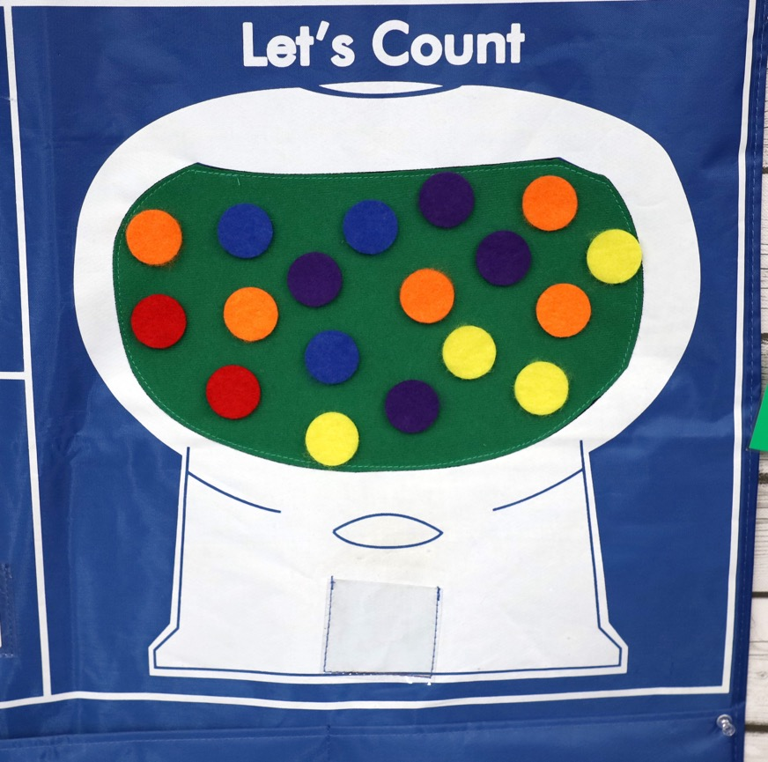
Number and Counting Defined
The concepts and skills children learn to:
understand quantity
count objects in a set
Notes:
Talking Points
Numbers can be used to represent quantity (how many).
For example, when you have two red circles, “two” represents the number of red circles.
Counting describes the process we use to identify the quantity of objects in a group.
Altogether, this math area describes the concepts and skills children learn to understand quantity and to count objects in a set.
Facilitator Notes
You may be familiar with the term “number sense.” It refers to understanding number, counting, and number operations (for example, addition or subtraction). Content related to number sense is addressed in this suite of resources, which focuses on number and counting, as well as the Addition and Subtraction suite of resources, which focuses on developing addition and subtraction concepts and skills.
This session introduces math vocabulary to describe various concepts and skills related to number and counting. Consider providing participants with the “Glossary of Number and Counting Vocabulary” handout at the start of the session.

Slide 8

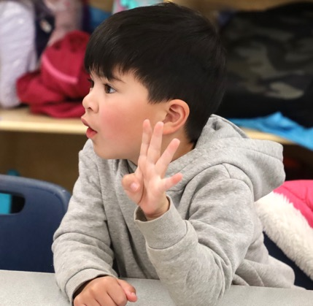
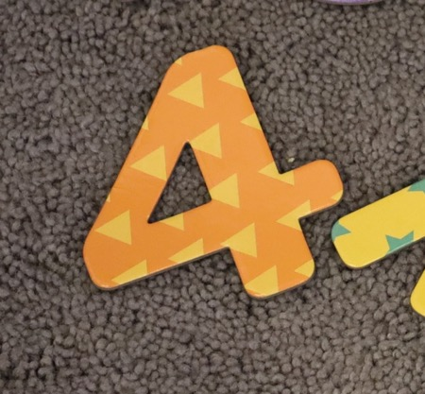
Different Ways to Represent a Number
“four”
“cuatro”
“bốn”
Objects
Fingers
Number words
Numerals
Notes:
Talking Points
The amount of something can be represented in many ways.
Children start by using concrete objects to represent quantity.
For example, showing you four rubber ducks.
They can also use their fingers.
For example, holding up four fingers.
They can use number words. Number words are the way we represent numbers using language. This includes words and sign language.
For example, saying “four” in English, “cuatro” in Spanish, or “bốn” in Vietnamese.
At the end of preschool and into kindergarten, children learn to represent numbers using numerals, the symbols we use to record numbers.
For example, writing, using an Augmentative and Alternative Communication (AAC) device or using picture cards to record the symbol “4.”

Slide 9
Learning About Number and Counting
Notes:
Talking Points
Now, let’s discuss how young children develop an understanding of number and counting.

Slide 10
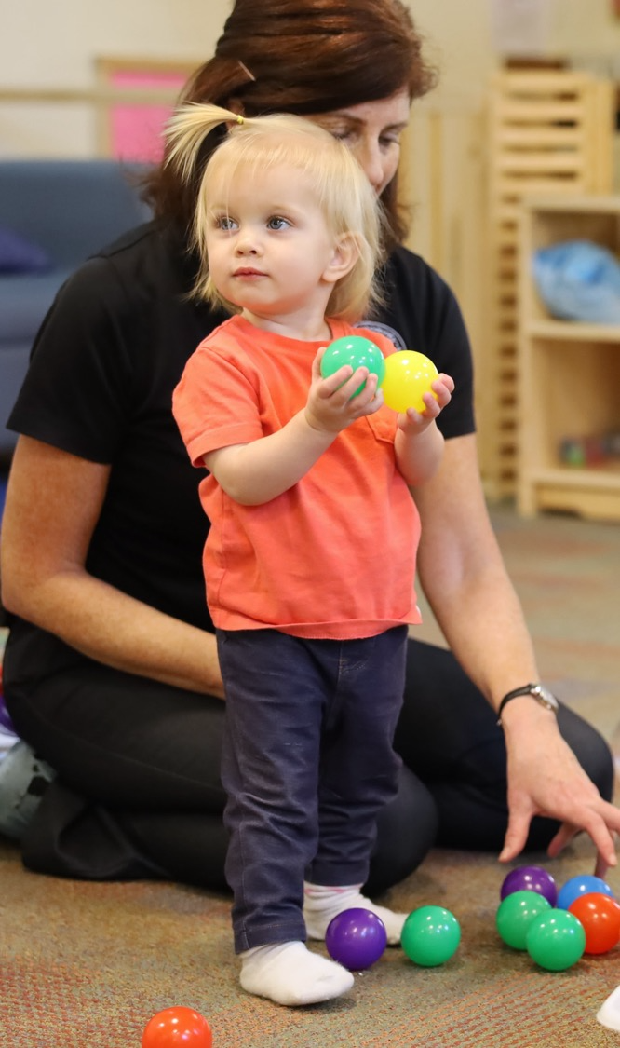
Four Components of
Number and Counting
Attending to quantity
Comparing numbers
Counting and cardinality
Recognizing, naming, and recording numerals
Notes:
Talking Points
The following slides describe four important components of number and counting. These components include children’s ability to:
attend to quantity
compare numbers
count and develop an understanding of cardinality
recognize, name, and record numerals
Facilitator Notes
Consider reviewing The Development of Counting from Infancy Through the Early School Years research brief for a more in-depth understanding of how children develop counting skills.

Slide 11
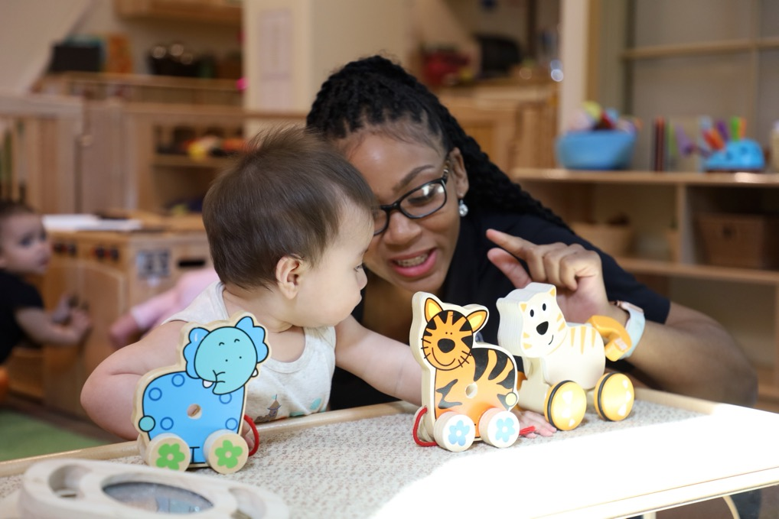
Attending to Quantity
Young children’s understanding of numbers is approximate and becomes more precise with age. They begin to:
notice amounts of things or people and
understand concepts like “more” and “less”
Feigenson et al. (2002)
Notes:
Talking Points
Attending to quantity describes young children’s ability to notice quantity in the environment. This skill also includes understanding concepts like “more” or “less.”
Young children notice amounts of things or people. Infants can notice changes in the number of items in a set. For example, they notice if a picture changes from showing one block to four blocks.
Young children understand concepts like “more” or “less” (Feigenson et al., 2002). For example, they might grab the bowl that has more crackers in it.
Young infants’ understanding of number is approximate. This means that their understanding is not precise. For example, a six-month-old infant might not notice when the number of items changes from 10 to 12. However, they will notice if the number changes from 10 to 20 dots. As children get older, their ability to notice becomes more precise. They recognize smaller changes in number.
Facilitator Notes
Review PPT 2a: “Number and Counting: Infants and Toddlers” for a demonstration of how researchers study infant’s ability to attend to quantity.

Slide 12
How Many Dots?
Notes:
Talking Points
Children and adults know how many objects are in a small set through subitizing [pronunciation: soo-bi-ty-zing]. Subitizing is the ability to immediately observe the number of objects in a group without counting.
[Click to reveal the picture on the left with five dots. After 1–2 seconds, click again to make the picture disappear.] How many dots did you observe? [After participants answer:]
That’s right. There were five dots. Now, let’s try again.
[Click to reveal the picture on the right with 10 dots. After 1–2 seconds, click again to make the picture disappear.] How many dots did you observe? [After participants answer:]
This picture had 10 dots. What did you notice about this experience? Was it easier to observe 5 or 10 dots? [Provide time for participants to answer.]
You just experienced subitizing [pronunciation: soo-bi-ty-zing]. Children and adults can observe how many objects are in a small set through subitizing. Subitizing is the ability to immediately observe the number of objects in a group without counting.
The ability to subitize starts in infancy as infants attend to quantity. Starting around age three, children can subitize up to three objects and then four later in preschool.
Adults can easily subitize small sets but it is more difficult to subitize larger sets.
Facilitator Notes
The goal of this activity is to show subitizing in action. Subitizing is a skill we use when identifying the number of objects in a small group by looking briefly and not by counting. Therefore, it’s important to show the dot pictures very briefly.
Consider practicing clicking through these pictures before the session.
For participants with visual impairments, consider offering tactile stimuli such as dice with raised bumps or glue dots on paper and asking how many bumps they feel without counting.

Slide 13
Even More Dots
Riggs & Castronovo (2010); Crollen & Collignon (2020)
Notes:
Talking Points
Let’s explore how we can use subitizing to identify the number of objects in a larger set.
[Click to reveal the picture with 10 dots organized like a domino. After 1–2 seconds, click again to make the picture disappear.] How many dots did you observe?
[After allowing time for participants to answer:] This picture had 10 dots. This is the same number of dots we observed in the last picture on the previous slide. You may have noticed that observing the 10 dots in this picture was easier. When observing this picture, you probably noticed that the dots were organized in two groups of five. Based on your conceptual understanding of addition, knowing that five and five equals ten, you could conclude that there were 10 dots altogether. This process is conceptual subitizing. Conceptual subitizing is the ability to immediately observe the number of objects in a group by composing small quantities into a whole.
Conceptual subitizing develops at around five to six years of age.
Subitizing is not only a visual skill. Research with blind adults suggests that they can subitize using tactile stimuli (for example, a die with raised bumps) as accurately as sighted adults do with visual stimuli (Riggs & Castronovo, 2010; Crollen & Collignon, 2020).
Facilitator Notes
The goal of this activity is to show conceptual subitizing in action. Subitizing is a skill we use when identifying the number of objects in a small group by looking briefly and not by counting. Therefore, it’s important to show the dot pictures very briefly.
Consider practicing clicking through these pictures before the session.

Slide 14
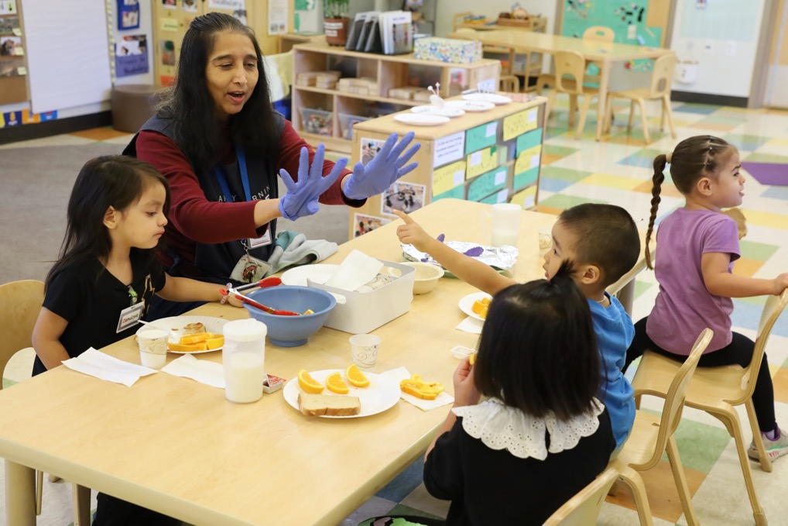
Comparing Numbers
Find out which set has more, which has less, or if both sets have the same number.
Use words like “more,” “less,” or “same.”
Notes:
Talking Points
The component we just discussed—attending to quantity—provides the foundation for children to compare numbers. When comparing the number of objects in two sets, children find out which set has more or less or if the sets are equal.
They also learn to use vocabulary like “more,” “less,” or “same” when comparing the number of objects in two sets.
Children may compare numbers using strategies like visually comparing, matching, or counting. Let’s explore these different strategies together.

Slide 15
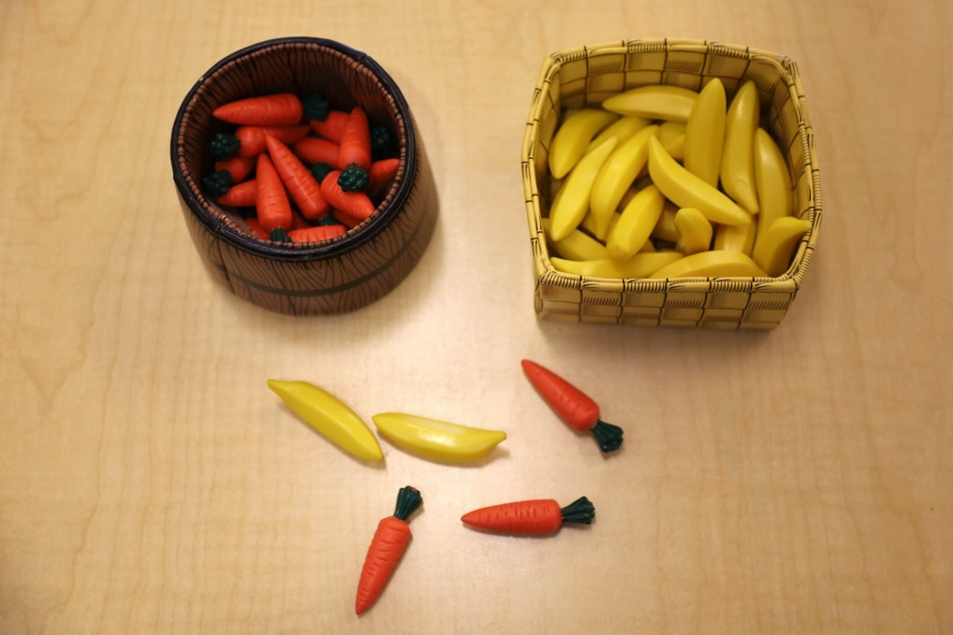
Comparing Carrots and Bananas
What are the different ways you could compare the number of carrots and bananas in these baskets?
Notes:
Time: 5–10 minutes
Talking Points
Let’s think about some ways we can compare two sets of objects.
[Point to the baskets on the slide:] Take a look at the picture on this slide. What are the different ways you could compare the number of carrots and bananas in these baskets? Which basket has more?
Turn to a partner and discuss your ideas. Discuss as many options as possible.
[Provide participants with about five minutes to work in pairs. Then, invite the pairs to share their strategies with the larger group.] In pairs, you identified a variety of strategies to compare numbers. Some ways children learn to compare numbers include visually comparing, matching, and counting.

Slide 16


Comparing Numbers: Different Strategies
2
1
1
4
2
3
more
less
4 ducks
2 ducks
Visually comparing
Matching
Counting
Notes:
Talking Points
Next, let’s discuss how children compare numbers.
Children, just like adults, may compare numbers using different strategies. Let’s review the different strategies children may use when comparing numbers:
Visually comparing: This strategy involves simply looking at two sets and deciding which is more without counting. Children and adults use this strategy when there are only a few objects being compared or when the difference between the two sets being compared is very big.
Matching: This strategy involves putting two sets of objects in one-to-one correspondence. When children match two sets, they identify whether one has more by comparing the length of the lines of objects.
Counting: This strategy involves counting the number of objects in each set to decide which one has more or whether they have the same amount.

Slide 17
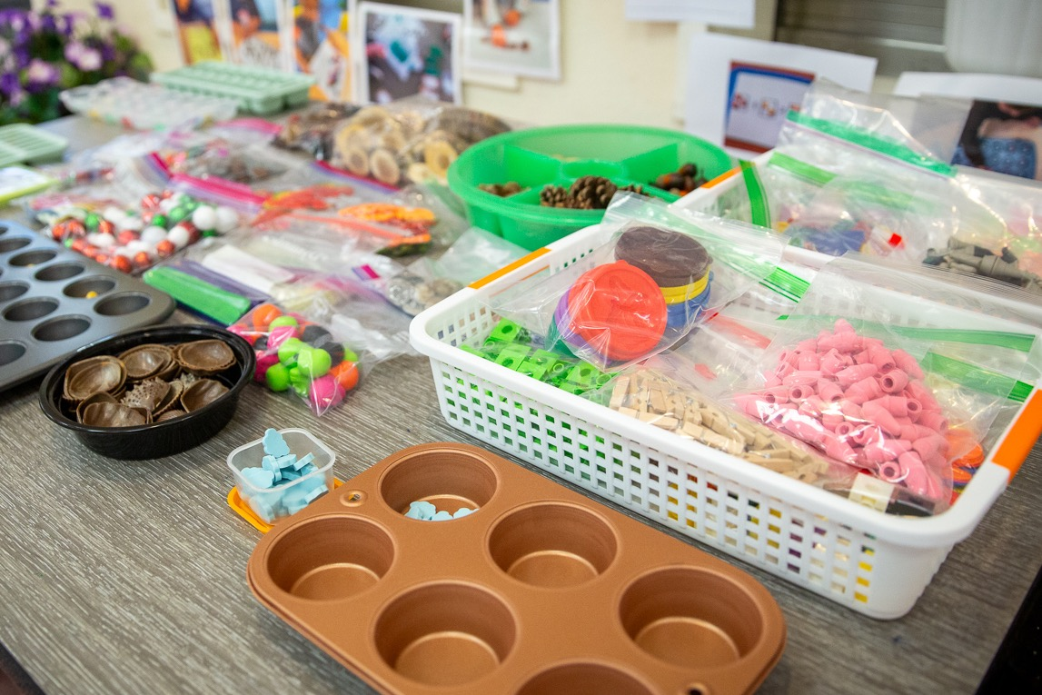
Let’s Count!
Notes:
Time: 5–10 minutes
Materials: 30–40 small objects for each table or small group (paperclips, counters, pens, pinecones, or buttons)
Talking Points
[Select a facilitation strategy from the Facilitator Notes.]
[Provide each table group with their own collection of 30–40 small objects. Then:] Take turns counting the objects on your table. As you watch others count, notice the strategies they are using.
How are they keeping track of which objects they have counted and which ones they still need to count?
Are they counting by one or skip-counting by two or five?
What language are they counting in?
Is everyone using the same strategies?
[Provide time for participants to count.]
[Then, depending on the facilitator strategy you chose, invite participants to share their strategies and observations.]
As adults, we count without having to think about it. Many of the strategies we use to count come naturally to adults, just think what it takes for a child who is learning to count! We will discuss some of these concepts and skills children need to learn in order to develop an understanding of counting and cardinality in the following slides.
Facilitator Notes
Adjust the way you organize the activity based on group size, session length and format, and participants’ needs. For example:
For longer sessions, invite participants to work individually and share their experiences with their tables before discussing as a larger group.
For shorter sessions, invite participants to work with a partner and share with the larger group.
This activity is similar to Counting Collections (Franke et al., 2018), an activity in which young children count a collection of objects and then make a representation of what they counted. Learn more about Counting Collections on the DREME TE website.

Slide 18
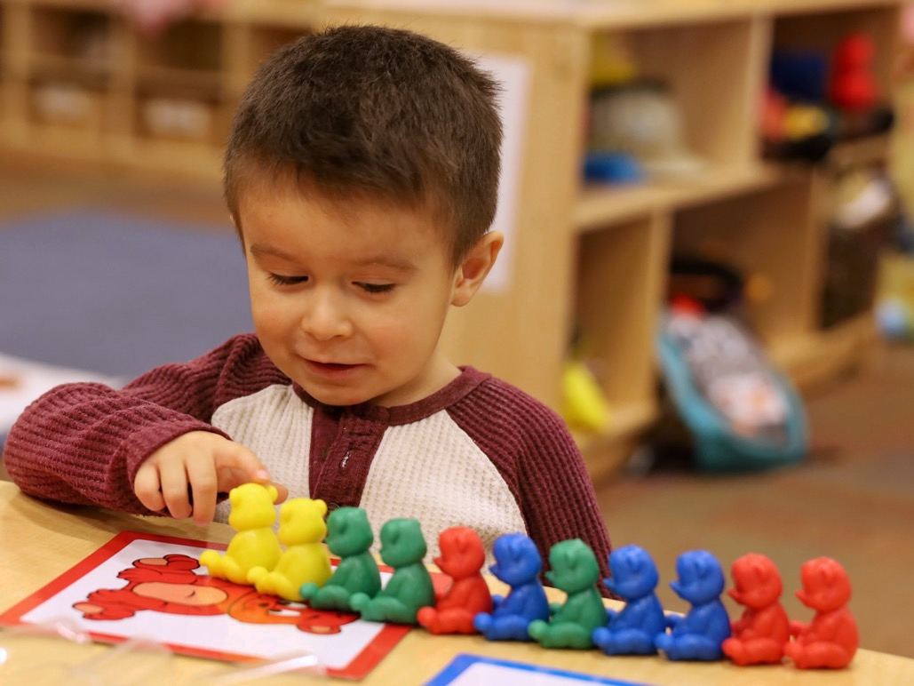
Counting Principle 1: Stable Order
Numbers are in a specific order that does not change.
Notes:
Talking Points
Children learn about counting by observing adults or other children use counting to find out how many.
As children learn to count with meaning (or to find out how many), they learn to apply three counting principles: stable order, one-to-one correspondence, and cardinality.
The first counting principle is stable order. Stable order is understanding that number words are in a specific order and this order never changes.
Children begin understanding stable order when they learn to recite the count list. The count list is the ordered list of number words in any language, including sign language.
For example, the count list in English is one, two, three, four, five, and so on.
Children first begin to recite parts of the count list at around age two. By age four, most children can recite the count list up to 10 and understand the principle of stable order.

Slide 19
The Role of Language in Counting
Multilingual learners learn to recite the count list in the languages they are exposed to.
Children who have limited exposure to language may experience delays in learning to count.
Cankaya et al. (2014); Leybaert & Van Cutsem (2002); Santos & Cordes (2022)
Notes:
Talking Points
Before we discuss counting principles two and three, here is a note about the role of language in children’s ability to recite the count list.
Consistent exposure and opportunity to use number words—in any language—plays an important role in learning to count, specifically learning to recite the count list.
Multilingual learners learn to recite parts of the count list in any of the languages they are exposed to frequently. For example, a child learning Spanish at home and English in their early learning and care setting may communicate their first few number words in Spanish. Typically, they will learn English number words quickly in their early learning and care setting. Multilingual learners learn to count at the same pace as monolingual children.
The types of languages children are exposed to can also influence children’s understanding of number and counting (Cankaya et al., 2014). Languages vary in how they represent mathematical concepts, including their number-naming system. Languages such as Chinese or Japanese have a number system in which number words map directly onto a base-ten structure (for example, the word for “11” in Chinese is equivalent to “ten-one”). Languages such as English and Spanish have a less obvious number word system (for example, the word for “11” in English is “eleven”). Research suggests that children learning languages with more transparent number systems, such as Chinese, Japanese, or Arabic, may have an easier time (at least at first) in learning to recite numbers, especially numbers that follow ten.
However, research suggests that children with limited language exposure in the early years may experience delays in learning to count or producing number words.
For example, children who are deaf or have hearing impairments and are learning sign language may experience delays in learning parts of the count list compared to hearing children (Santos & Cordes, 2022).
This might be because caregivers are not fluent in sign language and have fewer ways to communicate with their children. As a result, they may not be exposing the children to as much language—including number and counting words—as hearing children.

Slide 20
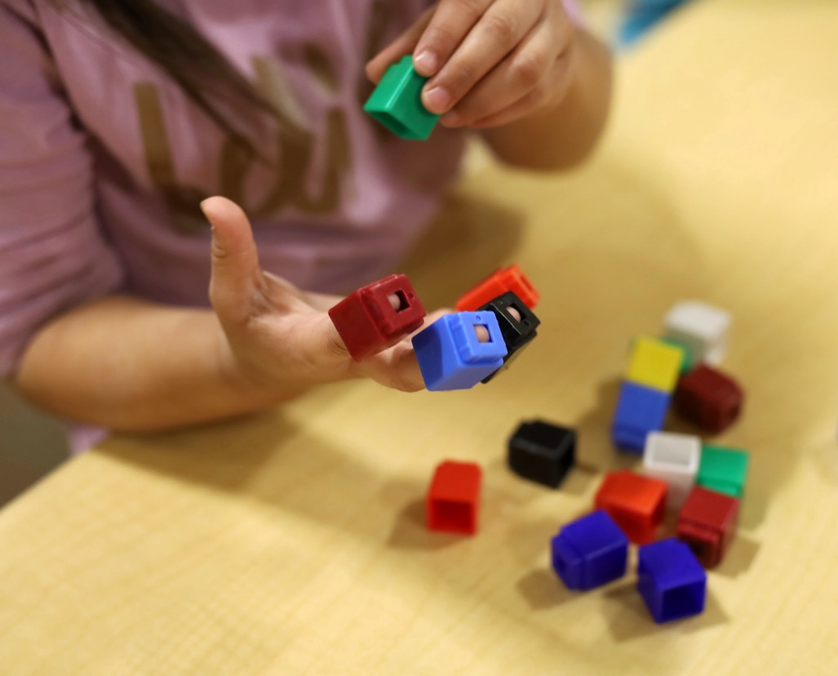
Counting Principle 2: One-to-One Correspondence
The ability to assign one number word to each object while counting.
Espy et al. (2004)
Notes:
Talking Points
The second counting principle is one-to-one correspondence—the ability to assign one number word to each object while counting.
For example, when counting feathers on a dream catcher, a child might touch each feather as they say each number word.
Understanding one-to-one correspondence requires a lot of practice and modeling from caregivers, educators, or older siblings.
Children first need to understand that every item only gets counted once.
Children also need to learn strategies to keep track of the items they already counted, and the items still left to be counted. [Make a connection to participant answers from the earlier counting activity.] Children might keep track by moving all the counted items to one side or arranging them in a line.
Children’s approaches to learning skills, specifically their executive functioning skills, are important when learning to count and engage in one-to-one correspondence (Espy et al., 2004). Executive functioning includes children’s ability to ignore distracting information (inhibition) and remember information for short periods of time (working memory). When children are learning to engage in one-to-one correspondence, children need to remember which objects have already been counted.

Slide 21
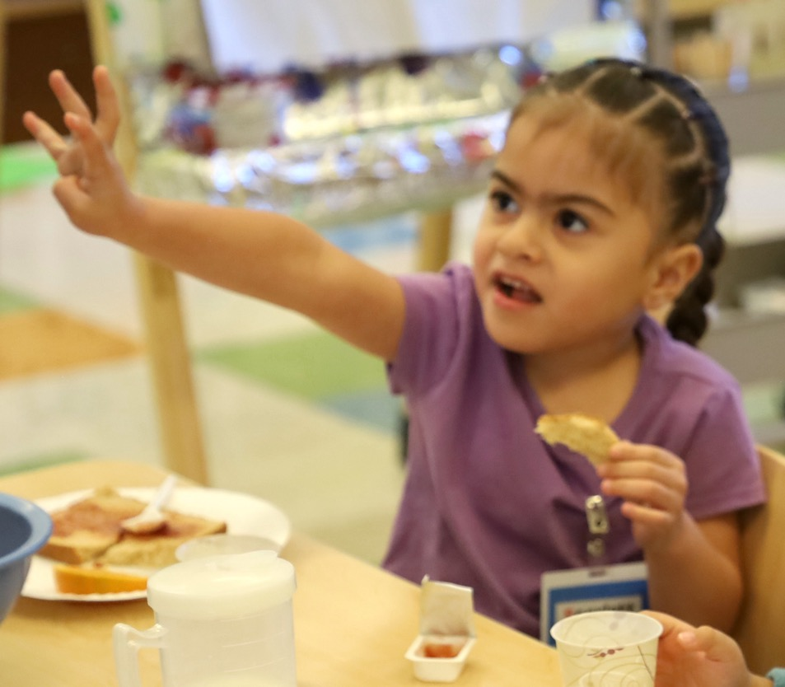
Counting Principle 3: Cardinality
Cardinality: The last number word in the count list represents the size of the set.
Gunderson & Levine (2011; Ramani et al. (2015; Silver & Libertus (2022)
Notes:
Talking Points
The third counting principle is cardinality. As mentioned earlier, cardinality is understanding that, when counting, the last number word in the count list represents the quantity of the set.
For example, a child might count a row of five apples as “one, two, three, four, five.” If they understand cardinality, they not only know that the number word “five” names the last apple. They also know that the number word “five” represents the total number of apples in this set.
Developing an understanding of cardinality is quite complex and requires a lot of practice with counting.
Most children develop an understanding of cardinality by the end of preschool or TK.
However, it is important to remember that children develop at their own pace and in their own way and a variety of factors can impact children’s understanding of counting (Jordan & Levine, 2009; Silver & Libertus, 2022).
Children who experience more number words in meaningful contexts learn number words faster (Gunderson & Levine, 2011). Educators and families need to use number words and counting in daily routines and play.
Additionally, traditions and routines in children’s homes and communities influence their experiences with counting. For example, some children may learn to count using their fingers, while others are introduced to tools like an abacus. Asking families about important traditions and routines for their family can help educators incorporate those into their setting.
Facilitator Notes
Review PPT 2b: “Number and Counting: Preschool, Transitional Kindergarten, and Kindergarten” for more information on the three counting principles.
Consider showing participants Count Play Explore’s “I’m Ready” videos to provide examples and encouragement for how they or the families they work with can engage children in counting in everyday routines and play. Some relevant videos are:
California Dad: Snack Time (Un papá típico de California: La hora del bocadillo in Spanish)
Wide World of Math: Treasure Hunt (Amplio mundo de las matemáticas: Búsqueda del tesoro in Spanish)

Slide 22
Alphabet Counting: Counting Principles
How did you apply the three principles while learning to count using the alphabet?
Stable order
One-to-one correspondence
Cardinality
Notes:
Talking Points
Think back to the alphabet counting activity we did at the beginning of this session. In table groups, discuss how you applied your understanding of the three principles of counting (stable order, one-to-one correspondence, and cardinality) while learning to count using the alphabet.
[After some time for small group discussion, invite participants to share with the whole group. Then, summarize some key points. For example:]
Unlike young children when they first learn to recite the count list, you already knew the order of the alphabet, so you were able to apply the stable order principle to this new counting system.
From your experience with the number system, you also had some strategies to engage in one-to-one correspondence (for example, by lining up your items or pointing to each item as you count them). What may have been more challenging was to connect meaning to each letter in the alphabet.
From our experience with the number system, we understand how much “five” represents, but with the new alphabet counting system, we may not yet understand what “g” represents.
Facilitator Notes
Adjust the discussion method (for example, in pairs or at tables) based on group size, session length and format, and participant needs.

Slide 23
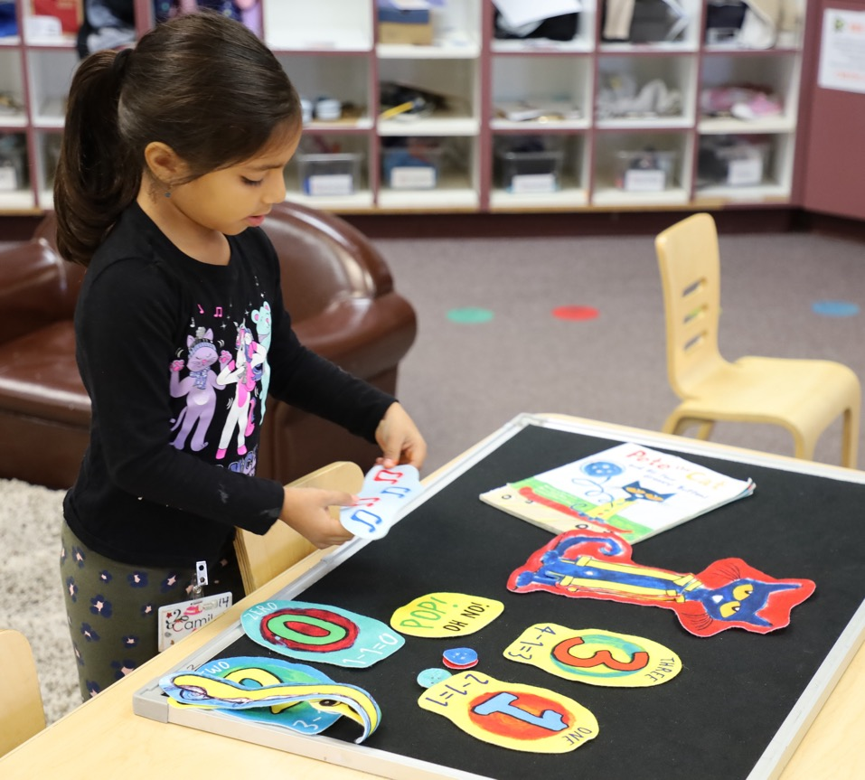
Recognizing, Naming, and Recording Numerals
Numerals are symbols for representing numbers (for example, 1, 2, 3, 4).
Young children learn about number concepts through interactions with concrete objects.
They gradually build knowledge of what numerals represent.
Notes:
Talking Points
The last component in our suite of resources on number and counting describes children’s ability to recognize, name, and record numerals. Numerals are symbols that represent numbers. For example, the numeral “2” represents two objects.
Most languages and countries use the Arabic numeral system (Hindu–Arabic numerals). These are the numerals we use in the United States.
Young children learn about number concepts through interactions with concrete sets of objects. Gradually, they recognize that numerals represent numbers (for example, that “2” represents the value of two).
Children first begin to recognize a few numerals under ten between ages three and four.
Children can record numerals by writing, using an Augmentative and Alternative Communication (AAC) device, or using picture cards.
Facilitator Notes
Review PPT 2b: “Number and Counting: Preschool, Transitional Kindergarten, and Kindergarten” for more information on how children learn about numerals.

Slide 24
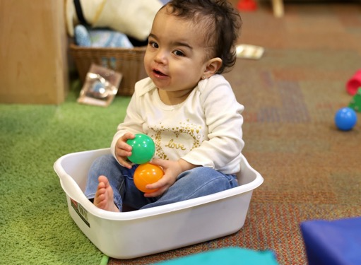
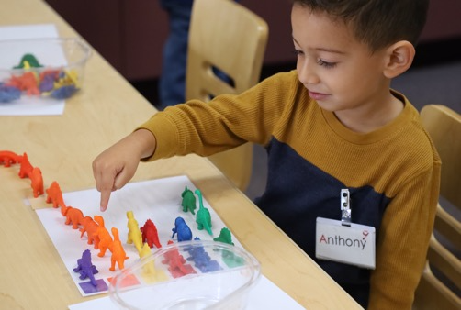
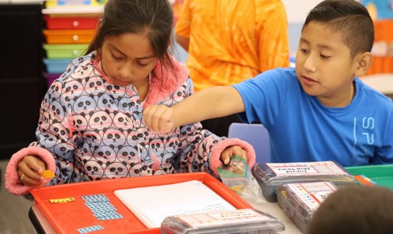
Overview of Children’s Knowledge of Number and Counting​
Components | Infants and Toddlers | Preschool, TK, and K | Early Elementary
Attending to quantity | Notice changes in number | Subitizes up to three or four objects | Subitizes up to four objects
Comparing number | Understands and begins to use words like “more” or ”less” | Compares numbers by matching or counting | Expresses comparisons using mathematical symbols (for example, 3 < 15)​
Counting and cardinality | Understands and uses a few number words | Counts to 10, then 20, and 30 and develops an understanding of cardinality​ | Counts to 1,000,​ Skip counts by 2, 5, and 10
Recognizing, naming, and recording numerals | Not applicable | Recognizes and records a few numerals | Recognizes, names, and records numerals to 1,000​
Notes:
Talking Points
We have discussed four components related to understanding numbers and developing counting skills. Think about how children’s math learning develops and becomes more complex over time.
This slide shows what children, at three points of development, know about number and counting across the four components.
Infants notice changes in the number of objects. With adult support, toddlers learn to communicate a few number words and use comparative words like “more” or “less.”
Children in preschool, transitional kindergarten, and kindergarten learn to recite the count list to 10, then to 20 and 30. They also learn to count using one-to-one correspondence and develop an understanding of cardinality. Once children know how to count with one-to-one correspondence, they can compare two small sets by counting. In preschool, children also learn to recognize a few numerals. By age five, they can recognize and record numerals up to 20.
Children learn to recite the count list to 1,000 in early elementary school. They can compare numbers larger than ten and express these comparisons using mathematical symbols such as <, >, and =. In addition, they can recognize and record numerals up to 1,000.

Slide 25
Reflect:
Exit Ticket
What is something you learned today?
Notes:
Time: 5–10 minutes
Materials: One note card per participant
Talking Points
We discussed four components of number and counting: attending to quantity; comparing numbers; counting and cardinality; and recognizing, naming, and recording numerals.
We explored how these four components develop throughout early childhood. We also applied some of these number and counting skills in a playful, hands-on adult experience.
Consider what you learned today. Then, record something you learned on a note card—your exit ticket.
[Provide a few minutes for participants to record what they learned. Select a facilitation strategy for the debrief. Adjust talking points to match the strategy you chose.]
This session described how children come to understand numbers and develop counting skills. When you return to your learning setting, you might notice ways children use numbers and counting. You also might pay attention to ways you support children to develop an understanding of number and counting skills. Noticing will help you be more intentional about the ways you support children’s learning in this math area.
Facilitator Notes
Adjust the way you organize the activity based on group size, session length and format, and participants’ needs.
Invite participants to share their reflections with their table groups.
If you prefer to keep participants’ reflections anonymous, invite participants to bring their cards to you to share. Collect the “exit tickets” to identify what participants learned and relate to topics for coaching or future professional learning.

