Slide 1
Geometry: Early Elementary
Notes:
Talking Points
In this session, we will explore how early elementary children deepen their understanding of shapes. We will also focus on ways we can support early elementary children to deepen their understanding of shapes.
We will use “TK” to refer to transitional kindergarten and “K” for kindergarten.
Facilitator Notes
Adjust talking points to reflect your session length and participant needs. If necessary, add introductory and “housekeeping” information.

Slide 2

Acknowledgments
Count Play Explore Professional Learning Resources is a product of the Fresno County Superintendent of Schools developed by WestEd in collaboration with FCSS and AIMS Center for Math and Science Education. They are not intended for commercial redistribution, unauthorized modification, or use outside the scope of professional education.
Notes:
Talking Points
The Count Play Explore Professional Learning Resources were made possible by Count Play Explore, an early math, science and computer science initiative led by the Fresno County Superintendent of Schools, Early Care and Education Department. This initiative is generously funded by the California Department of Education and the California State Board of Education. These resources, developed by WestEd in collaboration with FCSS and AIMS Center for Math and Science Education, are intended to be used as a guide for implementing evidence-based strategies, promoting active learning, and encouraging developmentally appropriate practices in early education settings. They are not intended for commercial redistribution, unauthorized modification, or use outside the scope of professional education.

Slide 3
Session Goals
Describe how early elementary children learn about shapes.
Identify ways to support early elementary children in developing geometry knowledge and skills.
Notes:
Talking Points
First, we will review how children in the early grades learn about shapes.
Next, we will explore some ways that educators and families can support early elementary children to develop geometry knowledge and skills.
Throughout our session, we will take time to reflect on our current practices. We will also think about how we might use information from this session in our work.
Facilitator Notes
Adjust talking points to reflect your session length and participant needs.

Slide 4
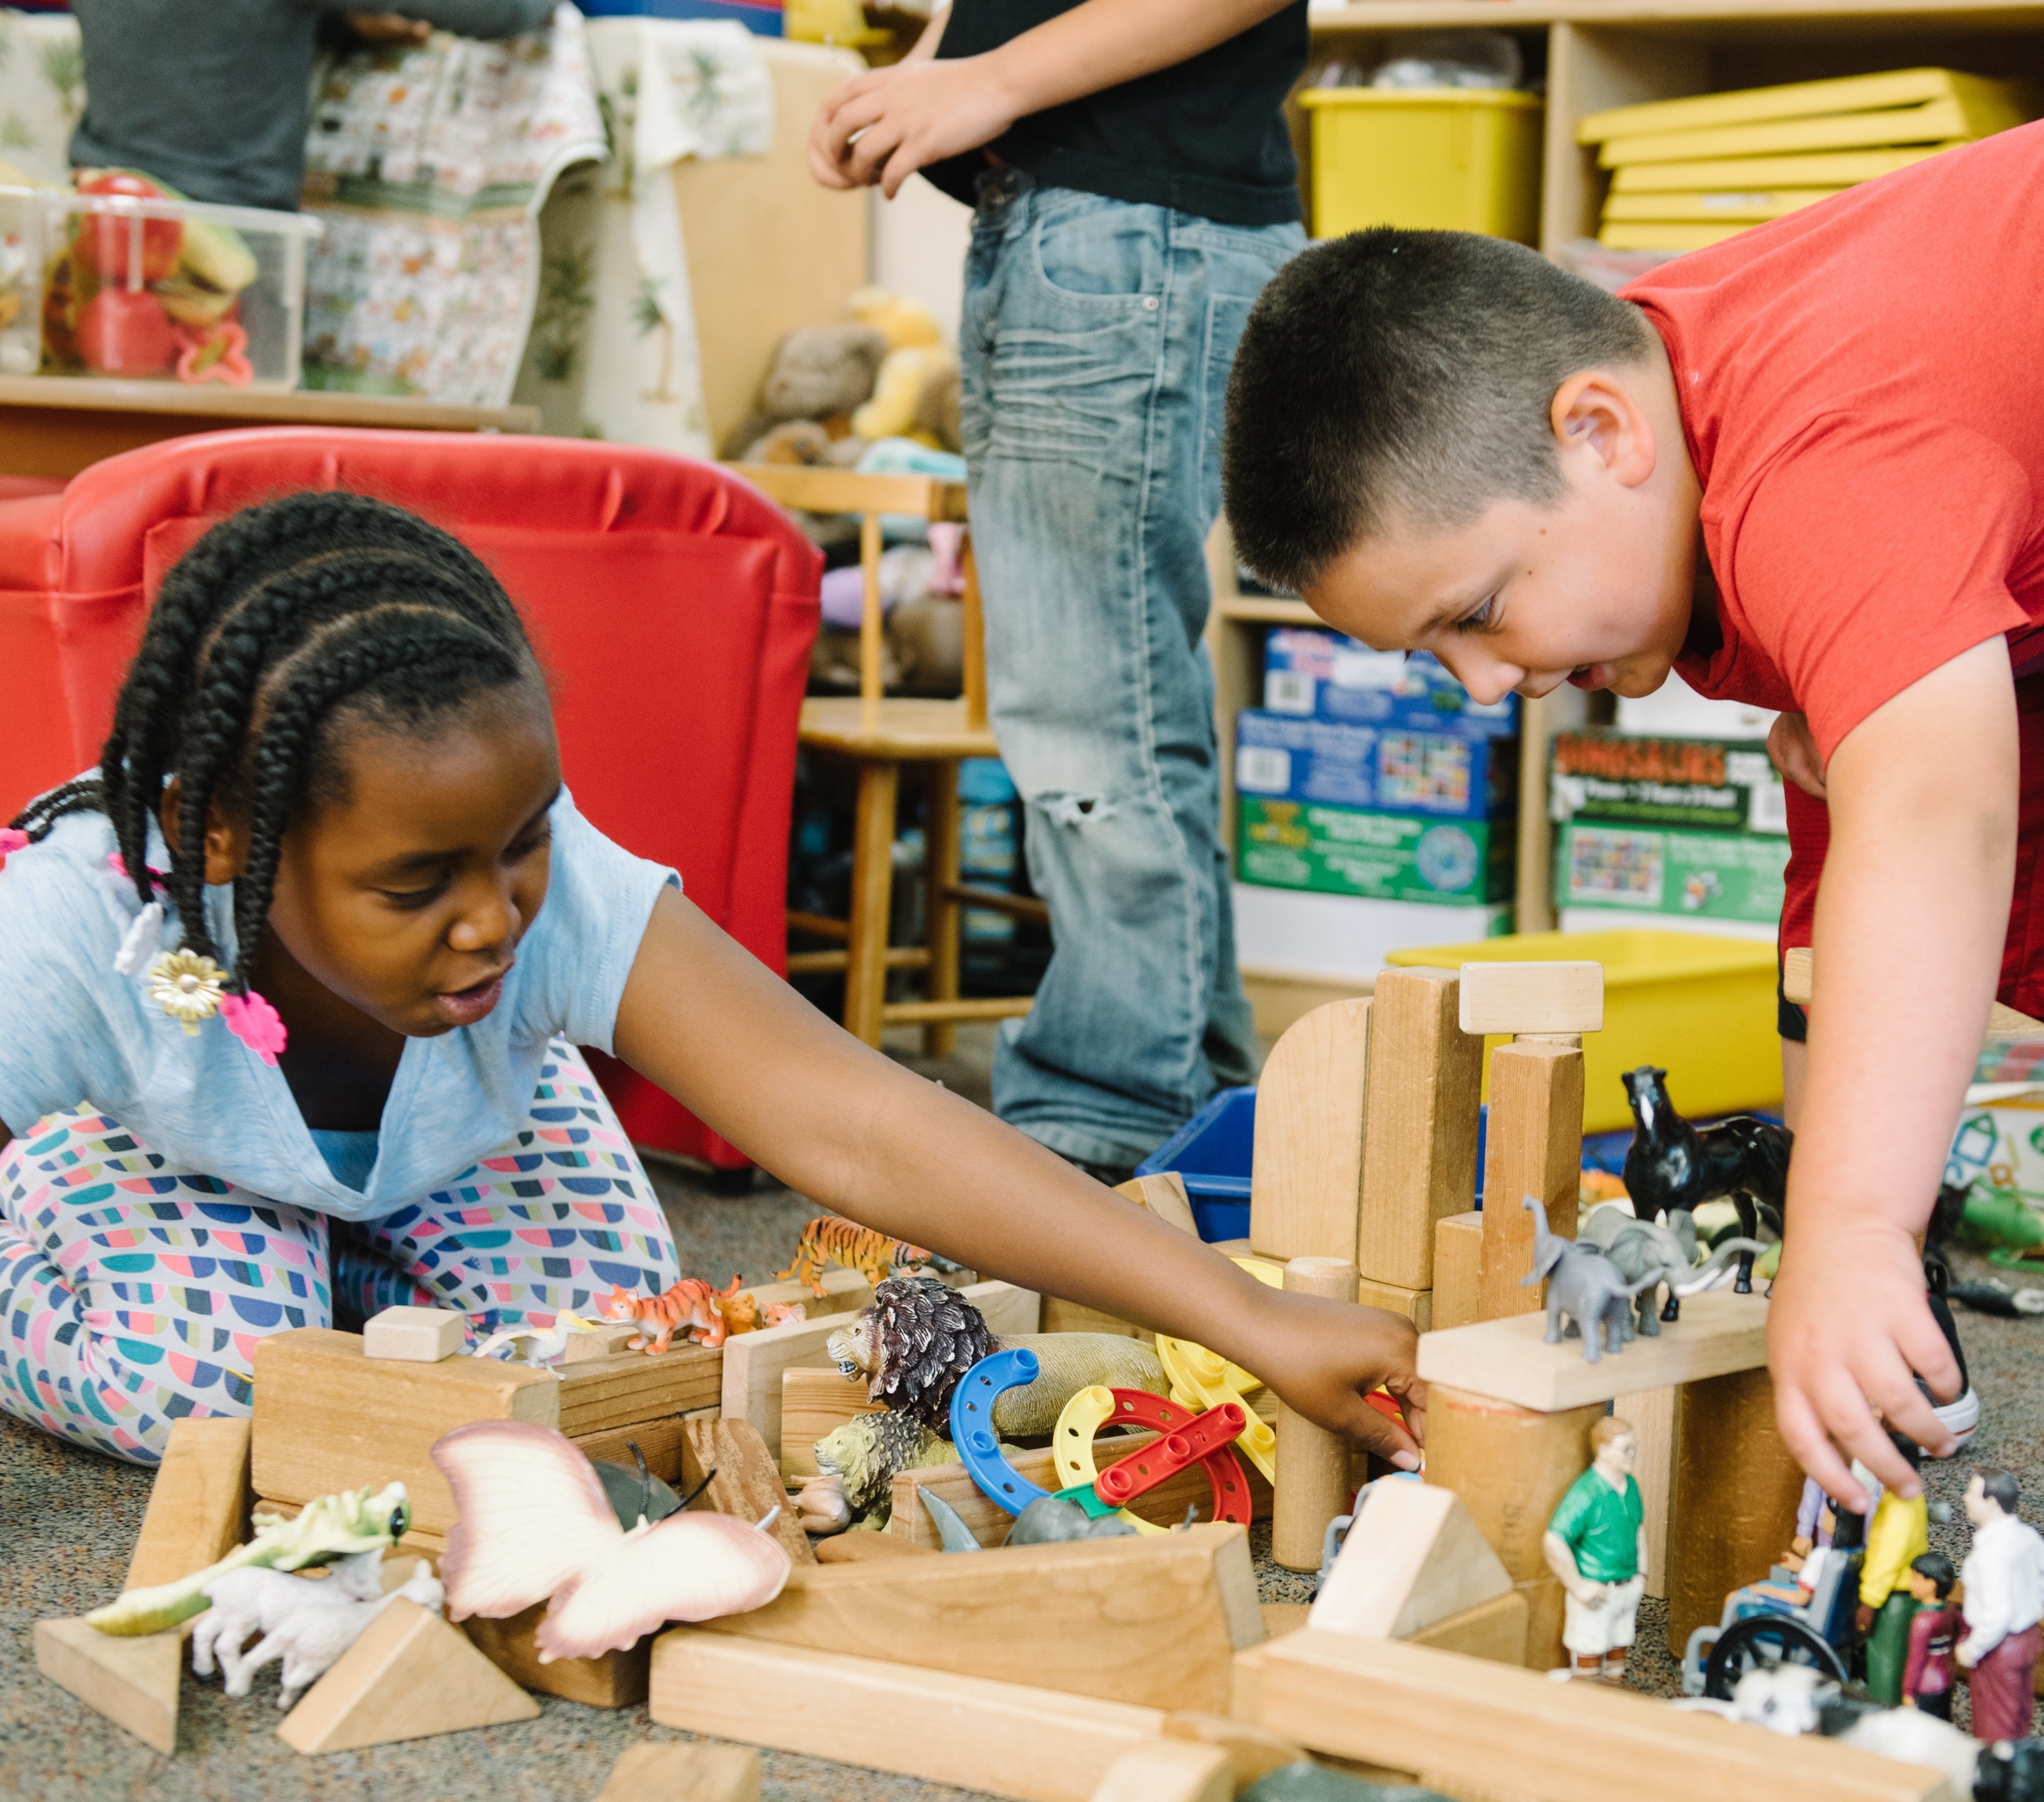
Reflect: Learning About Shapes
What are some ways children build, reason, and problem-solve with shapes during your classroom projects or activities?
Notes:
Time: 7–15 minutes (including debrief)
Materials: Three-column charts with columns labeled “first grade,” “second grade,” and “third grade”; markers
Talking Points
Early elementary children are learning about shapes every day!
Take a couple minutes to think about your classroom projects or activities in which children create or build with shapes. Reflect on children’s opportunities to reason with shapes or solve a problem.
How might the influence of children’s home environments and cultural backgrounds impact the ways children explore and reason about shapes in your setting?
[Allow participants a few minutes to reflect before inviting them to share their reflections.]
Facilitator Notes
Adjust the way you debrief participant reflections based on group size, session length and format, and participants’ needs. Charting reflections using a three-column chart will help participants connect their current practices to session content. You can use the following options for charting participant reflections:
Invite participants to share their reflections with the whole group. As they share, chart their reflections in the appropriate column.
Provide markers and a sheet of three-column chart paper to each table. Ask each table to choose a recorder and reporter. Allow time for participants to share their examples with their table group and for the recorder to chart their reflections in the appropriate column. Then, encourage the reporter from each table to share one or two reflections from their table’s chart.
If you have not presented content from PPT 1 “Introduction to Geometry: Birth–8 years” before engaging in this session, consider presenting the “Pull-Up Polyhedra” activity in slide 8 of PPT 1 at this point in your session. This will allow participant to engage in a playful, hands-on activity about two- and three-dimensional shapes.

Slide 5
Learning
About Shapes
Notes:
Talking Points
Wow! The children you work with are learning about shapes in a lot of different ways! Let’s examine how early elementary children deepen their understanding of shapes through these explorations.

Slide 6
California Common Core State Standards
Reason with shapes and their attributes
1st grade | 2nd grade | 3rd grade
1.G Distinguish between defining attributes versus non-defining attributes. Compose two-dimensional or three-dimensional shapes. Partition circles and rectangles into two and four equal shares. | 2.G Recognize and draw shapes having specified attributes. Partition a rectangle into rows and columns of same-size squares and count to find the total number of them. Partition circles and rectangles into two, three, or four equal shares. | 3.G Understand that shapes in different categories may share attributes, and that the shared attributes can define a larger category. Partition shapes into parts with equal areas.
California Common Core (2013)
Notes:
Talking Points
Before we get started, let’s review some relevant standards from the California Common Core State Standards (California Common Core, 2011).
The first grade standards build on what children know about shape identification and shape attributes. The standards also describe what children will learn about composing and decomposing shapes. By the end of first grade, children will be able to:
Determine if attributes are defining
Understand that closed shapes have the same start and end point, while open shapes do not
Compose two- and three-dimensional shapes
Partition circle and rectangles into halves and fourths
The second and third grade standards continue to build on what children know about shape identification and shape attributes. In addition, children continue to develop their ability to analyze and reason with shapes. By the end of third grade, children will be able to:
Recognize, classify, and compose shapes with specific and similar attributes
Partition shapes into two, three, and four equal shares and begin to recognize the shares as fractions
Facilitator Notes
This slide makes connections between the components and relevant standards.
The standards listed in the slides are condensed. You may want to provide participants with copies of the relevant California Common Core State Standards. Consider whether electronic or printed copies will be more useful for your participants.

Slide 7
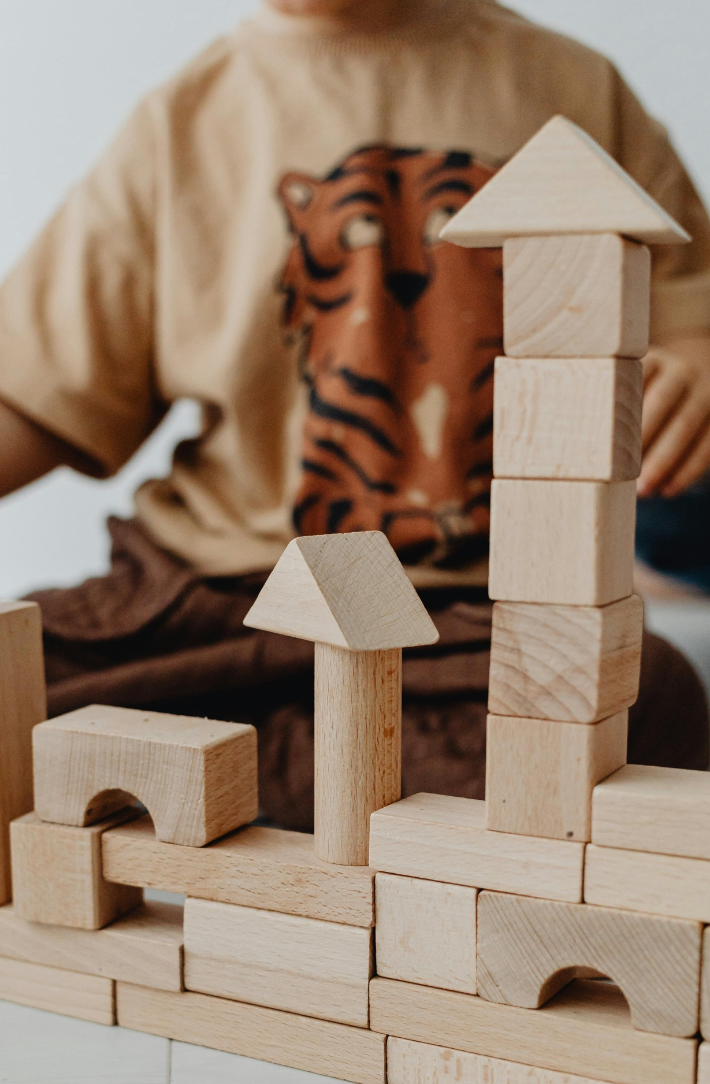
Learning About Shapes in
Early Childhood
Five Components
Perceiving similarities and differences
Classifying shapes
Naming shapes
Learning about the attributes of shapes
Composing and decomposing shapes
Notes:
Talking Points:
There are five components of learning about shapes in early childhood:
Perceiving similarities and differences
Classifying shapes
Naming shapes
Learning about the attributes of shapes
Composing and decomposing shapes
Children in preschool, TK, and K develop considerable knowledge and understanding of shapes. They learn the names of common shapes, perceive similarities and differences in shapes, and can classify shapes.
Now, we will focus on how elementary school children continue to develop their knowledge and understanding of shapes. We will examine how early elementary children learn the names of more two- and three-dimensional shapes, classify shapes by attributes, and compose and decompose shapes.

Slide 8
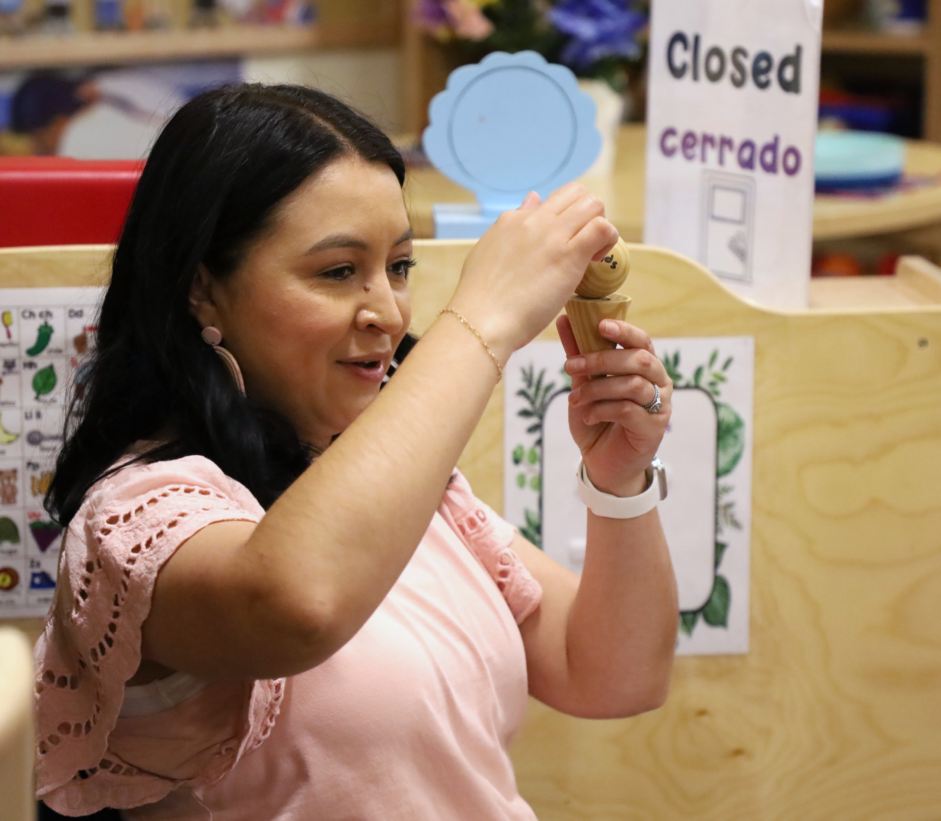
Naming Shapes
Name a greater variety of two-dimensional shapes:
  trapezoids, rhombuses, hexagons, and octagons
Use formal names for three-dimensional shapes:
  spheres, cones, cubes, cylinders, pyramids, and prisms
Notes:
Talking Points
Children learn their first few shape names as toddlers. Then they expand their shape vocabulary in preschool and in kindergarten.
As children move into early elementary years, they may learn the names of a greater variety of two-dimensional shapes, including trapezoids, rhombuses, hexagons, and octagons. They may also learn more formal names for three-dimensional shapes such as spheres, cones, cubes, cylinders, pyramids, and prisms.
Facilitator Notes
For more information about common two- and three-dimensional shapes and their names, review slide 16 and 18 of PPT 1 “Introduction to Geometry: Birth–8 years.”

Slide 9
Reasoning About Shape Attributes
Rely on shape attributes to classify shapes.
Learn that multiple shapes can share the same attributes.
Quadrilaterals
Notes:
Talking Points
Children in preschool, TK, and K begin to understand that shapes have attributes such as number of “corners” or “sides.” They also recognize that attributes can help them decide how to classify a shape. For example, a child might recognize that a square has four sides.
In first and second grade, children learn about the attributes of three-dimensional shapes and begin to use more formal vocabulary such as edges, vertices, and faces.
First-graders and second-graders also begin to understand which attributes define a particular shape. This understanding helps children use shape attributes to identify shapes more consistently and accurately.
They understand that the number of edges or vertices is a defining attribute, but size, orientation, or color are not defining attributes of a shape.
They can explain how two shapes are different using what they know about shape attributes. For example, they may be able to explain that a triangle has three edges and three vertices, and a square has four edges and four vertices.
By around third grade, children understand that multiple shapes can share the same attributes. For example, they recognize that rectangles, rhombuses, and squares all have four sides.
Children in third grade also learn that shapes that share similar attributes are part of a larger category. For example, they learn that rectangles, rhombuses, and squares are all quadrilaterals.

Slide 10
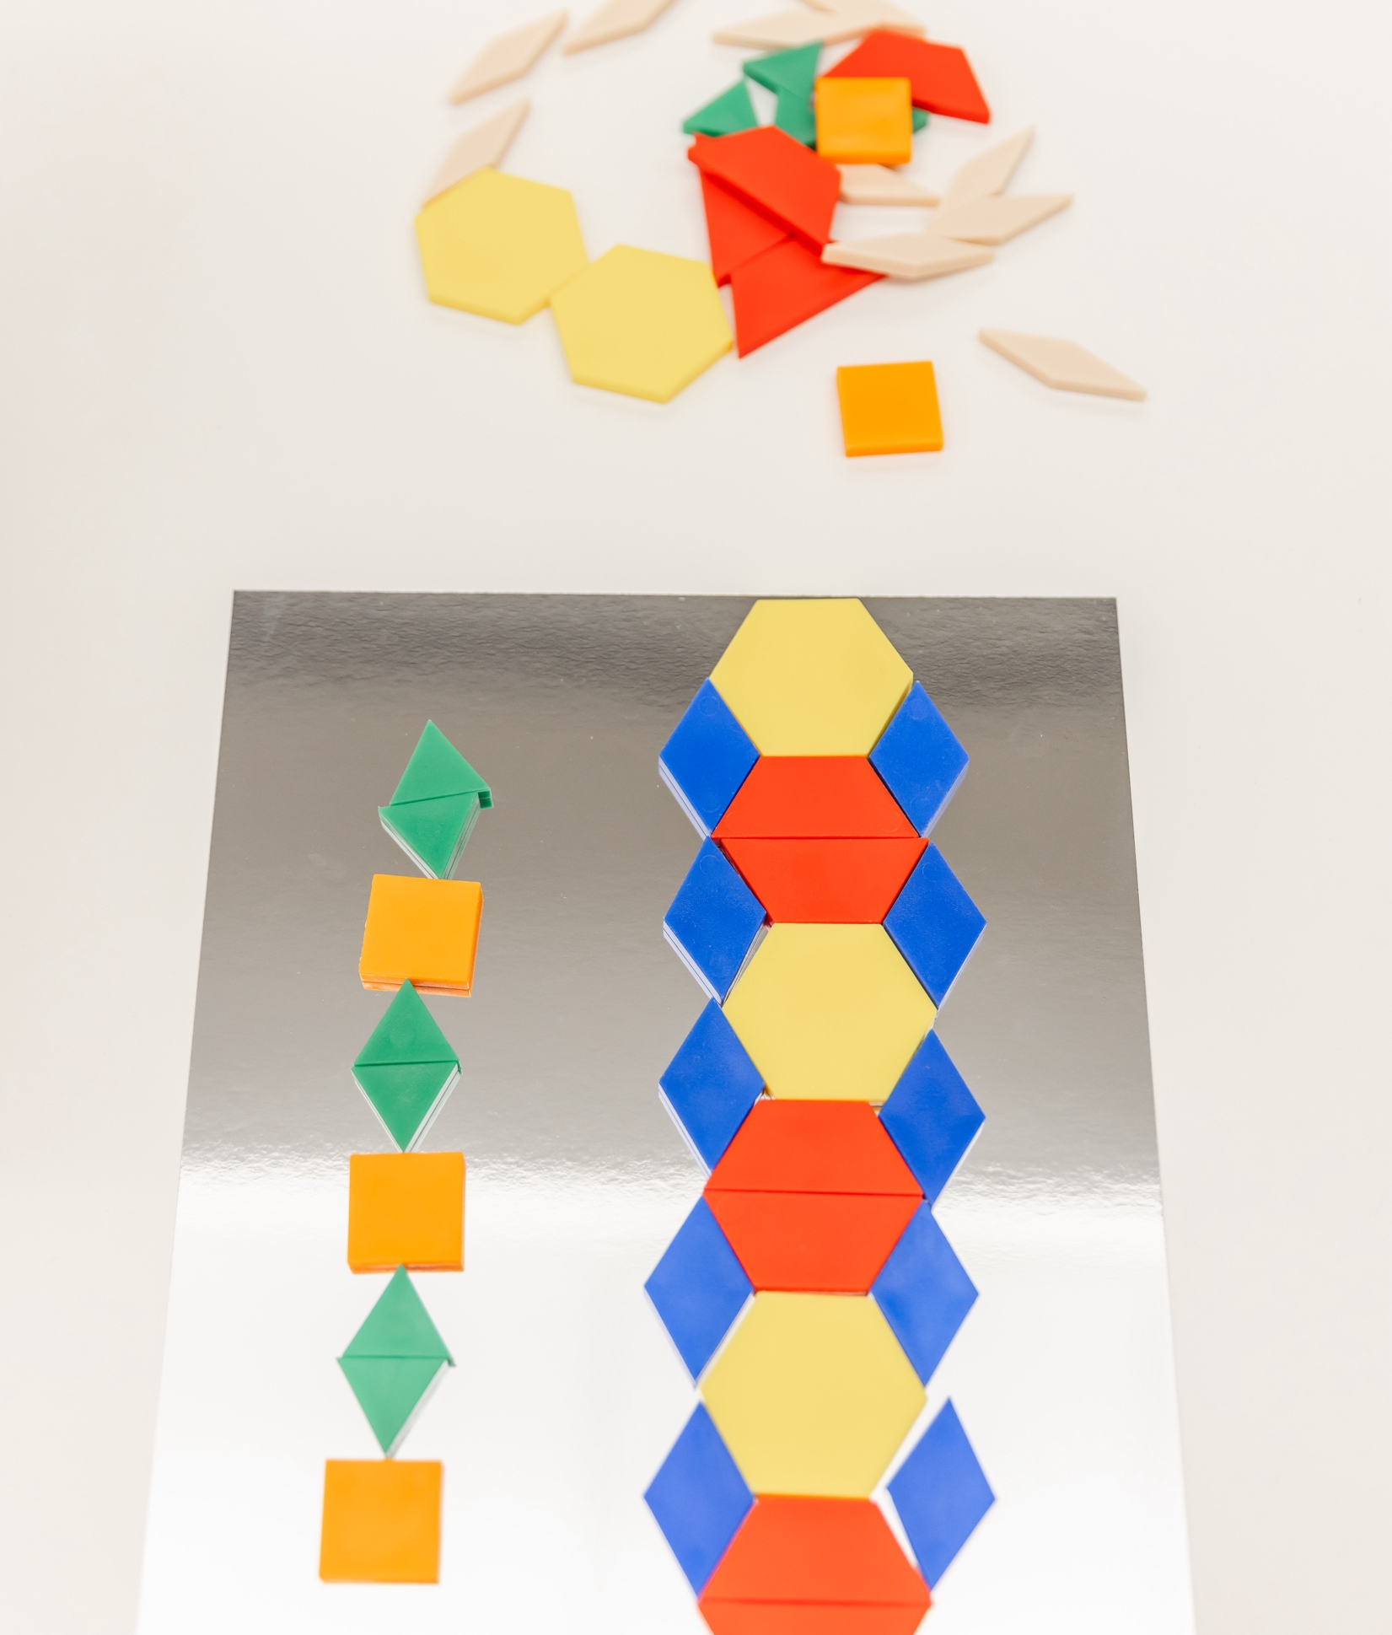
Composing and Decomposing Shapes
Compose and decompose shapes to make complex pictures and patterns using spatial thinking.
Notes:
Talking Points
In preschool, TK, and into K, children begin to compose and decompose shapes when building or making art. For example:
If a preschooler runs out of square blocks while building a tower, they might combine two triangles to make a square.
A kindergartner may put a triangle on top of a square to represent a house while drawing.
Children in the early elementary grades compose and decompose a variety of two- and three-dimensional shapes to make more complex pictures and patterns. At this age, children can decompose two-dimensional shapes multiple times. For example:
They learn to cut a square diagonally to make two triangles. Then they cut each triangle to make more triangles.
Children this age also learn to use three-dimensional shapes to compose complex structures, such as bridges, arches, and ceilings. Using mental rotation to solve problems, children can create complex pictures and structures. For example:
When building a roof of a house, children may try out several shape blocks, until they find one that balances on top of two-cylinder blocks standing upright.

Slide 11
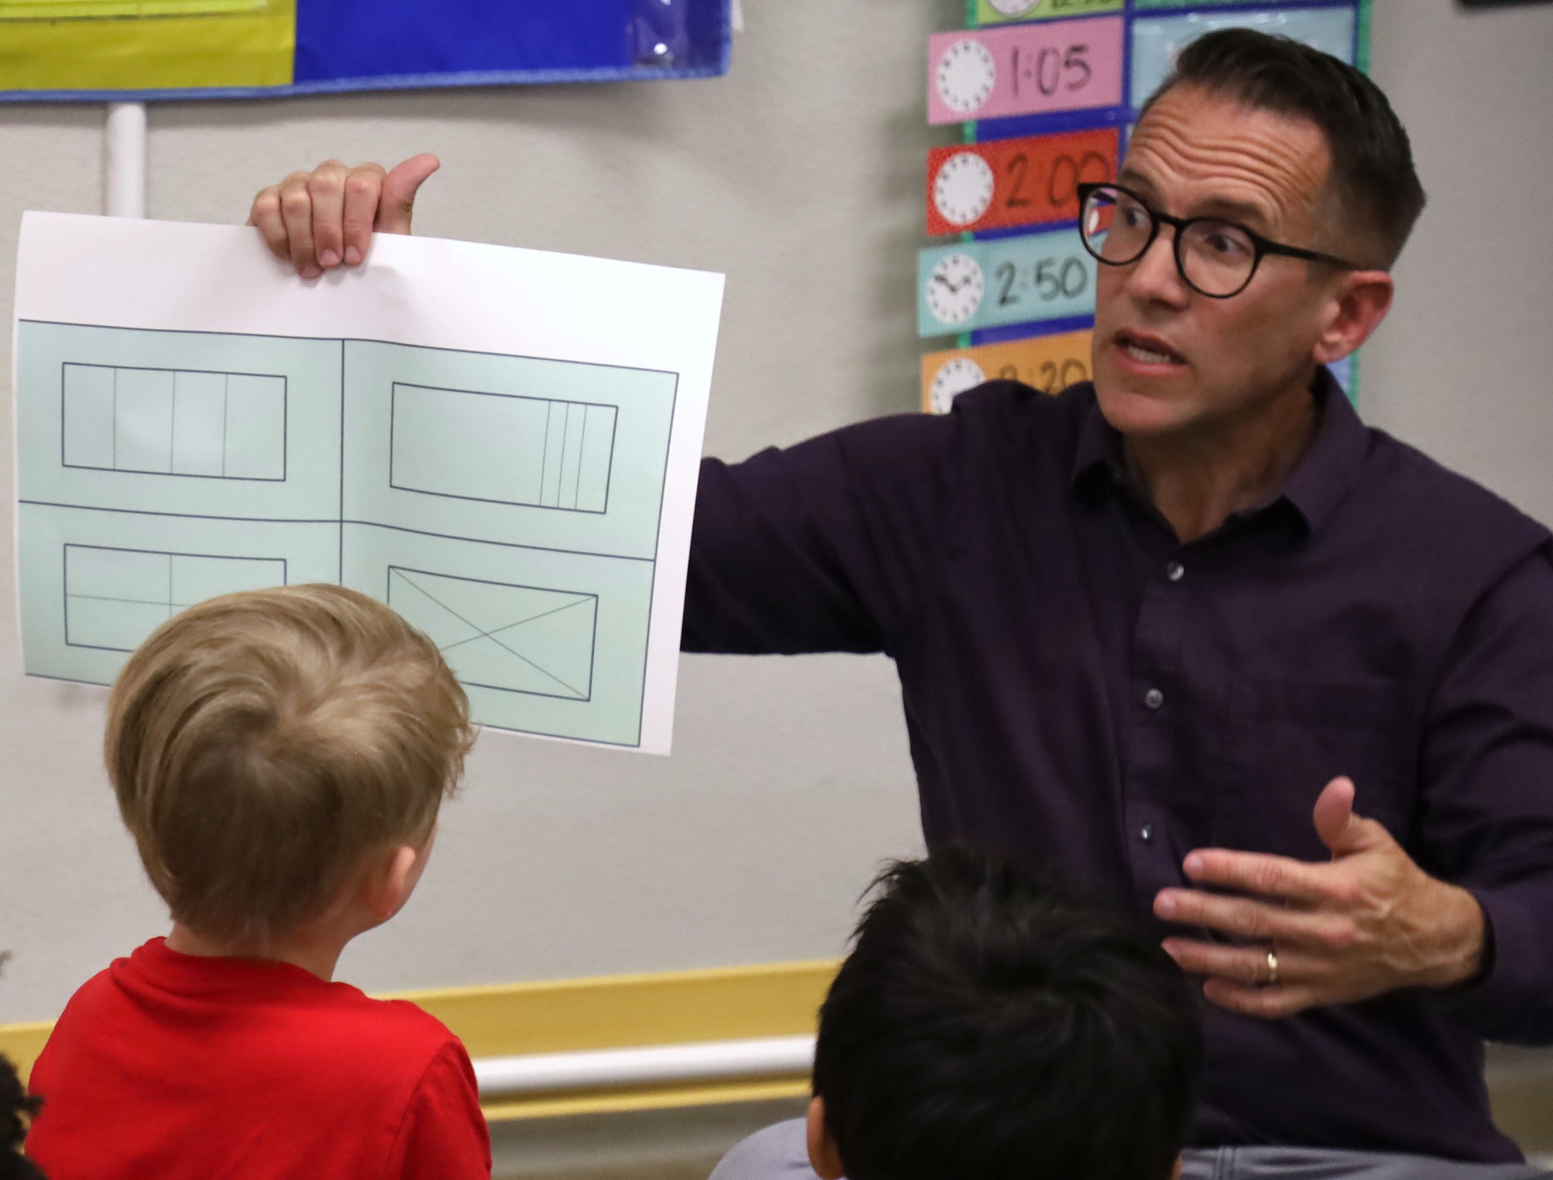
Partitioning Shapes
Partition shapes into smaller equally sized units and use these units to describe a shape’s area.
Notes:
Talking Points
Children in the early elementary grades begin to partition shapes into equal shares. For example:
Children can partition circles and rectangles into two, three, and four equal parts.
By third grade, children understand that shapes can be divided into smaller equal parts. This understanding forms the basis for children’s understanding of geometric area and fractions. For example:
They use vocabulary like “halves, thirds, and quarters” to describe these parts.
At this age, children know that they can divide—or partition—rectangles into rows and columns of equal-sized units. They also understand that they can describe this rectangle’s area by counting the total number of units.
Facilitator Notes
For longer sessions, consider offering some time for hands-on exploration of partitioning shapes. Provide participants with shapes printed on paper. Invite participants to partition shapes into two, three, and then four equal shares. For example, you might challenge them to use a pencil to partition a square, rectangle, hexagon, and octagon into different equal shares.

Slide 12
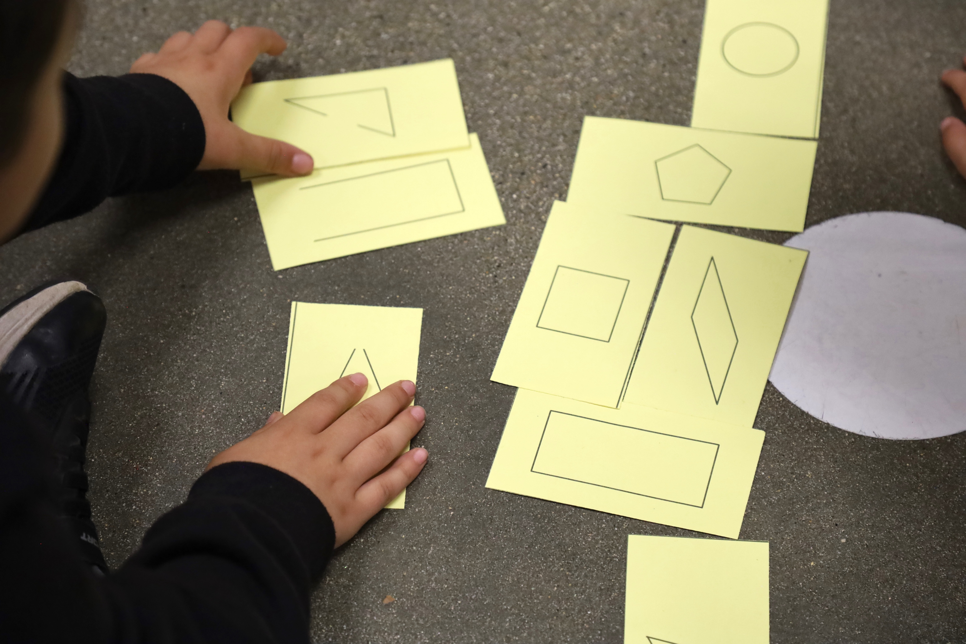
Observe: Learning About Shapes
Decomposing Shapes (first grade)
Decomposing Shapes (first grade) – Audio Descriptive Version
Notes:
Time: 10–20 minutes (including debrief)
Materials: Early elementary shapes video [before your session, select a video to show]
Now we will observe a video. As you observe the video, think about ways children are showing that they are:
Classifying shapes
Naming shapes
Learning about the attributes of shapes
Composing and decomposing shapes
Consider how the interests, cultures and lived experiences, languages, abilities, and emerging skills of the children in this video might have affected how they learned about and explored shapes.
You might record your observations. After the video, we will discuss what you noticed.
Facilitator Notes
Choose a video that shows children learning about shapes.
We provide the following videos (you may use other videos):
Decomposing Shapes (first grade) [https://youtu.be/nVsELQ9_wuE]
Decomposing Shapes (first grade) – Audio Descriptive Version [https://youtu.be/GjT6CfSD89E]
Learning About Shape Attributes (first grade) [https://youtu.be/cYqNUw5GVVg]
Learning About Shape Attributes (first grade) – Audio Descriptive Version [https://youtu.be/U9cKMdq3Yu4]
Classifying Shapes by Attribute (first grade) [https://youtu.be/jAYY0yfIkRw]
Classifying Shapes by Attribute (first grade) – Audio Descriptive Version [https://youtu.be/XM2m049lWy4]
Note: Discussion points are provided for the videos in the Facilitator Notes on the next slide.
If a component is not observed in the video, you might invite participants to:
Think about ways that children might develop knowledge and skills related to that component
Explain how educators might support children to develop the knowledge and skills related to that component
Consider playing the video more than once. The first time, invite the participants to just become familiar with the video. Then, invite the participants to observe specific ways children show their understanding of the components of shape learning.

Slide 13
Discuss: Learning About Shapes
In what ways did children in the video use the following components of learning about shapes?
Naming shapes
Learning about, and classifying shapes using their attributes
Composing and decomposing shapes
Notes:
Time: 10–20 minutes (including video observation on previous slide)
Talking Points
Let’s discuss what you noticed.
In what ways did children in the video demonstrate that they were:
Naming shapes
Learning about and classifying shapes using their attributes
Composing and decomposing shapes
Facilitator Notes
Adjust the debrief based on your group size, session length and format, and participant needs. Consider charting participants’ observations to visually provide ways children develop an understanding of shapes.
Consider using the following adaptations based on session length:
For shorter sessions, invite participants to share, with the large group, what they noticed about ways children in early elementary showed their understanding of shapes.
For longer sessions, offer time for participants to share their observations in pairs or at their tables. Then, invite each table to share their observations.
Here are some examples of how children in the video “Learning About Shape Attributes (first grade)” [https://youtu.be/cYqNUw5GVVg] learned about and classified shapes using their attributes and named shapes:
Learning about and classifying shapes using their attributes: As children were describing why shapes did not belong, they observed that most shapes were filled, and one was not. They also noticed which direction the points of the triangle were facing. One child explained that three shapes were part of the triangle family, while the other shape was part of the square family. Through these observations, children were noticing different attributes of a shape.
Naming shapes: Children named shapes like triangle and rectangle.
Here are some examples of how children in the video “Classifying Shapes by Attributes (first grade)” [https://youtu.be/jAYY0yfIkRw] learned about and classified shapes using their attributes and named shapes:
Learning about and classifying shapes using their attributes: Children noticed that some shapes were open, and other were closed. Children classified shapes into groups based on whether they were open or closed. One child classified all rectangles together. She described that the two shapes looked the same even though one was tilted.
Naming shapes: Children named shapes like rectangle, diamond, oval, triangle.
Here are some examples of how children in the video “Decomposing Shapes (first grade)” [https://youtu.be/nVsELQ9_wuE] explored decomposed shapes:
Naming shapes: In addition to naming the shapes (rectangle), one child learned the vocabulary “horizontal” and “vertical.”
Composing and decomposing shapes: One child described how three of the shapes had been decomposed in equal parts, while one shape was not decomposed in equal parts. One child then described the parts of the decomposed shapes as “halves.”

Slide 14
Supporting
Shape Learning
Notes:
Talking Points
We explored components of shape learning for children in early elementary grades. We also observed some ways early elementary children name two- and three-dimensional shapes, classify shapes by attributes, and compose and decompose shapes. Now, let’s discuss ways we can support children to learn about shapes—at school and at home.
Historically, inequities in our educational system have impacted Children of Color, multilingual learners, and children with disabilities. For example, Children of Color, multilingual learners, and children with disabilities have had unequal access to rigorous learning opportunities. We must work to ensure that every child—of any background, race, culture, ethnicity, language, gender, ability, or socioeconomic status—has equitable opportunities to engage in high-quality geometry learning environments and experiences.

Slide 15
Explore: M⁵ Early Math Approach
Mutual Learning
Meaningful Investigations
Materials and Learning Environment
Math Vocabulary and Discourse
Multiple Representations
Notes:
Time: 15 minutes
Materials: M⁵ Overview handout
Talking Points
We often refer to five core early math teaching practices as the M⁵ (pronounced: M to the fifth) Early Math Approach, or M⁵. These practices include:
Mutual Learning
Meaningful Investigations
Materials and Learning Environment
Math Vocabulary and Discourse
Multiple Representations
Let’s explore the M⁵ practices. Then, we will observe M⁵ in action.
Facilitator Notes
Consider your participants and their prior experiences with M⁵.
For groups that have significant experience with M⁵, you might offer a few minutes for participants to share with a partner their strengths and what practices they are working on. Or you might use this slide to briefly revisit the M⁵ practices and move to the next slide.
For groups that have less experience with M⁵, you might offer more time for participants to explore each practice. For example, you might allow time for them to review the practices in the handout on their own. Invite them to make or imagine a square over practices that they have “squared away” (practices they understand and use), a circle over “what’s still going around in their heads” (practices they still have questions about), and a triangle over three ideas that they will use in their classrooms. For more ideas on how to provide a more comprehensive review, visit the M⁵ Early Math Approach suite of resources.

Slide 16
Observe:
M⁵ in Action
Decomposing Shapes (first grade)
Decomposing Shapes (first grade) – Audio Descriptive Version
Notes:
Time: 5–7 minutes (not including debrief)
Materials: Observing M⁵ in Action: Shapes handout, early elementary shapes video, chart paper, markers
Talking Points
We observed what early elementary children learn about shapes. Then, we explored the M⁵ Early Math Approach. Now, we are going to observe a video with M⁵ practices. [Choose a strategy for facilitating this observation and debrief. Adapt the talking points to reflect this strategy.]
Facilitator Notes
Choose a video that shows children learning about shapes. This video may be the same one you used for observing children learning about shapes.
We provide the following videos (you may use other videos):
Decomposing Shapes (first grade) [https://youtu.be/nVsELQ9_wuE]
Decomposing Shapes (first grade) – Audio Descriptive Version [https://youtu.be/GjT6CfSD89E]
Learning About Shape Attributes (first grade) [https://youtu.be/cYqNUw5GVVg]
Learning About Shape Attributes (first grade) – Audio Descriptive Version [https://youtu.be/U9cKMdq3Yu4]
Classifying Shapes by Attribute (first grade) [https://youtu.be/jAYY0yfIkRw]
Classifying Shapes by Attribute (first grade) – Audio Descriptive Version [https://youtu.be/XM2m049lWy4]
Note: An answer key is provided for the video “Decomposing Shapes (first grade)” in the Facilitator Notes on the next slide.
Invite participants to take out the Observing M⁵ in Action: Shapes handout.
For larger groups and longer sessions, use a jigsaw approach. Before playing the video, assign each table one practice to focus on during the video. [If there are more than five tables, assign more than one table to focus on each practice.]
For smaller groups and shorter sessions, consider showing the video two to three times, inviting participants to focus on specific practices each time. Encourage them to record observations on the handout.

Slide 17
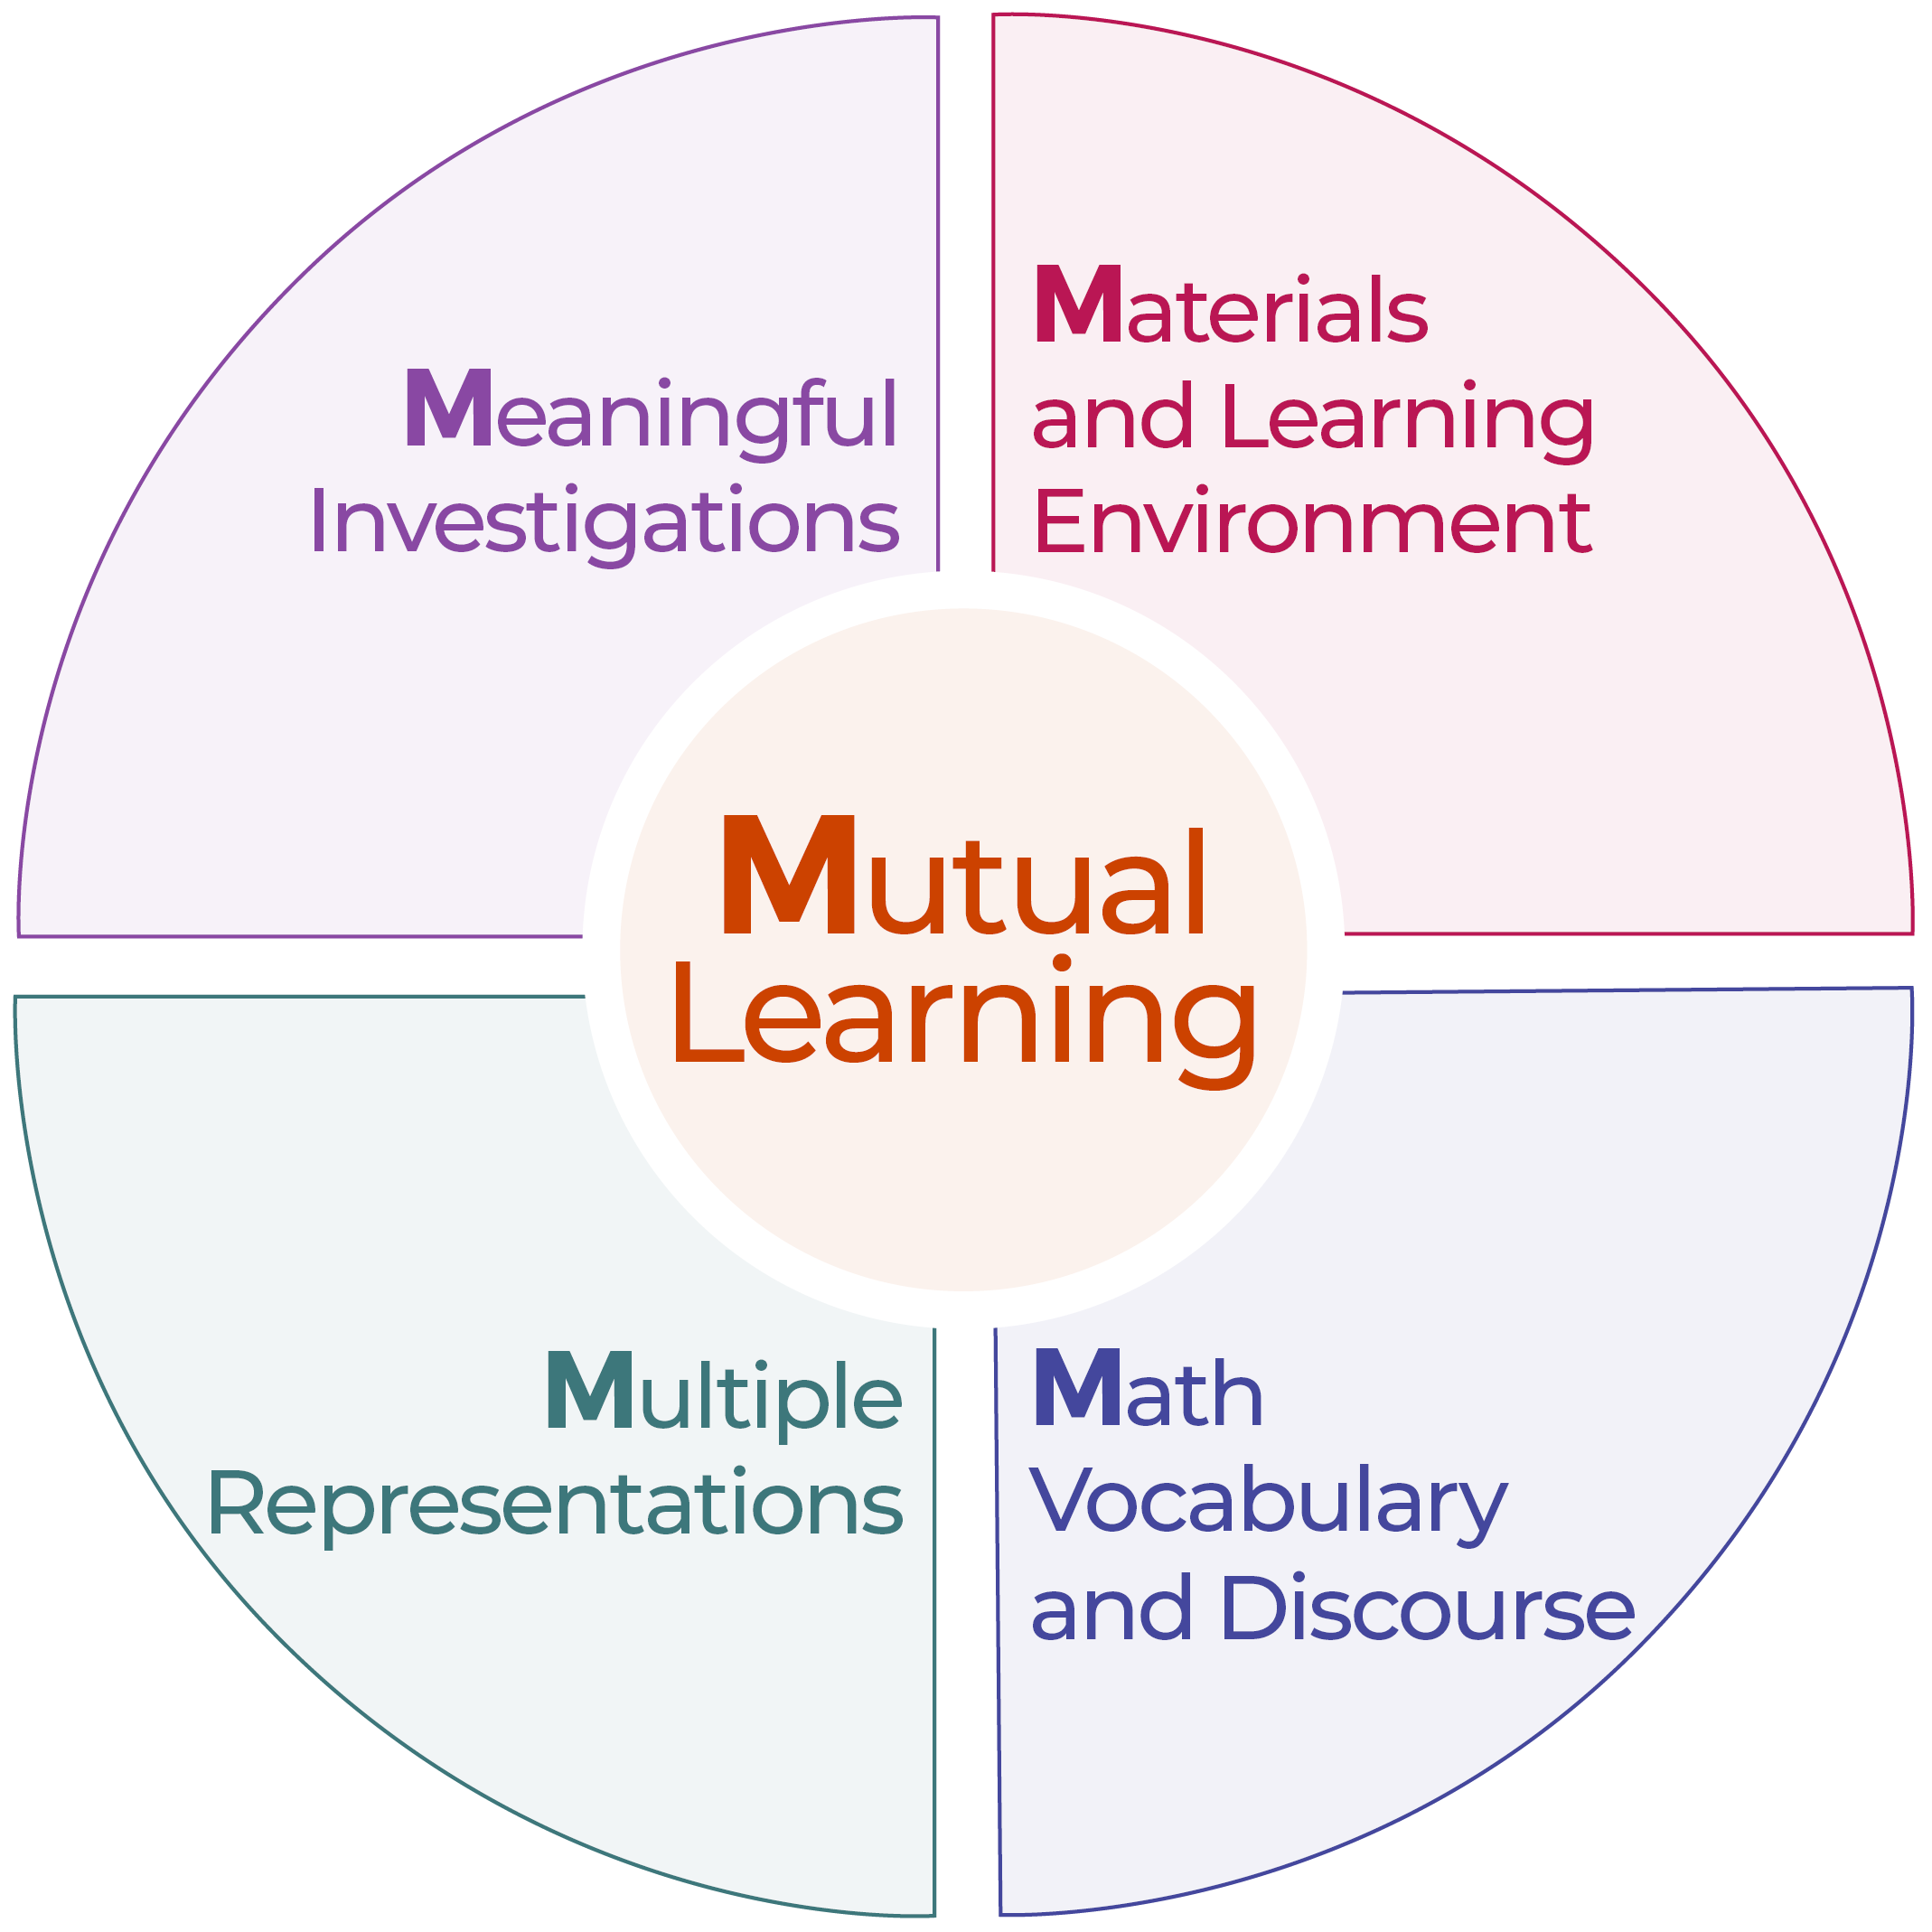
Discuss: Supporting Shape Learning
Mutual Learning
Meaningful Investigations
Materials and Learning Environment
Math Vocabulary and Discourse
Multiple Representations
Notes:
Time: 20–30 minutes (varies based on session goals)
Materials: Observing M⁵ in Action: Shapes handout, early elementary shapes video, chart paper, markers
Talking Points
Let’s unpack your observations of each M⁵ practice. How did the educator use M⁵ to support children’s learning about shapes?
Facilitator Notes
Use the Answer Key for Observing M⁵ in Action: Shapes handout for examples of ways M⁵ was used in the video “Decomposing Shapes (first grade).” [https://youtu.be/nVsELQ9_wuE]
For larger groups or longer sessions: After observing the video, ask each table to discuss what they noticed about their assigned practice. Then, invite each table to share their observations with the larger group. As each table shares, paraphrase, affirm, and add to their responses as needed. Consider charting each group’s observations to make practices visible.
For smaller groups or shorter sessions: Invite participants to share their observations with the whole group. Chart their observations to make the practices visible. As participants share, paraphrase, affirm, and add to their responses as needed. Consider inviting participants to share something they learned with someone from another table. For example, you might ask them to find someone with similar shoes, move to meet them, and share something they learned with that person.
For additional ideas on how to facilitate debriefs, visit the Facilitating Early STEAM Professional Learning module.
Time: 20–30 minutes (varies based on session goals)
Materials: Observing M⁵ in Action: Shapes handout, early elementary shapes video clip, chart paper, markers
Talking Points
Let’s unpack your observations of each M⁵ practice. How did the educator use M⁵ to support children’s learning about shapes?
Facilitator Notes
Use the Answer Key for Observing M⁵ in Action: Shapes handout for examples of ways M⁵ was used in the video clip “Decomposing Shapes (first grade).” [https://youtu.be/nVsELQ9_wuE]
For larger groups or longer sessions: After observing the video clip, ask each table to discuss what they noticed about their assigned practice. Then, invite each table to share their observations with the larger group. As each table shares, paraphrase, affirm, and add to their responses as needed. Consider charting each group’s observations to make practices visible.
For smaller groups or shorter sessions: Invite participants to share their observations with the whole group. Chart their observations to make the practices visible. As participants share, paraphrase, affirm, and add to their responses as needed. Consider inviting participants to share something they learned with someone from another table. For example, you might ask them to find someone with similar shoes, move to meet them, and share something they learned with that person.
For additional ideas on how to facilitate debriefs, visit the Facilitating Early STEAM Professional Learning module.

Slide 18
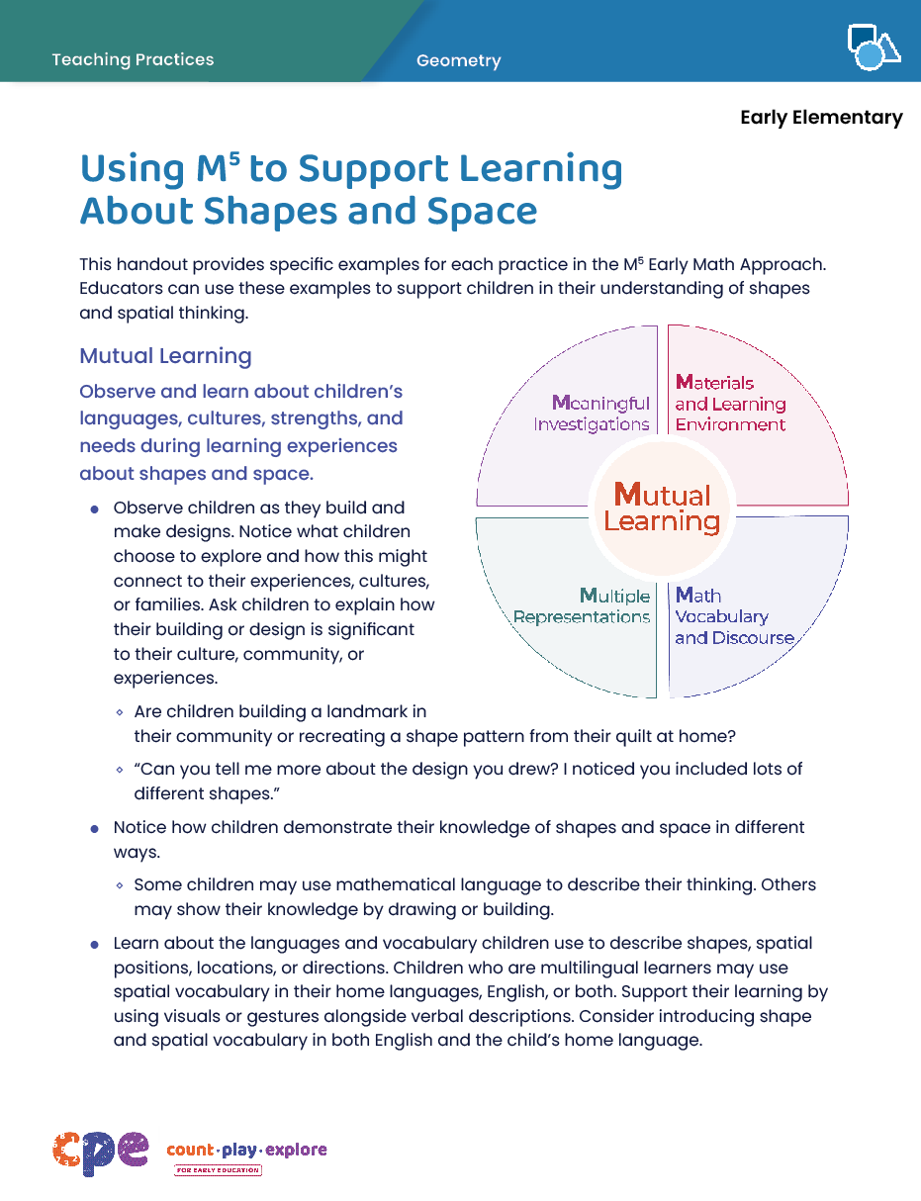
Explore: Using M⁵ to Support Learning About Shapes and Space
Notes:
Time: 15–30 minutes (including debrief on next slide)
Materials: Using M⁵ to Support Learning About Shapes and Space handout, chart paper, markers
Talking Points
We discussed the M⁵ Early Math Approach and observed some ways the practices might be used to support early elementary children’s geometry learning. Let’s consider other ways for using M⁵ to support early elementary children’s geometry learning.
Take out Using M⁵ to Support Learning About Shapes and Space. Review the ideas on how to use M⁵ to support early elementary children’s geometry learning.
Facilitator Notes
This document was also used in the suite of resources on Spatial Thinking. This resource refers to a broader concept of geometry that includes both shapes and spatial thinking.
Provide five to seven minutes for participants to review the handout.
While participants are reviewing the handout, post five charts around the room. Each chart will have one of the five M⁵ Early Math Practices as headers (Mutual Learning, Meaningful Investigations, Materials and Learning Environment, Math Vocabulary and Discourse, Multiple Representations) and one column each for first grade, second grade, and third grade. For larger groups, create and post a chart for each M⁵ practice at each grade level. Leave markers near each chart. Use the talking points and facilitator notes on the next slide to guide the debrief.

Slide 19
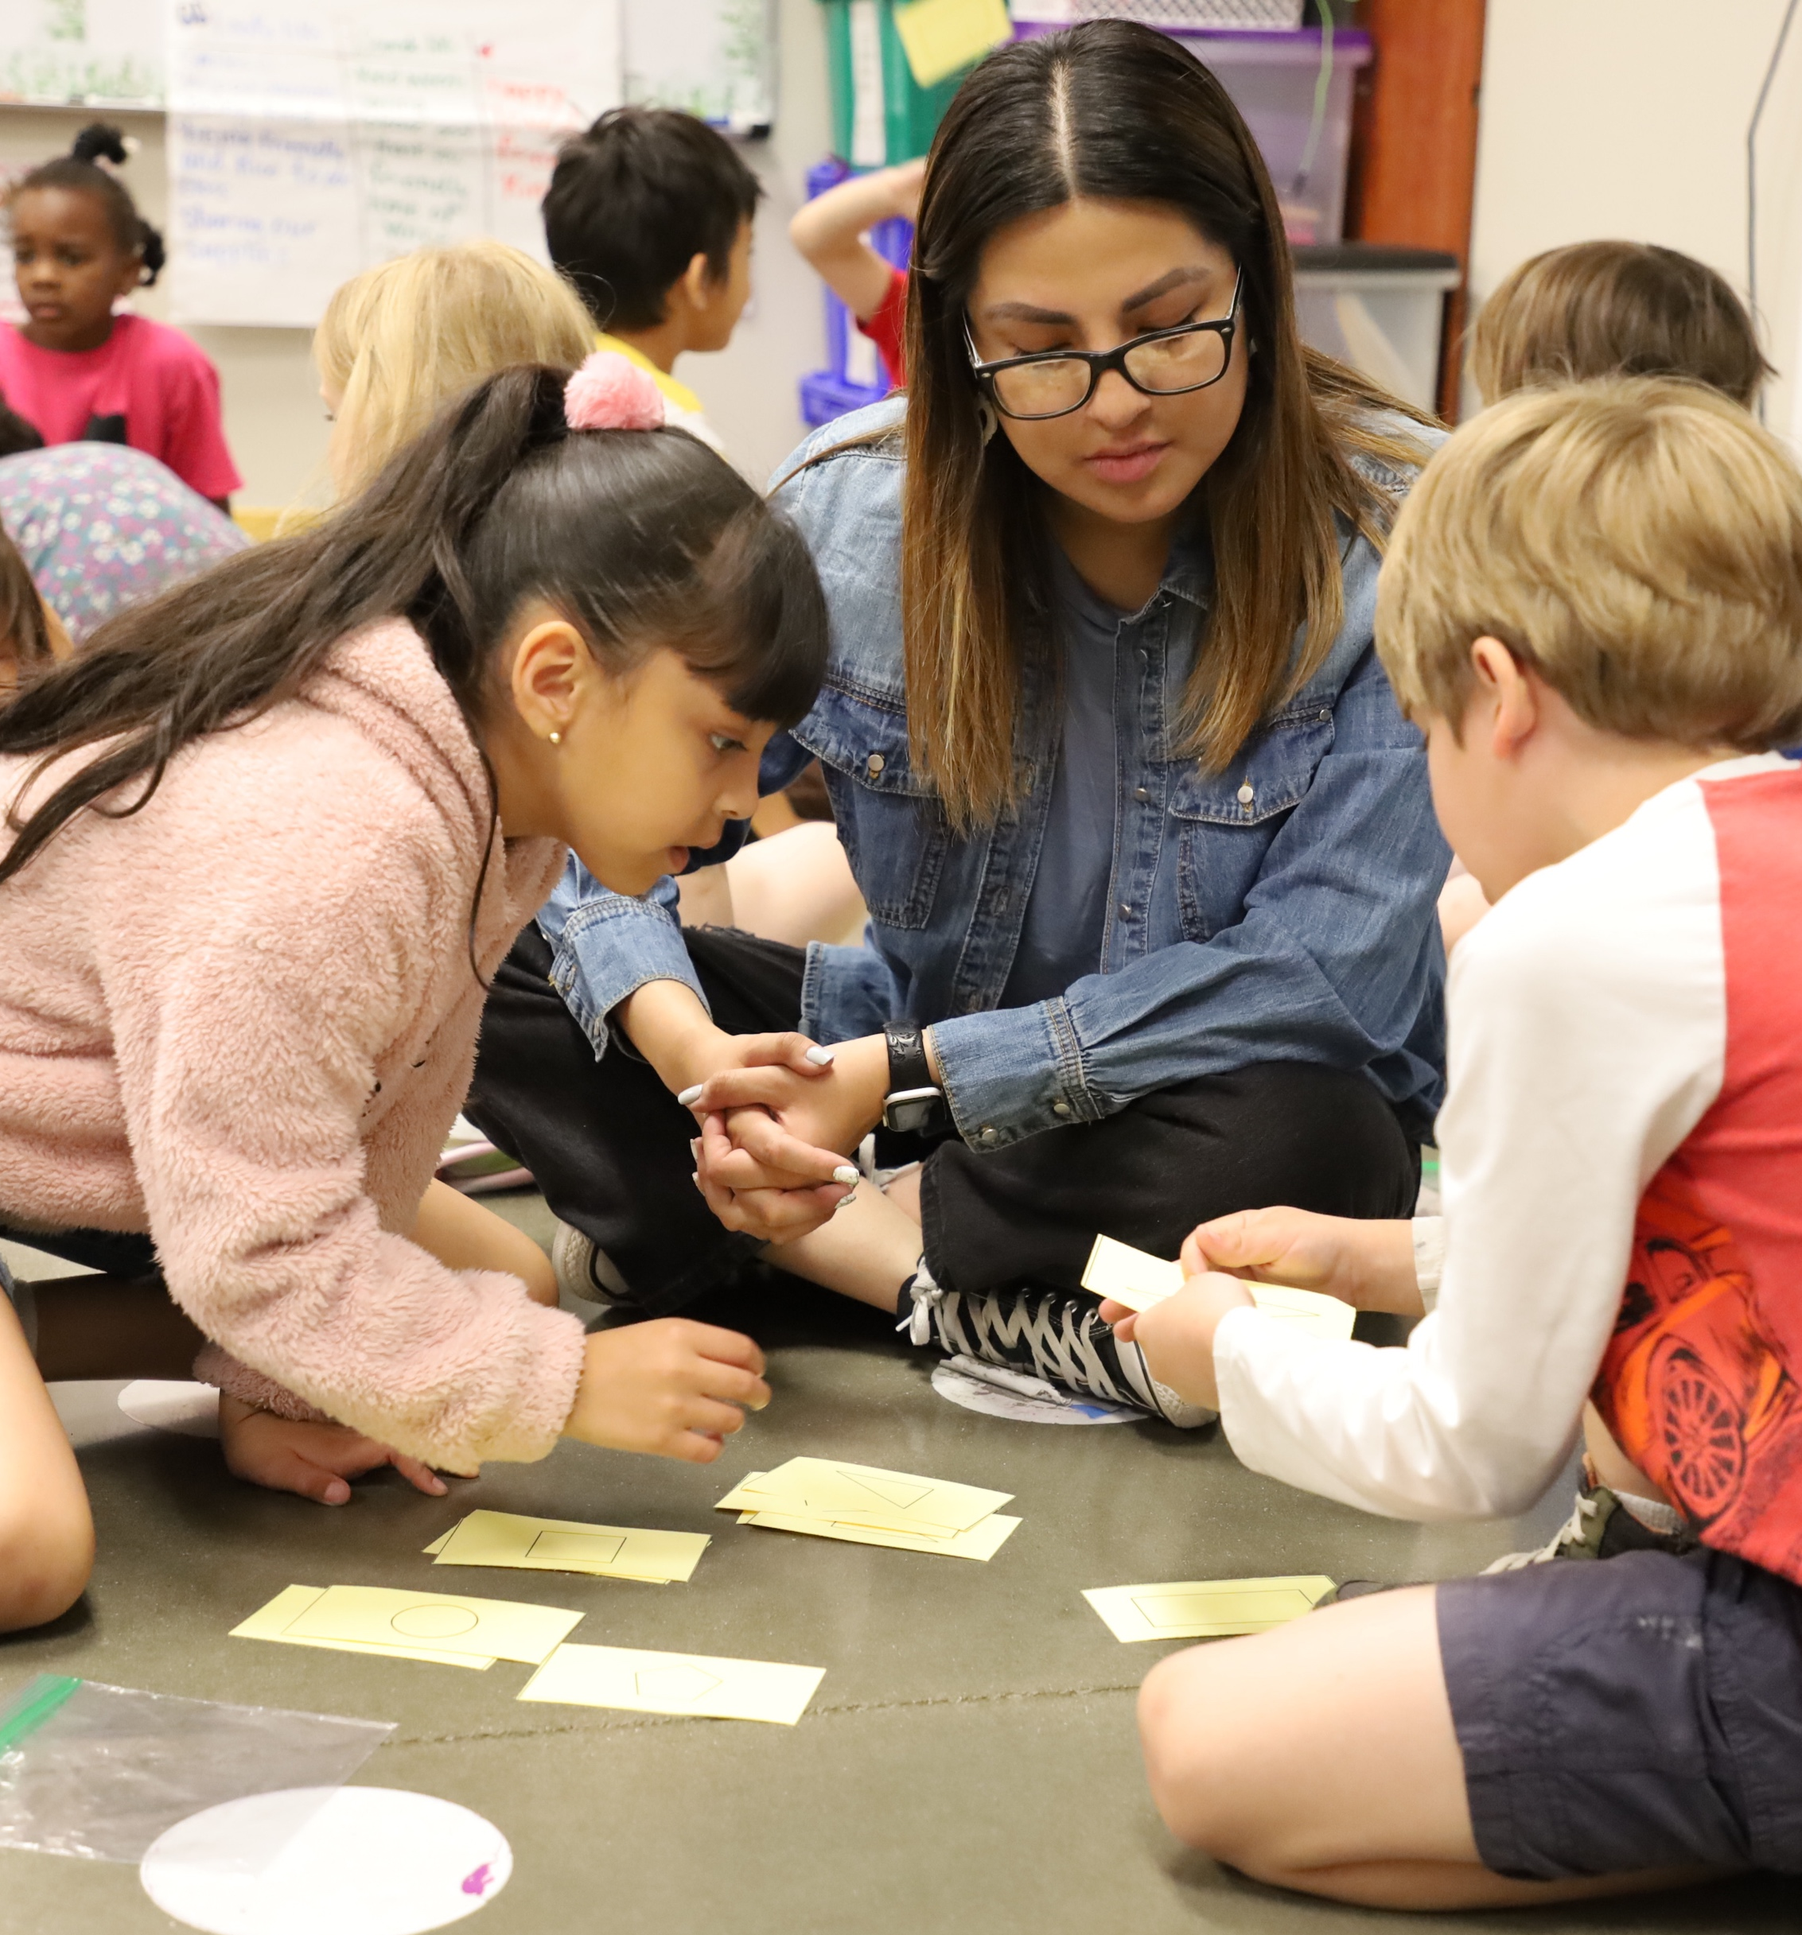
Discuss: Using M⁵ to Support Learning About Shapes and Space
Notes:
Time: 15–30 minutes (including review of document on the previous slide)
Materials: Using M⁵ to Support Learning About Shapes and Space handout, chart paper, markers
Talking Points
You reviewed some ideas on ways to support early elementary children’s shape learning using the M⁵ Early Math Approach. Next, let’s reflect on ways we can continue to support early elementary children’s shape learning. We might think about strategies we already use as well as strategies that we want to try.
We will form small groups that will travel from chart to chart together. [Provide directions on how to form groups. The facilitator notes offer some suggestions.]
When you arrive at the chart, identify and chart something you would like to try. For example, on the Math Vocabulary and Discourse chart, you might want to invite children to create definitions for different shapes based on what they know about their attributes.
I will signal groups when it’s time to move to the next chart. Leave the marker at the chart for the next group to use. Move clockwise to the next chart. When you arrive, review the ideas suggested by the previous groups. Identify and chart additional ideas.
The last group at each chart will share with the whole group two to three ideas that they found most interesting or valuable.
Reflect on the diversity of early learners in your setting. Consider children’s interests, languages, cultures and lived experiences, abilities, and emerging skills as you discuss.
[After the activity concludes:] You might share the ideas you want to try with your coach and revisit this handout as you plan learning experiences throughout the year.
Facilitator Notes
Select a strategy for forming small groups. Some ideas include charting by grade level, numbering off at tables, numbering off in the whole group, or moving in table groups.
Consider modeling what to do at charts.
When considering the time allotted for this activity, leave at least five minutes at the end for the whole group to share. The remaining time should be divided into the number of charts. For example, if you have 25 minutes total, allow 20 minutes for the main activity and 5 minutes for the debrief. If there is one chart for each M⁵ Early Math Practice, the time allotted at each chart is four minutes (20/5 = 4).
After the activity concludes, invite participants to return to their seats.

Slide 20
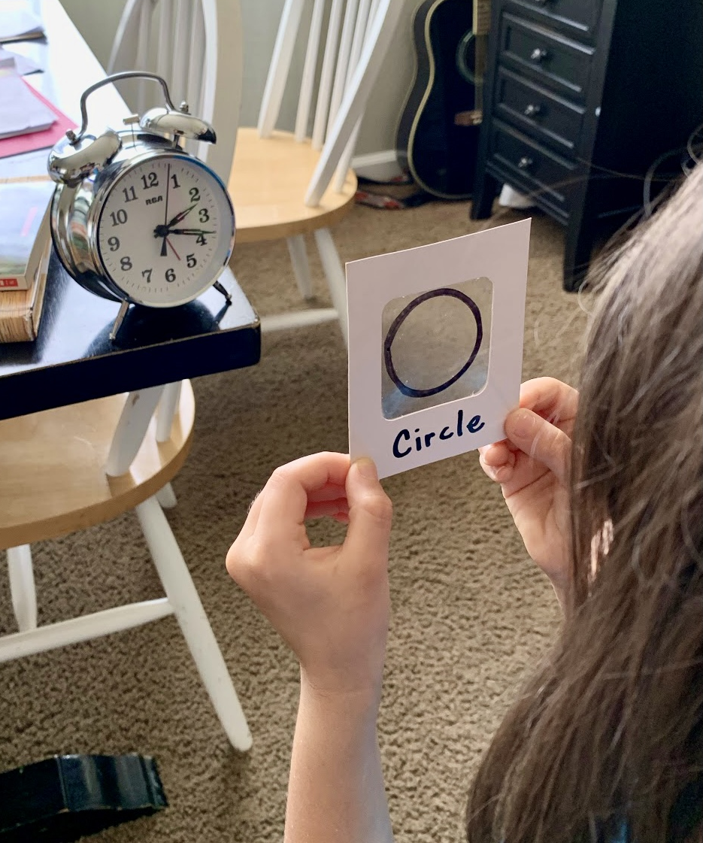
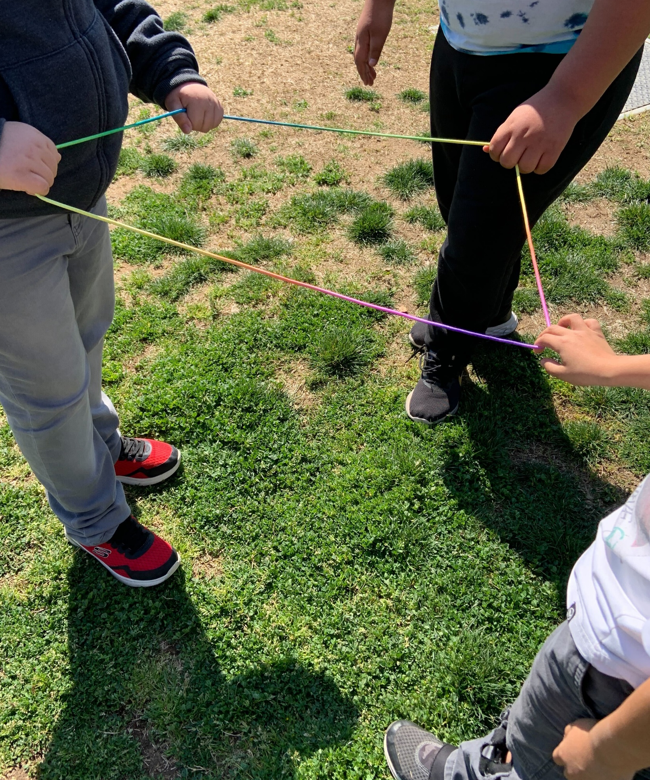
Explore: Activities to Learn About Shapes
Shape Viewfinder
Stretchy Shapes
Notes:
Time: 10–15 minutes
Materials: Shape Viewfinder handout, Stretchy Shapes handout
Talking Points
We reviewed a variety of ways that you can support children’s shape learning using M⁵. Next, we will read and discuss two activities that allow children to explore and learn about shapes in playful, hands-on ways.
Take out the Shape Viewfinder and Stretchy Shapes activity handouts.
These activity handouts include instructions for setting up the activities. They also include ideas on how to support children’s learning using the M⁵ Early Math Approach.
With a partner choose one of the two handouts. Read the handout together. Then, discuss how you might use this activity in your classrooms. Consider the following questions:
Think about the children in your classroom. In what ways might you modify this activity to respond to their languages, cultures, strengths, and needs?
What vocabulary might you introduce through this activity?
Facilitator Notes
Provide 5–10 minutes for participants to review and discuss one handout with a partner.
For longer sessions, offer time for participants to share, with their tables, how they might use the activity they reviewed.
For longer sessions, consider offering time for participants to do the activity. Be sure to prepare and bring the necessary materials. Encourage participants to discuss what they notice as they engage in the activity.

Slide 21
Reflect: Learn, Wonder, Do
Identify something you:
Learned
Are wondering about
Would like to try
Notes:
Time: 5 minutes
Talking Points
Take a few minutes to think about our session.
Consider the following questions:
What is something you learned?
What is a wonder you still have?
What is something you want to try in your learning setting?
[Allow two to three minutes for participants to think and record. You might invite participants to share with a partner.]
Thank you for your time, attention, and engagement. It’s been wonderful working with you.
Facilitator Notes
For longer sessions, consider asking participants to share with the larger group.
As participants discuss their reflections, note the questions that they still have and the things they would like to try. These reflections may inform the topics of future trainings, coaching, or communities of practice.

