Slide 1
Building a Culture of Inquiry
Notes:
Talking Points
Hello, and welcome everyone! Today we will be exploring how to build a culture of inquiry in your learning setting.
Facilitator Notes
Adjust the talking points to reflect the session length and participant needs. If necessary, add introductory and “housekeeping” information.

Slide 2

Acknowledgments
Count Play Explore Professional Learning Resources is a product of the Fresno County Superintendent of Schools developed by WestEd in collaboration with FCSS and AIMS Center for Math and Science Education. They are not intended for commercial redistribution, unauthorized modification, or use outside the scope of professional education.
Notes:
Talking Points
The Count Play Explore Professional Learning Resources were made possible by Count Play Explore, an early math and science initiative led by the Fresno County Superintendent of Schools, Early Care and Education Department. This initiative is generously funded by the California Department of Education and the California State Board of Education. These resources are intended to be used as a guide for implementing evidence-based strategies, promoting active learning, and encouraging developmentally appropriate practices in early education settings. They are not intended for commercial redistribution, unauthorized modification, or use outside the scope of professional education.

Slide 3
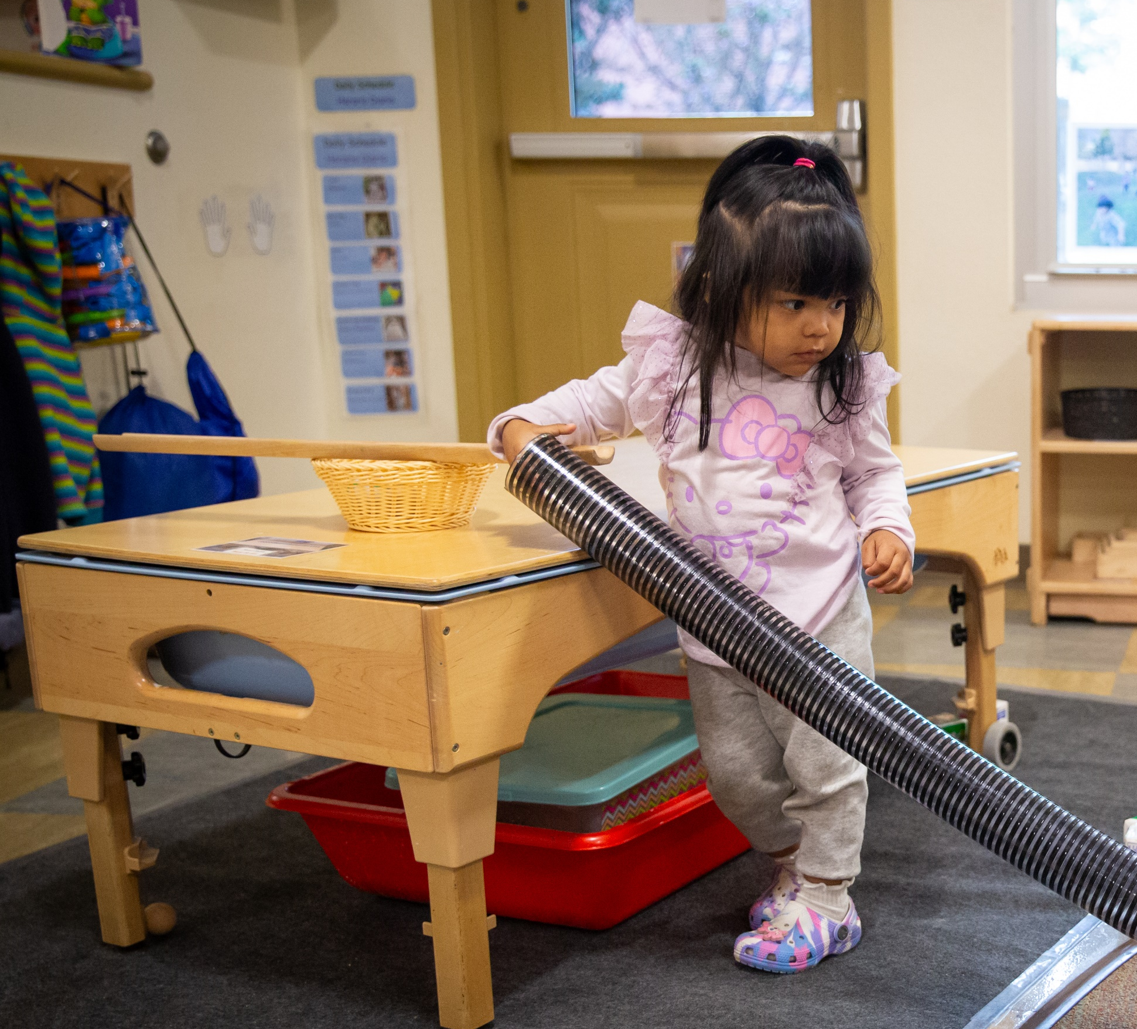
Session Goals
  Experience and discuss what we mean by inquiry.
  Explore ways to build a culture of inquiry in your learning setting.
Notes:
Talking Points
In this session, we will:
experience and discuss what we mean by inquiry and
explore ways to build a culture of inquiry in learning settings.
Facilitator Notes
Adjust slide content and talking points to reflect what you plan to address in your professional learning session.

Slide 4
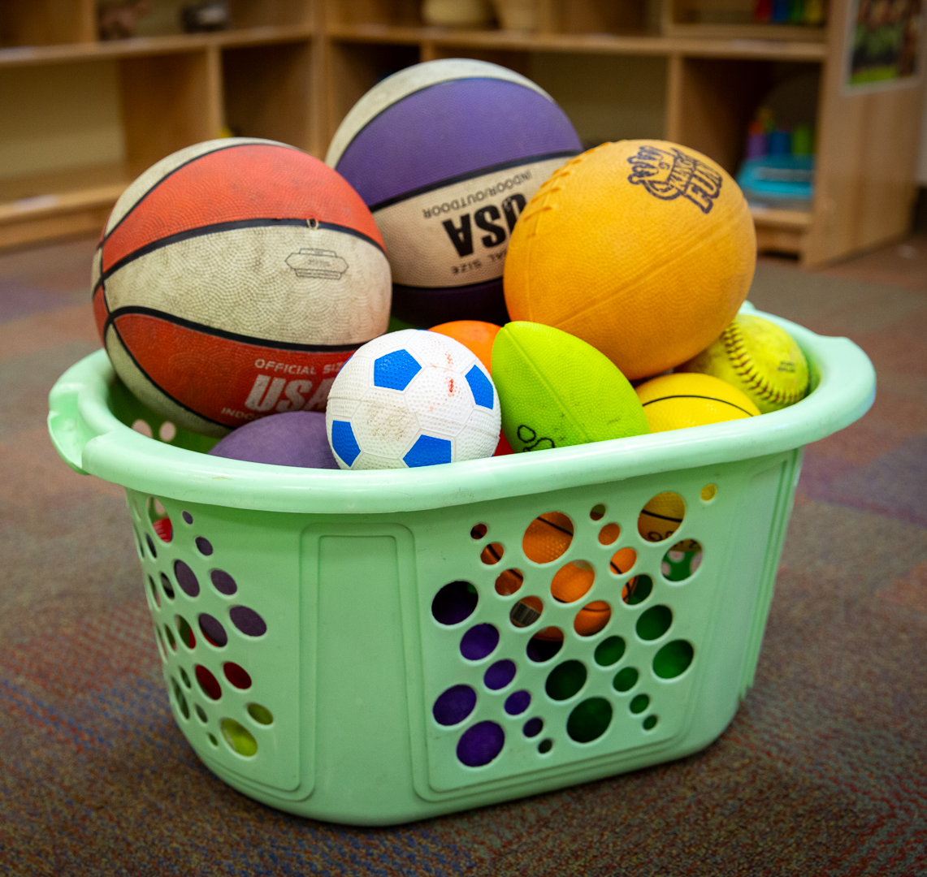
What do you wonder?
Notes:
Time: 5 minutes
Materials: Balls of different sizes and materials, chart paper (optional)
Talking Points
Let’s wonder together.
Here is a photo of a basket of balls.
Observe the balls. What do you wonder about the balls?
[Select a facilitation strategy from the Facilitator Notes to support participants in generating questions.]
[After participants generate questions and share with the larger group:] Being curious and asking questions are drivers of inquiry. Curiosity provides the motivation to explore and experiment (Casey, 2014).
Facilitator Notes
For shorter sessions, encourage participants to brainstorm questions in a whole group setting. Document participants’ questions on chart paper.
For longer sessions, invite small groups to document the what they wonder about the balls on their own sheet of chart paper. Then, encourage small groups to share with the larger group.
You might contribute your own questions to the brainstorming process as needed. For example, “Does one ball bounce higher than others?” “Which ball is the biggest?” “What do the balls feel like?”

Slide 5
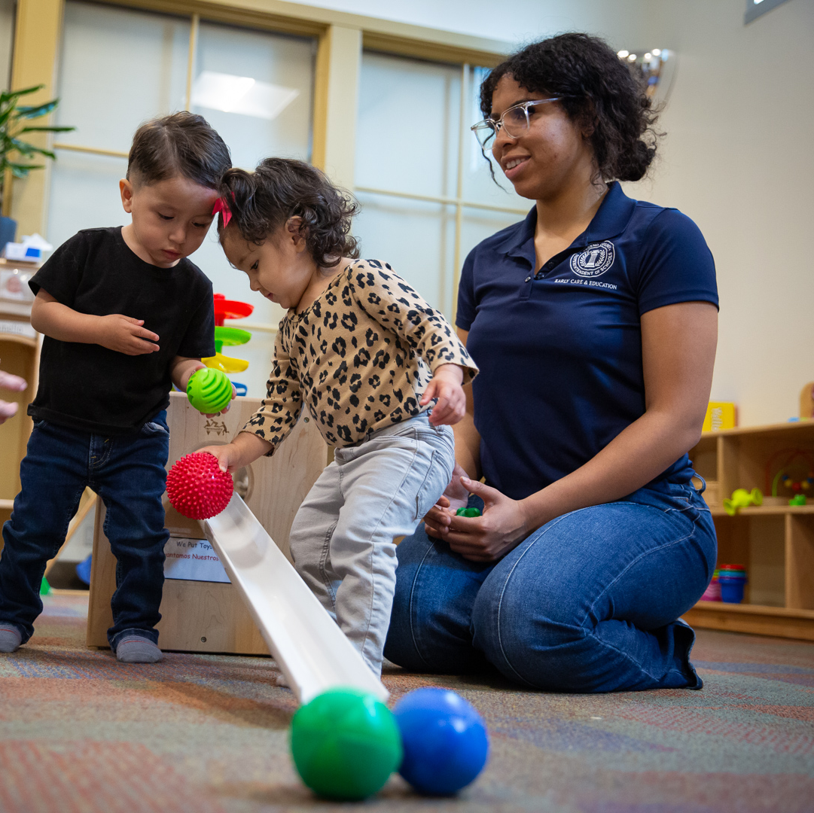
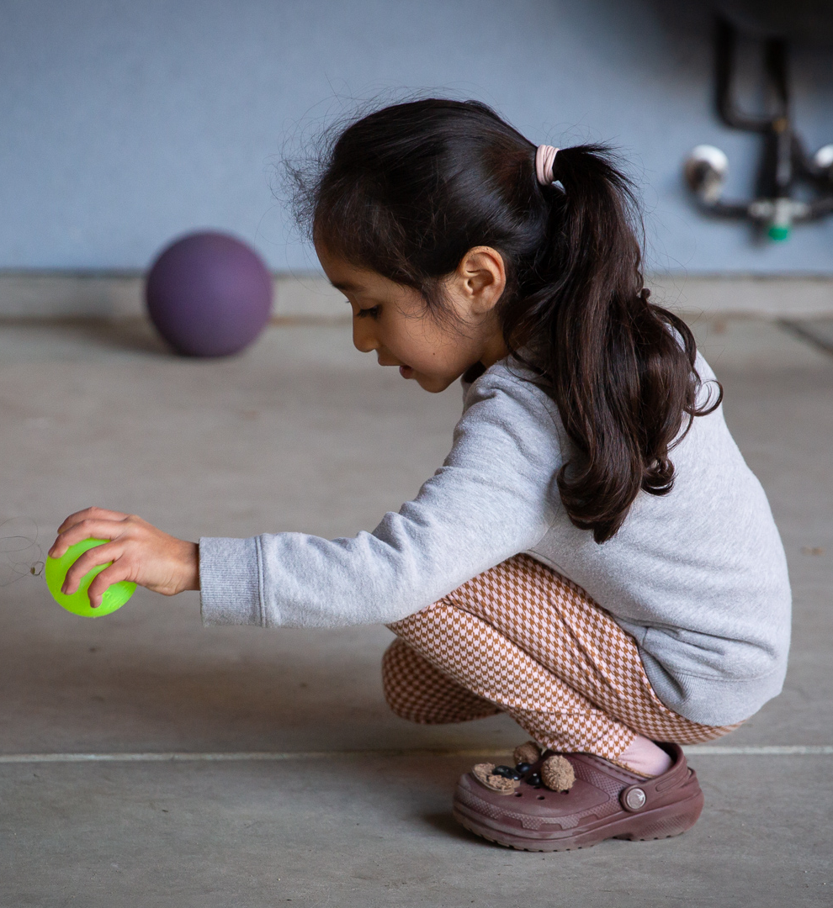
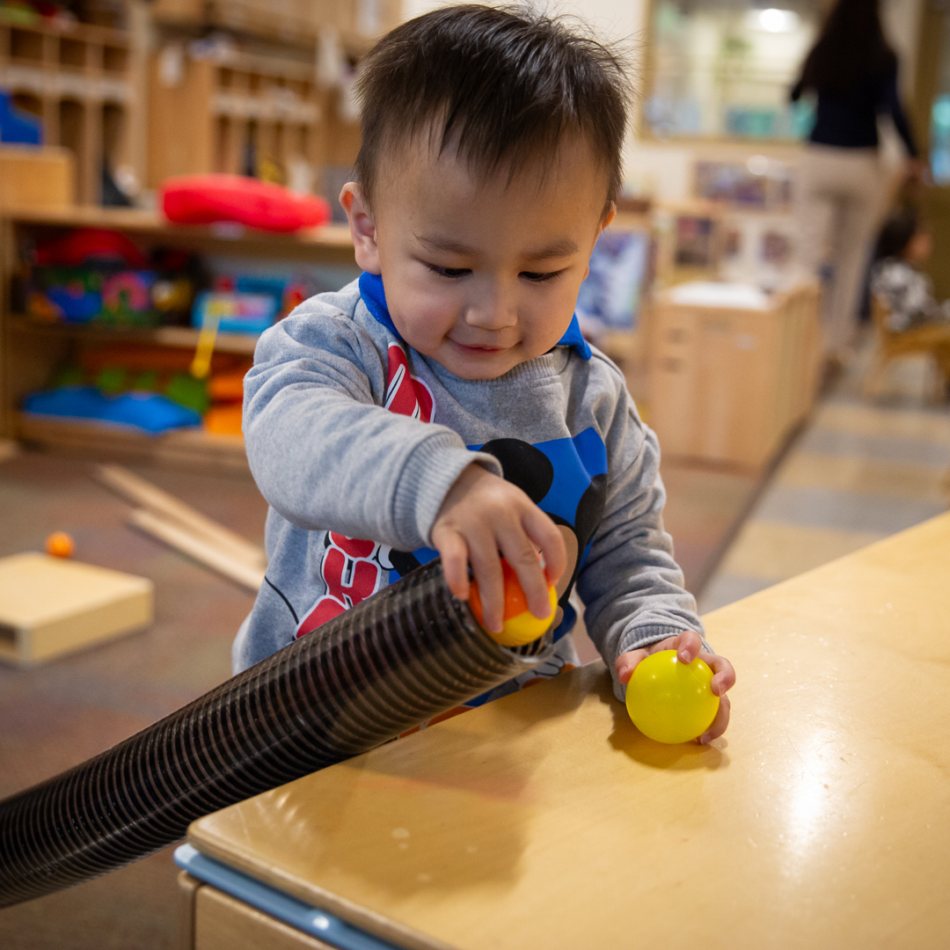
What can you do to find out?
Choose a question to investigate.
Plan for what you might do to find out.
Investigate.
Notes:
Time: 15 minutes
Materials: Chart paper and markers, balls of different sizes and materials, masking tape (optional)
Talking Points
Now, let’s consider ways we might find out more about the questions we raised.
With a partner (or small group), choose a question to investigate.
Think about what you can do to find out the answer to your question.
Make a plan for how you can investigate.
Consider what you think might happen and why.
[Provide a few minutes for participants to plan and discuss.]
Let’s investigate it. Gather information to help you answer your question.
Facilitator Notes
Support participants as they investigate answers to their questions about the balls.
You can help focus participants’ investigations by providing them a choice between two questions:
“Which ball rolls the farthest?”
“Which ball bounces the highest?”
Consider encouraging groups to document or measure. They can use the optional masking tape to mark the distance different balls travel. For example,
For groups investigating which ball rolls the farthest, ask, “How are you remembering the different distances the balls roll?”; “How might you document how far the ball rolled?”; “How might you measure the distances the balls traveled?”
For groups investigating bouncing, ask, “How high did it bounce?”; “In what ways might you document, or mark, the height of each ball?”
If groups finish their investigations sooner than others, consider encouraging them to extend their investigation. For example:
“What new questions do you have?”
“How might you find out more about the question you are investigating?”
“What additional tools or materials might you need to continue exploring?”

Slide 6
Discuss:
Engaging in Inquiry
  What question did you investigate?
  What did you do during your investigation?
  What did you learn?
  What further questions do you have?
Notes:
Time: 10 minutes
Talking Points
Let’s take a few moments to share about the different ways we investigated and what we learned.
What question did you investigate?
What did you do during your investigation?
What did you learn?
Facilitator Notes
Invite a few groups to share their experiences.
You might prompt participants with the following questions as they discuss ways they investigated:
“In what ways did you plan and carry out an investigation to answer your question?”
“In what ways did you make predictions and test your ideas about how the balls move?”
“In what ways did you gather or document information during your investigation?”
“You explored concepts related to physical science (for example, exploring forces and how things move). What were some of the explanations you came up with as you investigated different physical science concepts?”

Slide 7
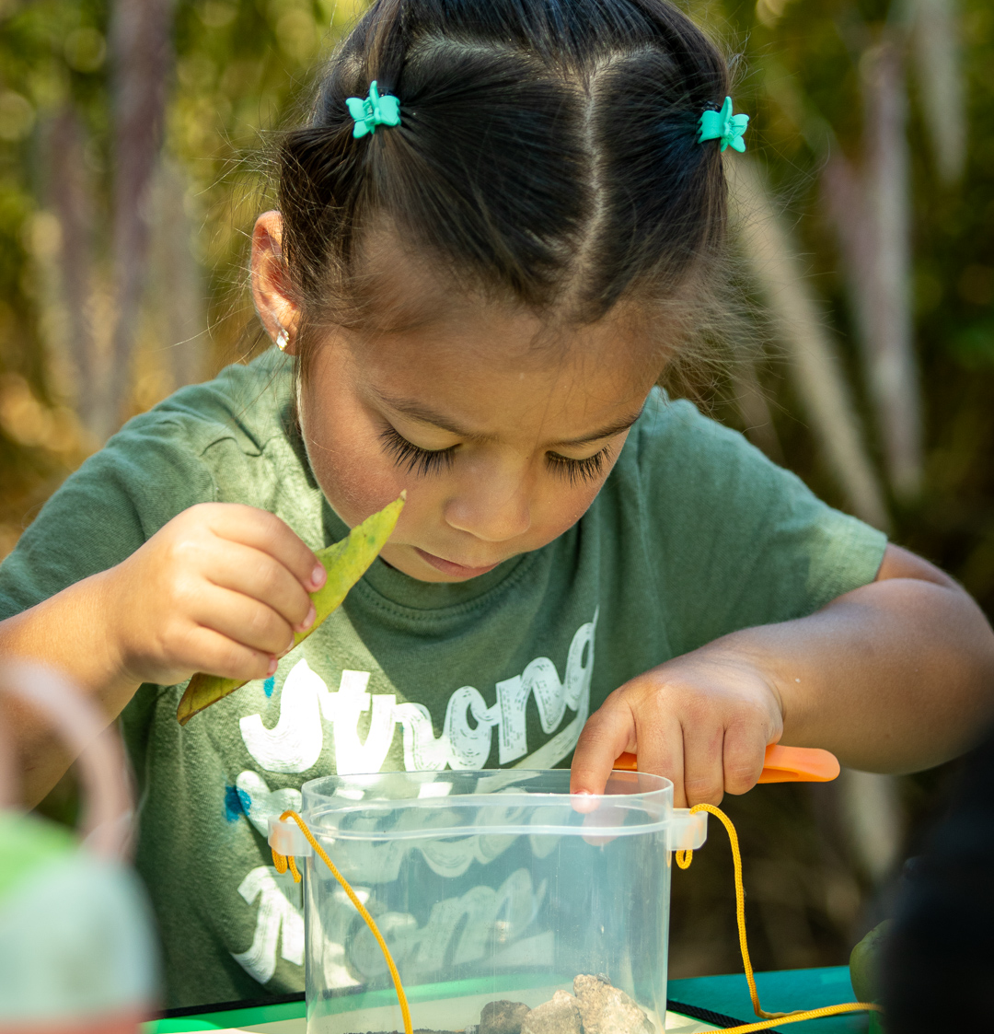
What is inquiry?
Inquiry refers to the many ways in which people wonder about, explore, and develop and communicate understanding of their world.
Broderick & Hong (2020); California Department of Education (2016, 2024); National Academies of Sciences, Engineering, & Medicine (NASEM; 2021)
Notes:
Talking Points
Inquiry refers to the many ways in which people wonder about, explore, and develop and communicate understanding of their world (Broderick & Hong, 2020; California Department of Education, 2016, 2024; National Academies of Sciences, Engineering, and Medicine [NASEM], 2021).
Play is central to inquiry. Inquiry often emerges through play, which is one way children engage with their environment to make sense of the world.
Your curiosity about balls led you to use inquiry to find out more and build understanding of your world.

Slide 8
Inquiry Supports Learning in STEAM
Engaging in inquiry
Ask questions, investigate, develop explanations
Understanding
STEAM concepts and phenomena in the world
Notes:
Children can use inquiry to build understanding within STEAM experiences.
STEAM is an integrated approach to exploring and making sense of the world around us. In STEAM learning experiences, children use science, technology (including computer science), engineering, the arts, and math to investigate, construct meaning, and communicate their ideas about objects and phenomena.
When we say phenomena, we mean observable events that involve STEAM concepts such as a seed sprouting, paint mixing to form a new color, or a ball rolling into a block structure causing it to topple over.
Across STEAM disciplines children can ask questions and express curiosity about phenomena in the world, use different skills and practices to investigate questions and curiosities, and develop explanations or conclusions based on the evidence they gather.

Slide 9
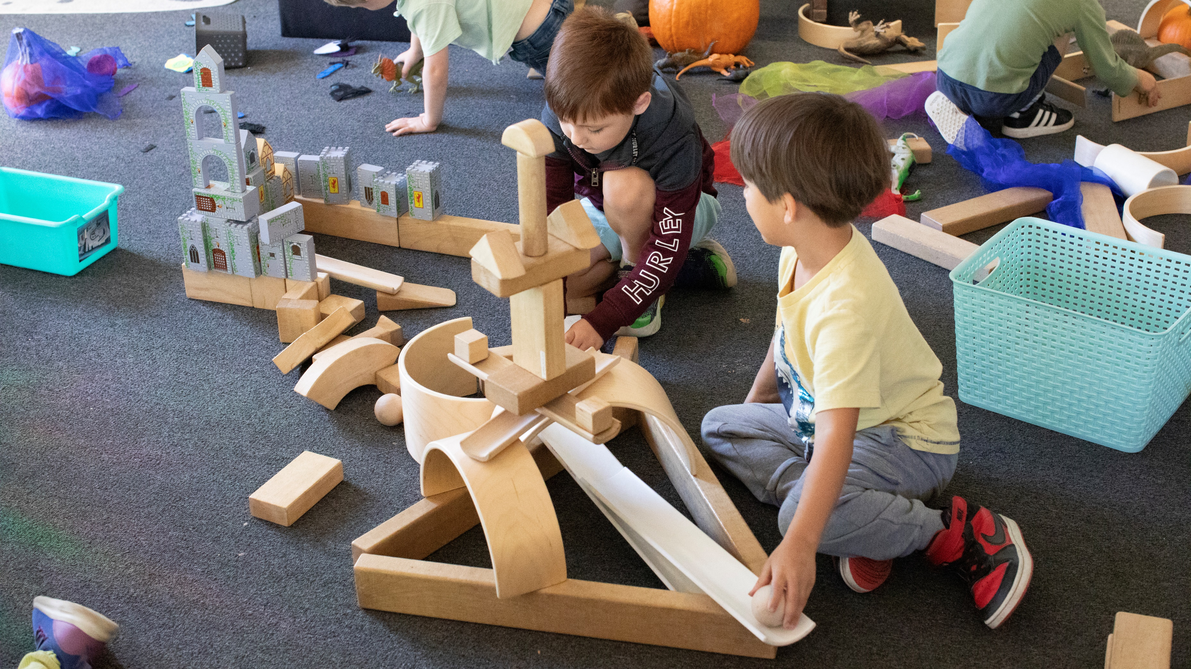
Observe: Children Engaging in Inquiry
Notes:
Time: 10 minutes (including discussion on following slide)
Materials: Video clip of children engaging in inquiry
Talking Points
Let’s notice ways that children engage in an inquiry with balls.
As you observe the video, consider the following questions:
What were children curious about?
In what ways did children test their predictions?
What might the children have learned during this inquiry experience?
In what ways did inquiry emerge through play?
How was the children’s engagement in inquiry similar to or different from your experience with inquiry?
[Select and play a video clip showing children engaging in inquiry. We provide a video in the Facilitator Notes.]
Facilitator Notes
Choose a video that shows children engaging in inquiry.
We provide the following videos (you may use other videos):
Exploring Size and Fit with Ramps and Balls (18–36 Months)
Problem Solving with Blocks (4–5 Years)
Note: Discussion points are provided for the video “Problem Solving with Blocks (4–5 Years)” in the Facilitator Notes on the next slide.

Slide 10
Discuss: Children Engaging in Inquiry
What were the children curious about?
In what ways did the children test their predictions?
What might the children have learned during this inquiry experience?
In what ways did inquiry emerge through play?
How was the children’s engagement in inquiry similar to or different from your experience with inquiry?
Notes:
Time: 10 minutes (including observing video on previous slide)
Talking Points
Let’s discuss what you noticed.
What were children curious about?
In what ways did children test their predictions?
What might the children have learned during this inquiry experience?
In what ways did inquiry emerge through play?
How was the children’s engagement in inquiry similar to or different from your experience with inquiry?
Facilitator Notes
Adjust the debrief based on your group size, session length and format, and participant needs.
Consider using the following adaptations based on session length:
For shorter sessions, invite participants to share with the larger group what they noticed about ways children engaged in inquiry.
For longer sessions, offer time for participants to share their observations in pairs or at their tables. Then, invite each table to share their observations.
Here are some examples of how children in the video “Problem Solving with Blocks (4–5 Years)” engaged in inquiry:
What were the children curious about?
The children were curious about how the balls move. One child wanted to find ways to turn the ball.
Collaboratively, both children were curious about ways to use the ball to knock something down.
In what ways did the children test their predictions?
One child tested ways to turn the ball by placing a block in different positions and noticing what happened when he released the ball down a ramp.
Collaboratively, the two children tested different ways to design the ramp structure and different ways to position the toy so that the ball will knock it down.
What might the child have learned during this inquiry experience?
The child learned that he could use different blocks to turn a ball and also stop a ball.
Collaboratively, the children learned ways to use the force of the ball to knock down a structure.
In what ways did inquiry emerge through play?
Children were playing with blocks and ramps. They were creating different structures and had different goals for their play. Through their play, they generated questions and identified problems (for example, “How can I make this ball turn?” “How can we get the ball to knock over the figure?”). Their play scenarios provided the purpose for their inquiry experiences.
How was the children’s engagement in inquiry similar to or different from your experience with inquiry?
Both children and adults experienced joy, were motivated to test different ideas because we were curious, experienced failed attempts—but kept trying, and worked independently and collaboratively.
For shorter sessions, encourage participants to share their reactions with the larger group.
For longer sessions, invite small groups to discuss what they notice in the videos. Then, invite small groups to share with the larger group.

Slide 11
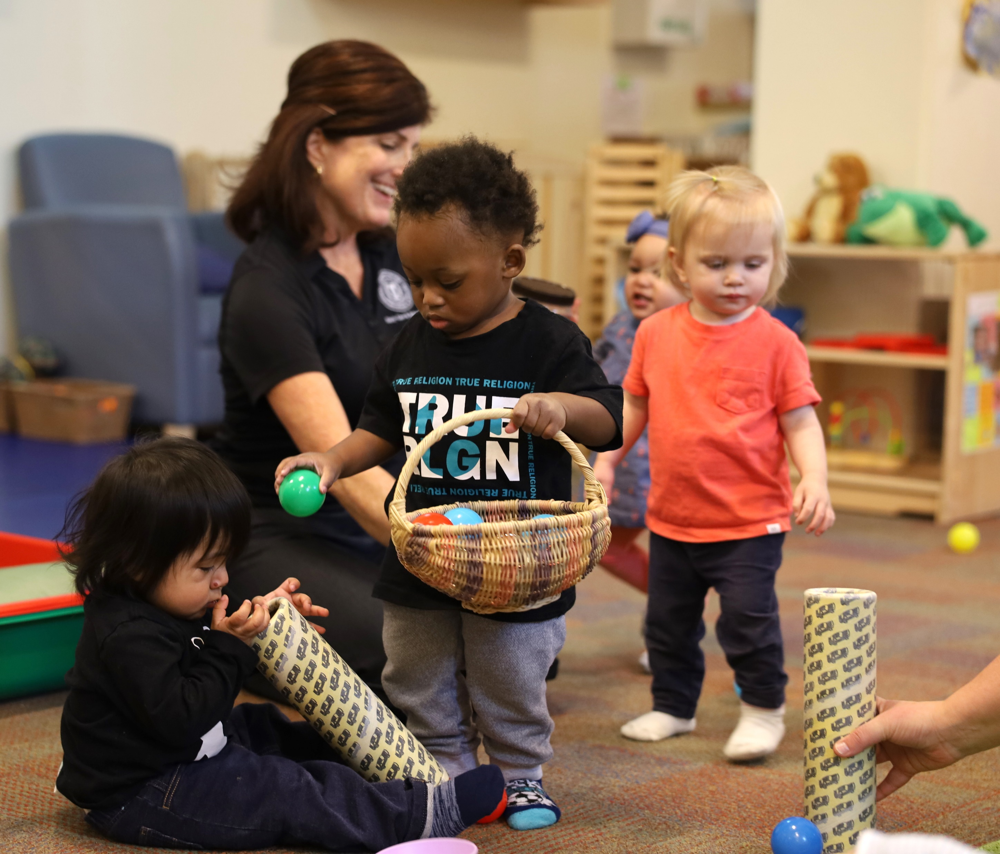
Why is inquiry important?
Young children are born ready to explore their world and make meaning, much like scientists.
Exploring the world through inquiry builds children’s neural connections.
Bjerknes et al. (2024); Gopnik (2012); Miller & Saenze (2020); NASEM (2021); Renninger & Hidi (2022); Shonkoff & Phillips (2010); van Lieshout et al. (2020)
Notes:
Talking Points
Young children are born ready to explore their world and make meaning, just as scientists do (Gopnik, 2012; Miller & Saenz, 2020; NASEM, 2021; Shonkoff & Phillips, 2010).
In fact, being curious is a trait we are all born with, and one that helps us learn, grow, and thrive (Bjerknes et al., 2024; Renninger & Hidi, 2022; van Lieshout et al., 2020).
Exploring the world through inquiry—touching, pulling, pushing, climbing, figuring out what happens if—is how children’s brains build neural connections (Shonkoff & Phillips, 2010). This is especially meaningful for young children whose brains are developing at rapid rates.
As children age, curiosity continues to guide and support learning and development throughout their lifespan.

Slide 12
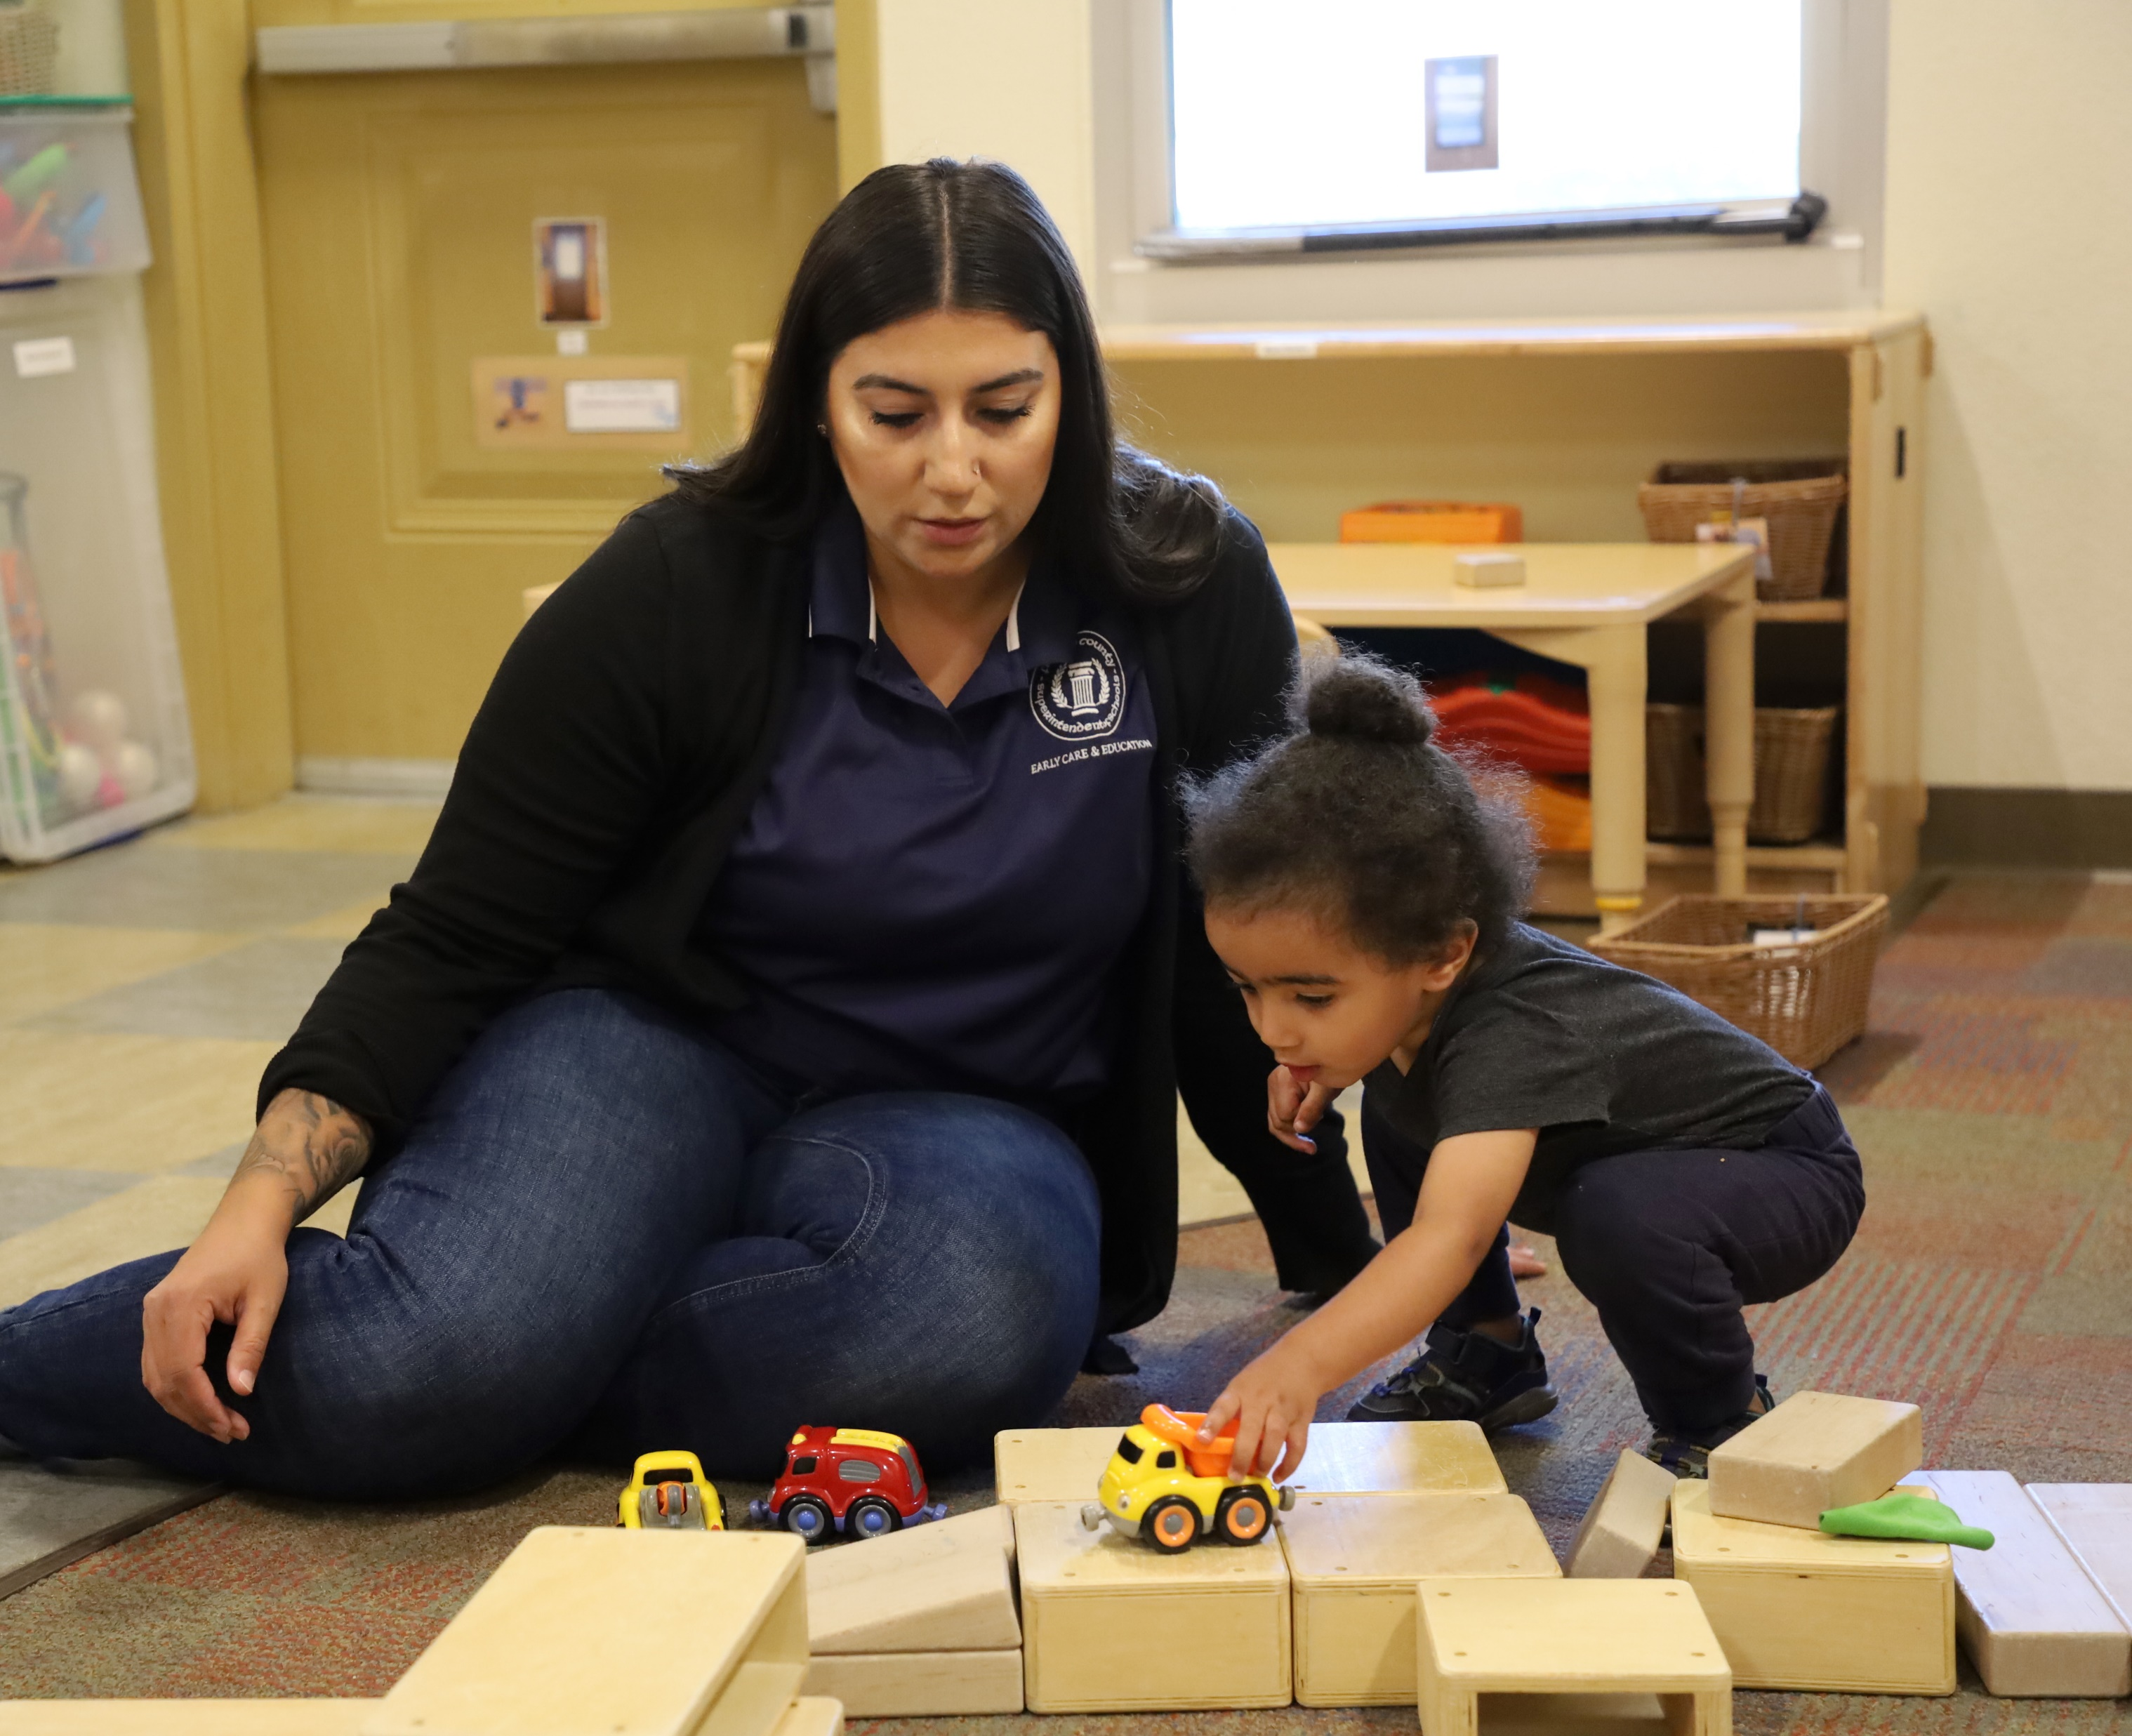
Why is inquiry important? (continued)
Inquiry experiences support children to
use knowledge and skills from different domains,
develop agency and identity as learners in STEAM, and
use their funds of knowledge to drive curiosity and guide investigations.
Bustamante et al. (2018); Cabell & Hwang (2020); Dweck et al. (2014); Hedges, et al. (2010); Keifert & Stevens (2018); NASEM (2021); National Research Council (2012); Siry et al. (2016)
Notes:
Talking Points
Inquiry experiences support learning across domains. For example, inquiry experiences:
offer opportunities to develop social and emotional skills, such as collaboration and persistence (National Research Council, 2012);
encourage children to use math, literacy, and fine and gross motor skills as part of their investigation process (Bustamante et al., 2018; Cabell & Hwang, 2020; NASEM, 2021); and
strengthen critical thinking skills needed to solve problems, answer questions, and develop deeper understandings of concepts (National Research Council, 2012).
Inquiry experiences can also support children to develop agency and identity as learners in STEAM. For example, inquiry experiences offer the following:
They create safe spaces for children to take risks. Through inquiry experiences, children learn that mistakes can help us learn (Dweck et al., 2014).
They provide opportunities where children can feel a sense of agency, like “I can do it!” These experiences enhance engagement and motivation to learn, which helps develop a positive sense of identity in STEAM (Dweck et al., 2014; Siry et al., 2016).

Slide 13
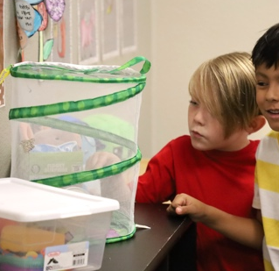
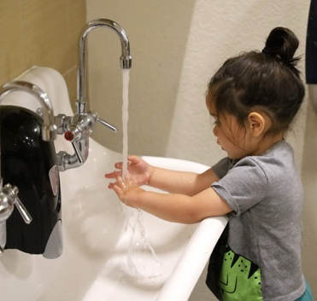
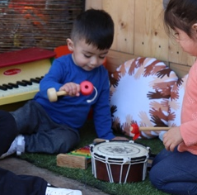
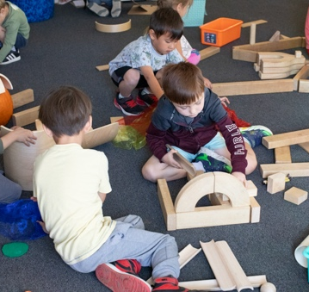
Explore: Inquiry across Ages and Contexts
Notes:
Time: 10–15 minutes (including the discussion on the next slide)
Materials: Inquiry across Ages and Contexts handout
Talking Points
Here are a variety of cards with photos and brief vignettes featuring children across ages and across contexts engaging in inquiry.
Choose a card that is meaningful to you. Review the vignette and photo and consider the following questions:
In what ways is the child demonstrating curiosity?
In what ways is the child investigating or experimenting?
What types of understandings might the child be building about different STEAM concepts and phenomena?
Find someone at your table who chose a different card.
Provide an overview of your card to your partner.
Compare and contrast how the children in the two scenarios are engaging in inquiry in similar and different ways.
Facilitator Notes
This activity is discussed on the following slide.

Slide 14
Discuss:
Inquiry across Ages and Contexts
  Consider the ways children
  demonstrate curiosity,
  investigate phenomena, and
  communicate their ideas.
Notes:
Time: 10–15 minutes (including the discussion on the previous slide)
Materials: Inquiry across Ages and Contexts handout
Talking Points
The vignettes we just examined reflected children across different ages and contexts.
Let’s discuss how children of different ages engage in inquiry.
[Encourage participants to respond to each point on the screen. Participants can use the photos and vignettes as examples. Use the sample answers in the Facilitator Notes to support a discussion.]
In what ways do children demonstrate curiosity?
In what ways do children investigate or experiment?
What types of understandings might the child be building about different STEAM concepts and phenomena?
Facilitator Notes
Some sample responses you might use to support a discussion follow.
Express curiosity:
Younger children might not verbally express what they are curious about. You might notice facial expressions, extended time looking at objects that inspire their curiosity, sounds of excitement (for example, the infant exploring musical instruments smiled every time he was able to create a sound).
Older children might demonstrate curiosity in similar ways. Some might verbalize what they are curious about by asking questions (for example, the children asked questions about butterflies and plants). Children might ask questions in different languages.
Investigate phenomena:
Younger children might mouth objects, bang objects together, or knock an object off a surface. Their investigations might be brief, and they will notice changes that happen immediately (for example, the infant during floor time noticed that wheels roll). Adults might highlight similarities and differences between objects. They might add language to children’s investigations and model different ways to use materials.
Older children might work more collaboratively. They might develop and revise plans before investigating, and they might notice more subtle changes over time (for example, the second-grade child noticed ways the plants changed over time). Adults might offer materials that children need to test some of their ideas and budding understandings. Adults might encourage children to explain what they are doing and then challenge their theories in ways that support them to investigate more deeply.
Communicate their ideas:
Younger or nonverbal children may repeat their actions to show what they know (for example, the child making bubbles at the sink showed her educator how she was able to make bubbles).
Older children will be able to share complete thoughts through spoken language, written text, or drawings (for example, the children observing the butterflies drew pictures and engaged in discussion about what the butterflies preferred to eat).

Slide 15
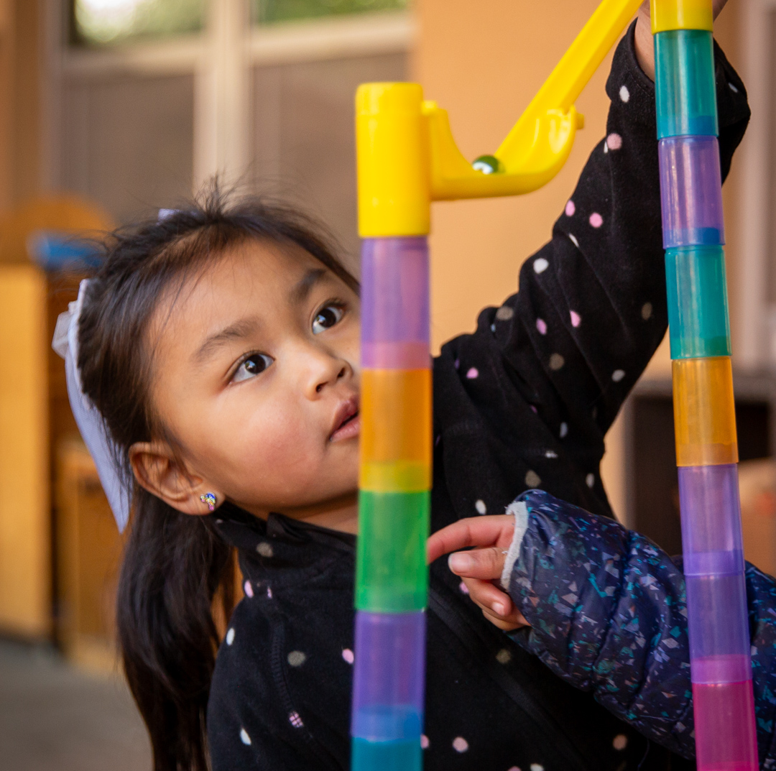
Summary: What is inquiry?
Inquiry is how children wonder and investigate phenomena or problems through play and experimentation to build meaning of their world.
Inquiry can deepen knowledge in STEAM and enhance skills across domains.
Inquiry can occur across contexts.
Children of all ages can engage in inquiry.
Denton & Borrego (2021); Hedges et al. (2010)
Notes:
Talking Points
Let’s review some key points that we explored in the first part of our session.
Inquiry is how people (adults and children) wonder about and investigate phenomena or problems through play and experimentation to build understanding of their world.
Inquiry can deepen knowledge and enhance skills across domains.
Inquiry can occur in different contexts—providing many diverse ways to support children in wondering about and investigating different concepts and phenomena.
Children of all ages can engage in inquiry in different ways.

Slide 16
Building a Culture of Inquiry
Children
  follow their curiosities,
  explore their environment,
  ask questions, and
  investigate.
Adults
  welcome and value children’s questions,
  guide children in their explorations, and
  join children in exploring the world.
Notes:
Talking Points
We explored what inquiry is and why it is important. Now we will consider an essential aspect of creating a culture of inquiry in our settings.
To support inquiry-based learning, we can create an environment that encourages children to follow their curiosity, explore their environment, ask questions, and engage in investigations. In a learning environment supportive of inquiry, the adults welcome and value children’s questioning, guide children in their exploration, and join children in exploring the world. They build a culture of inquiry.
To do this, we first need to embrace a mindset that is prepared to join children in their play and explorations.

Slide 17
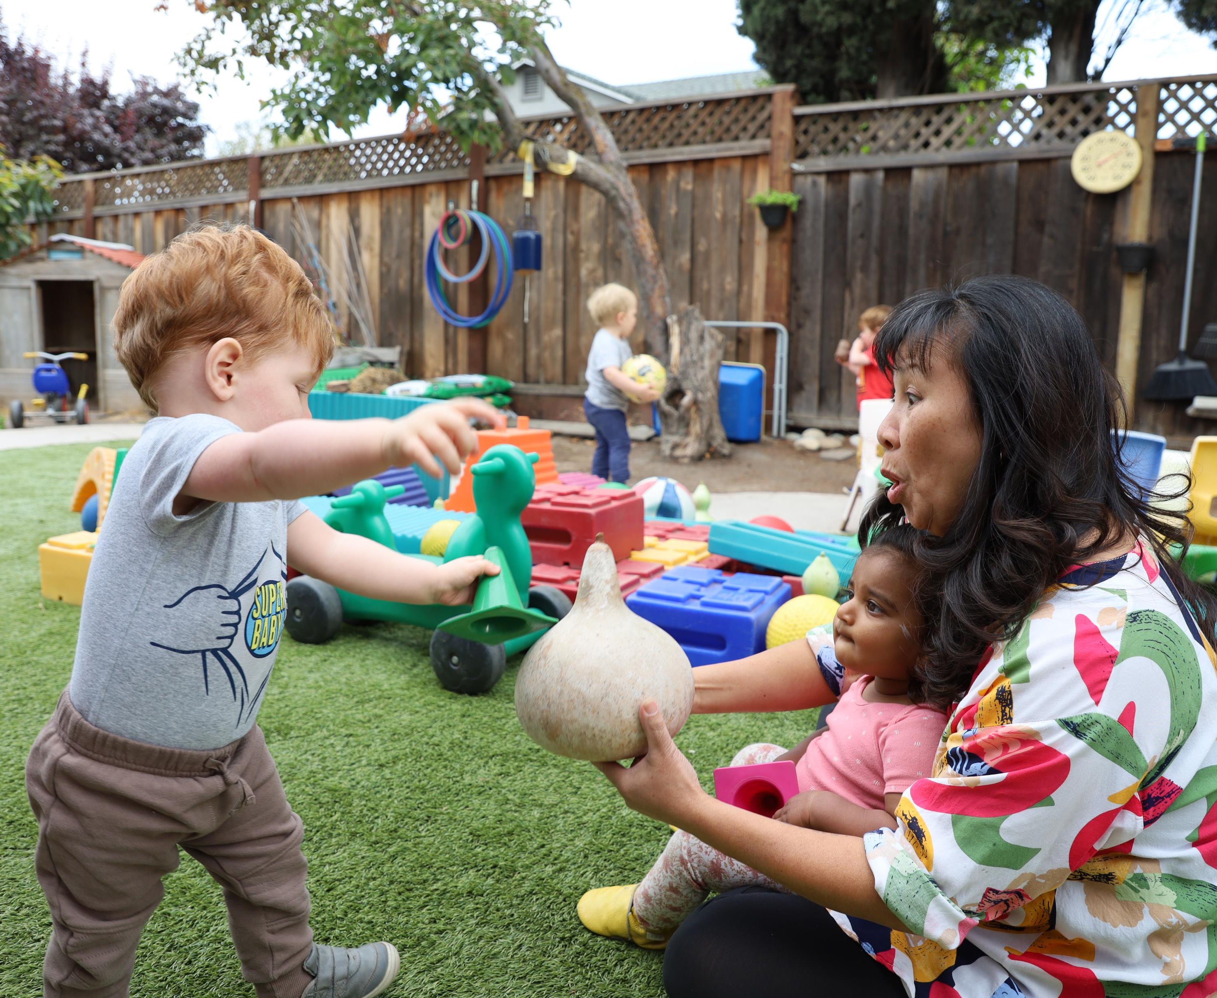
Inquiry Mindsets
Inquiry mindsets include our thoughts and feelings that affect the ways we interact with the world.
Notes:
Talking Points
Our mindsets include our thoughts and feelings that affect the ways we interact with the world.

Slide 18

Explore Inquiry Mindsets
Ada Twist, Scientist
What mindsets support
Ada to investigate?
Notes:
Time: 15 minutes
Materials: Inquiry Mindsets handout
Talking Points
Let’s take some time to think about the mindsets of both children and educators that support each in engaging in inquiry.
[Use the Inquiry Mindsets handout to encourage educators to consider the mindsets that support inquiry. In this activity, you will share the book Ada Twist, Scientist by Andrea Beaty. This book describes a curious child and ways her family embraces her curiosity. Participants will be encouraged to discuss the mindsets of the child and her parents.]
[After reading and discussing Ada Twist, Scientist:] Thank you for exploring mindsets for inquiry.

Slide 19
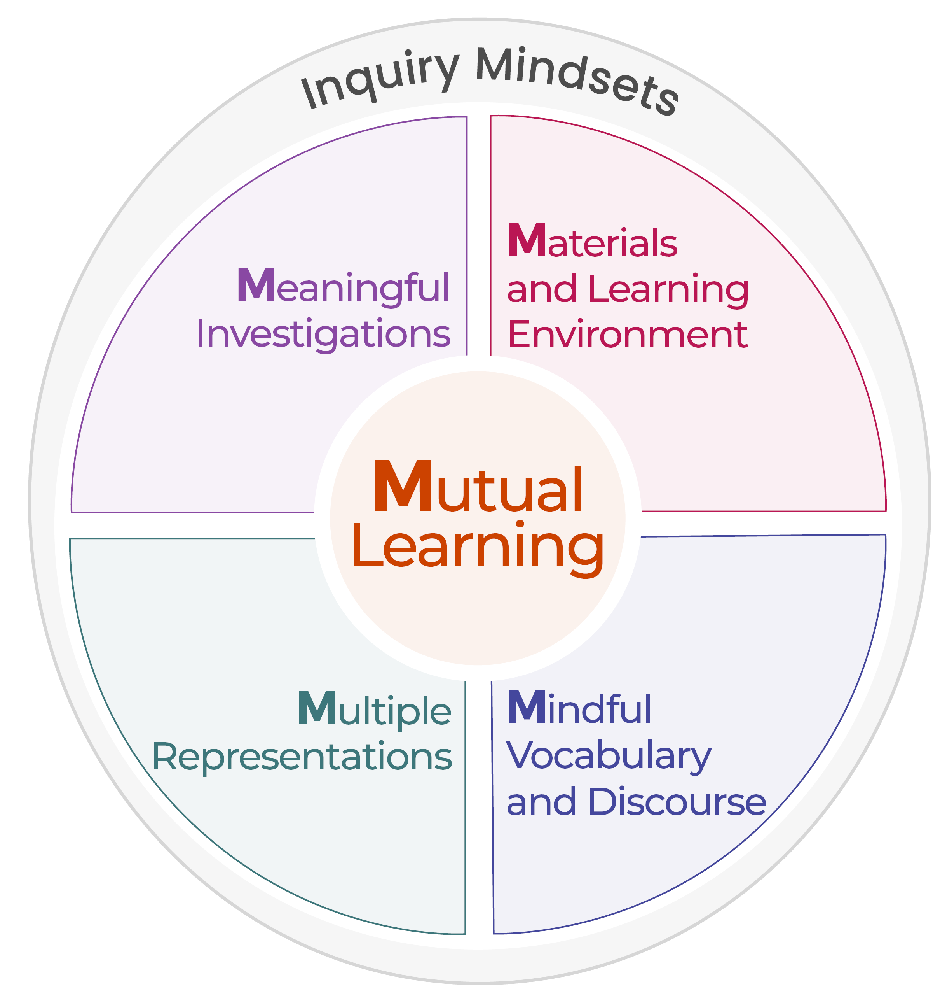
M⁵ Early STEAM Approach
Mindsets affect the way we engage and interact with children.
Notes:
Materials: M⁵ Early STEAM Approach Overview handout
Talking Points
Inquiry mindsets are a part of a broader approach of supporting children to engage in STEAM inquiry.
This approach is called the M⁵ Early STEAM Approach.
It includes five teaching practices: Mutual Learning, Meaningful Investigations, Materials and Learning Environment, Mindful Vocabulary and Discourse, and Multiple Representations.
Today, we focused on Inquiry Mindsets. The Inquiry Mindsets approach is represented in the graphic by a circle that encompasses all the M⁵ practices because our mindsets affect the ways we engage and interact with children.
Let’s briefly discuss the five teaching practices in the M⁵ approach and make connections to our inquiry experience with balls.
Mutual Learning: Learning about children’s interests, abilities, and lived experiences to develop meaningful inquiries and provide scaffolding that is responsive to children’s strengths. Because inquiry is inspired by what children are curious about, it is important for educators to notice what children are interested in and what questions they have—just like you generated your own questions based on your interests and curiosities when we investigated balls.
Meaningful Investigations: Providing open-ended inquiry-based experiences that children can actively investigate in ways that are aligned with their abilities and allow children to build meaning of STEAM concepts and phenomena. Open-ended experiences allow children to form different questions and investigate in different ways. Consider the many different questions you all generated during our inquiry experience with balls.
Materials and Learning Environment: Creating an environment that includes open-ended materials, scientific tools, time, and documentation to support inquiry. Consider the materials you were provided today. How did these materials support you to engage in inquiry? [Encourage participants to respond.]
Mindful Vocabulary and Discourse: Using language and open-ended prompts and questions to support children’s engagement in inquiry, understanding of STEAM concepts and phenomena, and abilities to communicate their ideas and understandings. Think about the different vocabulary you used during your investigation with balls. You communicated in different ways—using gestures and language. You also engaged in discourse as you shared your ideas with others and communicated plans and explanations.
Multiple Representations: Providing a variety of inquiry experiences that support children to communicate understanding of STEAM concepts and phenomena in different ways. In our experience with balls today, you explored concepts related to force and motion. We might continue exploring these concepts in other ways—for example, exploring other forces, such as the wind or our bodies, and ways these forces make objects move.
We will use the M⁵ approach in other sessions to think more about ways to support children in inquiry-based STEAM experiences.
Facilitator Notes
The M⁵ Early STEAM Approach is an adaptation of the M⁵ Early Math Approach. These approaches are intentionally similar to provide a consistent approach in supporting early learning across domains.
You might provide copies of the M⁵ Early STEAM Approach Overview handout for participants to keep and reference in other sessions or use as part of their ongoing professional learning.
Adjust talking points on this slide if you choose to engage participants with the handout in an active way. For example,
Consider inviting participants to add examples of ways they experienced the M⁵ Early STEAM Approach in their investigation with balls earlier in the session. They can add notes to the handout and discuss with small groups or in a whole group setting
The Science Observation and Investigation suite provides additional information on ways to use the M⁵ Early STEAM Approach in supporting children to engage in inquiry.

Slide 20

Write a Letter
  Write a letter to yourself.
  Describe one thing you learned today.
  Explain
    ways you might use what you learned in your setting and
    how you feel about using what you learned in your setting.
Notes:
Time: 10 minutes
Talking Points
As we close our session today, we invite you to reflect on your experiences and what you might have learned.
Write a letter to yourself.
In your letter:
Describe one thing that you learned today.
Explain ways you might use what you learned in your setting.
Include some of your thoughts and feelings—your mindset—about what you learned. For example, you might be excited to engage in inquiry with the children in your setting. Or you might be feeling cautious about engaging in inquiry.
[Invite participants to share with a partner. You might encourage a few volunteers to share with the larger group after they have discussed in pairs.]

Slide 21
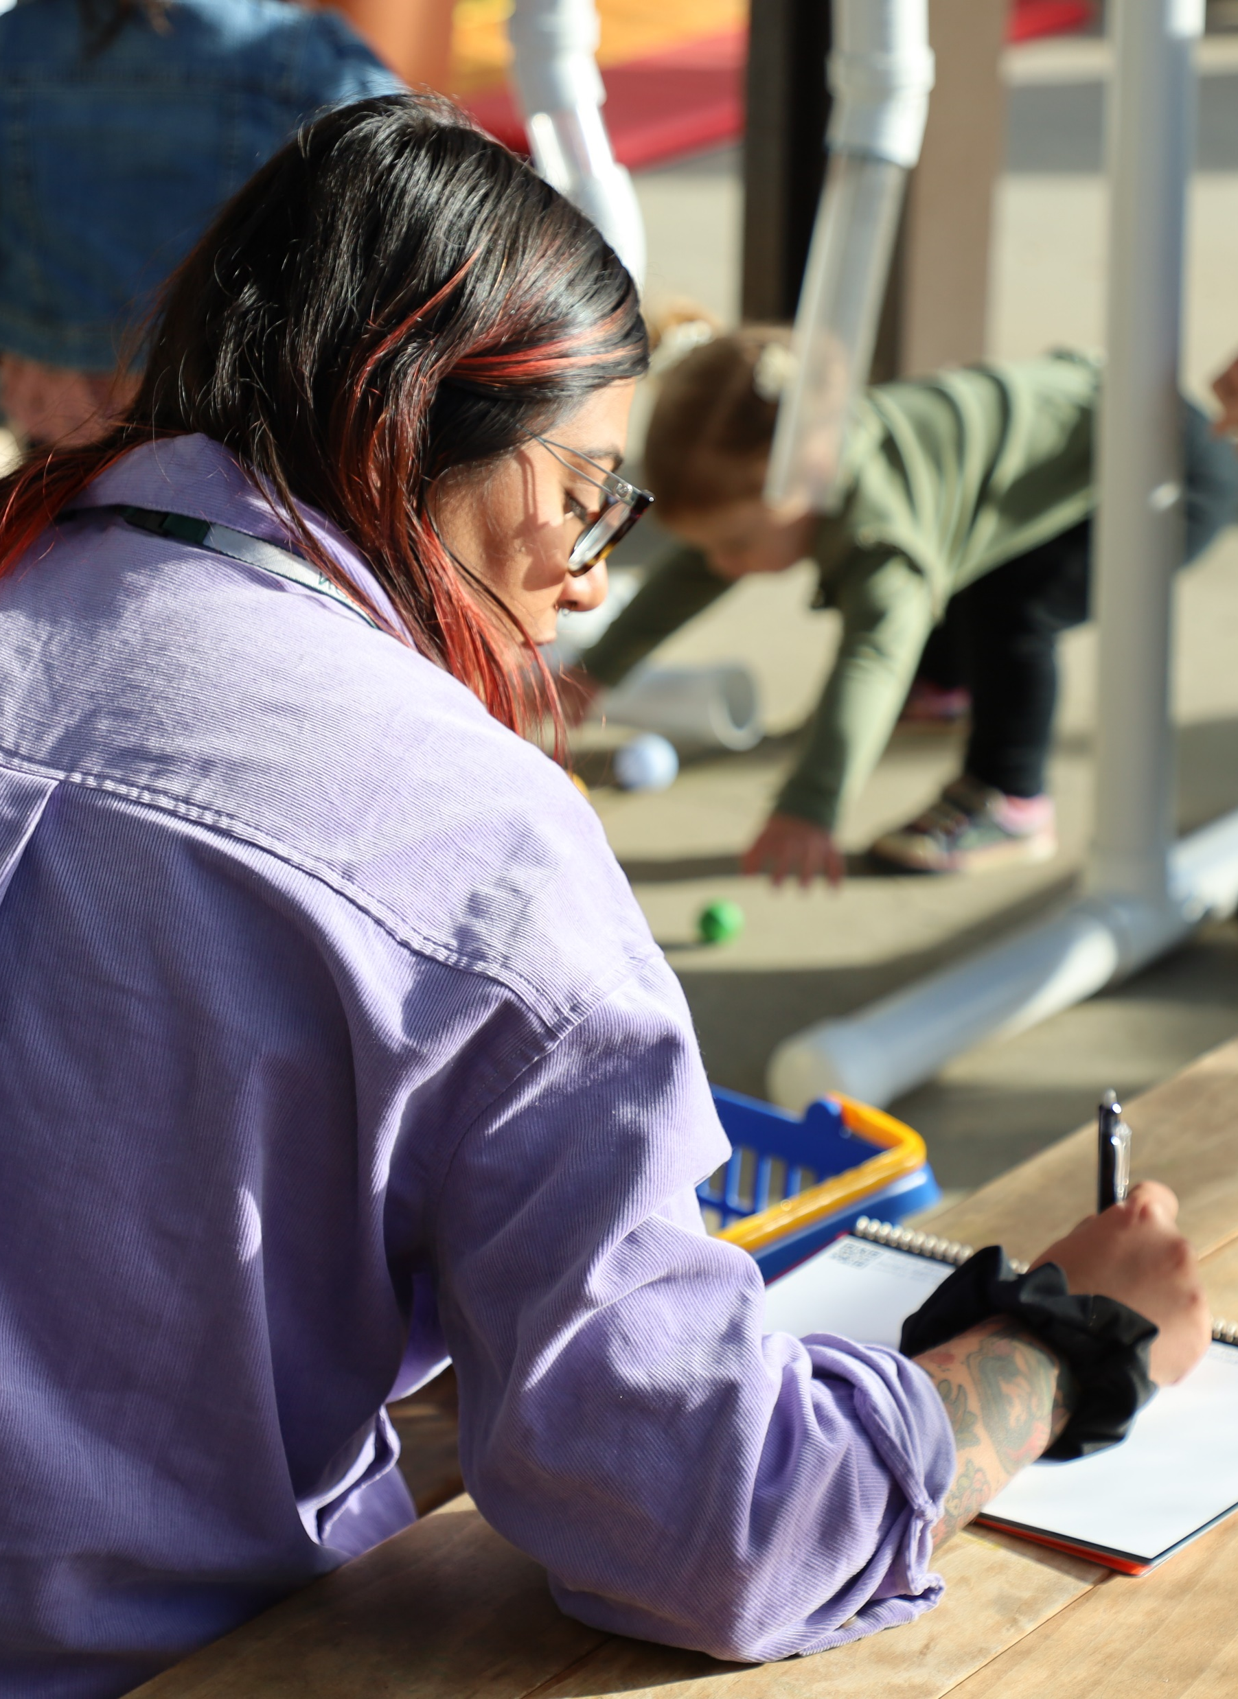
Apply to Your Setting
  Keep a journal
  Take photos or make notes
  Share with other educators

Slide 22
Thank you!
Notes:
Talking Points
Thank you all for your time and attention today.
Let’s remember that building a culture of inquiry is not something that happens in one day. It is a process we can work on daily.
Facilitator Notes
Consider ways you might support participants to build a culture of inquiry in their settings over time. For example,
Encourage them to keep a log of concepts and phenomena children in their settings are curious about.
Invite participants to take photos or make notes about the curiosities that their children have over a period of time and how they support children in their explorations.
Offer opportunities for participants to learn about ways others are engaging in inquiry with children. You might create a shared Google Document or create a Padlet as a digital space to share images and stories. Or you could facilitate a community of practice where participants can share in person.

