Slide 1
Addition and Subtraction: Preschool, Transitional Kindergarten, and Kindergarten
Notes:
Talking Points
In this session, we will explore how children in preschool, transitional kindergarten (TK), and kindergarten (K) develop an understanding of addition and subtraction. We will also focus on ways we can support children (3–6 years old) to understand and use addition and subtraction.
We will use “TK” to refer to transitional kindergarten and “K” for kindergarten.
Facilitator Notes
Adjust talking points to reflect your session length and participant needs. If necessary, add introductory and “housekeeping” information.
We recommend providing collections of small objects (for example, paper clips, shells, cotton balls, counting chips) that participants can use to engage in adding and subtracting experiences throughout this session. If your agency implements Counting Collections, you might provide some of these collections or invite educators to bring their own collections of objects from their learning settings.
As you plan your professional learning session, consider the content in each of the PPTs in this suite:
PPT 1 “Introduction to Addition and Subtraction: Birth—8 Years” describes how children (birth to eight years old) develop foundational concepts of addition and subtraction and provides opportunities for adults to engage in addition and subtraction concepts.
PPT 2b “Addition and Subtraction: Preschool, Transitional Kindergarten, and Kindergarten” and PPT 2c “Addition and Subtraction: Early Elementary Grades” describe in greater depth how children at different age levels develop their understanding and ways of solving addition and subtraction problems. These PPTs also include ideas on how to support children’s understanding and skills of addition and subtraction at specific age ranges.
Note, this suite does not offer a PowerPoint (PPT 2a) that focuses on infants’ and toddlers’ development of addition and subtraction concepts. Content related to infants and toddlers is addressed within the PPT 1 “Introduction to Addition and Subtraction: Birth—8 Years.” For more information on ways infants and toddlers develop knowledge and skills related to addition and subtraction, review the Number and Counting suite. Infants’ and toddlers’ understanding of addition and subtraction is closely related to their knowledge and skills of number and counting.
We encourage you to offer the content in PPT 1 before, or in combination with, the content in PPT 2b. If your participants work with children in more than one age range, you might combine parts of PPT 1, PPT 2b, and PPT 2c in one session or a series of sessions. Together PPT 1 and one of the age specific slide decks have been designed for up to three hours of professional learning. However, you can adjust slide decks to best meet participant needs and time allowances.

Slide 2

Acknowledgments
Count Play Explore Professional Learning Resources is a product of the Fresno County Superintendent of Schools developed in collaboration with WestEd and partners. They are not intended for commercial redistribution, unauthorized modification, or use outside the scope of professional education.
Notes:
Talking Points
The Count Play Explore Professional Learning Resources were made possible by Count Play Explore, an early math and science initiative led by the Fresno County Superintendent of Schools, Early Care and Education Department. This initiative is generously funded by the California Department of Education and the California State Board of Education. These resources are intended to be used as a guide for implementing evidence-based strategies, promoting active learning, and encouraging developmentally appropriate practices in early education settings. They are not intended for commercial redistribution, unauthorized modification, or use outside the scope of professional education.

Slide 3
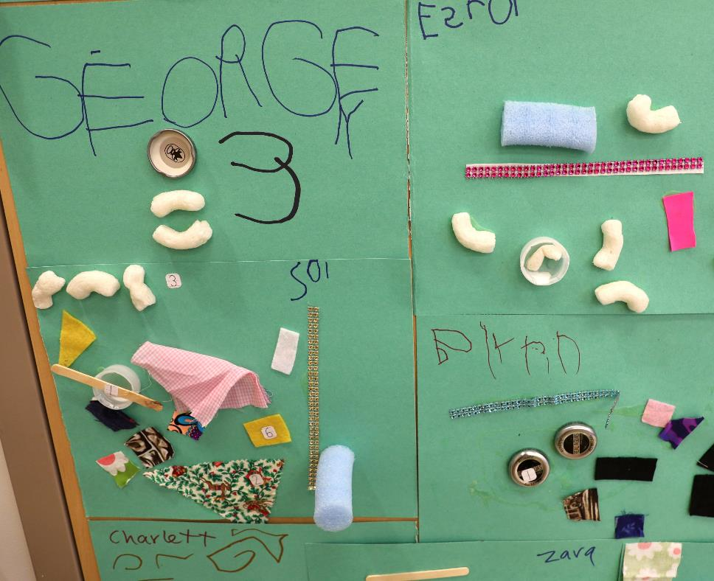
Session Goals
Understand how children in preschool, TK, and K:
develop and use addition and subtraction knowledge and skills
solve addition and subtraction problems
Explore ways educators can support children’s understanding of addition and subtraction
Notes:
Talking Points
Our goals for this session are to:
Understand how children in preschool, Tk, and K
develop and use addition and subtraction knowledge and skills
solve addition and subtraction problems
Explore ways educators can support children’s understanding of addition and subtraction
Throughout our session, we will take time to reflect on our current practices. We will also think about how we could use information from this session in our work.
Facilitator Notes
Adjust slide content and talking points to reflect what you plan to address in your professional learning session.

Slide 4
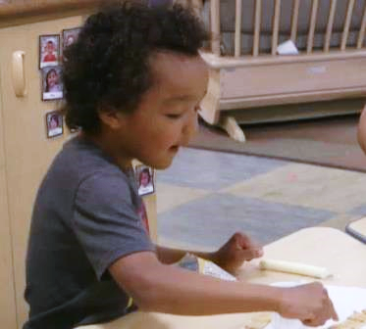
Observe: Adding and Subtracting
Adding and Subtracting During Snack (3–5 years)
Adding and Subtracting During Snack (3–5 years) - Audio Descriptive Version
Notes:
Time: 5–10 minutes
Materials: Video clip of children adding and subtracting in preschool, transitional kindergarten or kindergarten.
Talking Points:
Let’s begin by observing children using addition and subtraction.
As you observe the clip, notice how children add or subtract and ways the educators support them.
[Choose a strategy for facilitating this observation. Adapt the talking points to reflect this strategy.]
Thank you for sharing what you noticed about the ways children add and subtract and ways educators support them. In this session, we will explore more about how children learn and use addition and subtraction.
Facilitator Notes
Choose a video clip that shows children learning about and using addition or subtraction.
We provide the following video clips (you may use other videos):
Adding and Subtracting During Snack (3–5 years) [https://youtu.be/ZWGM-y_tL4k]: In this video, children explore adding and subtracting while eating crackers at snack time. Children use counting strategies to add or subtract.
Composing and Decomposing the Number 5 (3–5 years) [https://youtu.be/_FRjbFN8TNo]: In this video, children compose and decompose the number 5 using concrete objects in a teacher-led experience.
Adding During Storytime (3–5 years) [https://youtu.be/kntorkBEnVA]: In this video, an educator share a book with children and supports them to add and subtract as it relates to the story.
Counting and Adding While Reading (3–5 years) [https://youtu.be/MHszjwzaVOY]: In this video, an educator shares a book with children about ten dinosaurs coming to a party, one at a time. Then, the dinosaurs leave the party, one at a time. The children model the action in the story, pretending to be the dinosaurs arriving and leaving the party.
For larger groups or shorter sessions, invite participants to share with the larger group what they noticed about ways children added or subtracted.
For smaller groups or longer sessions, encourage participants to discuss with pairs or their table group. Then, invite participants to share with the larger group what they noticed about ways children added or subtracted.

Slide 5
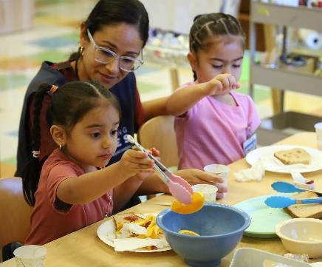
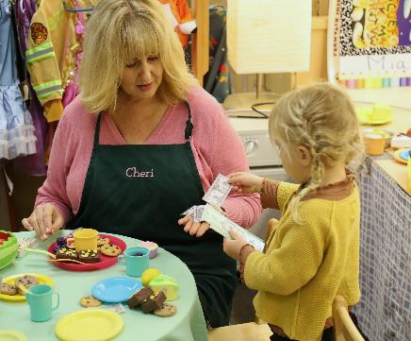
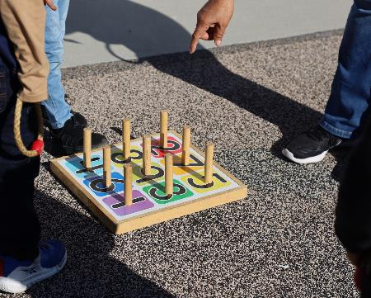
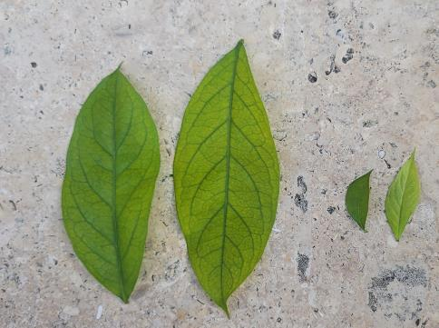
Adding and Subtracting to Solve Problems of Interest
Mealtime
Pretend Play
Games
Outside Exploration
Notes:
Talking Points
Children learn about addition and subtraction as part of daily interactions and play when provided opportunities to add and subtract to solve problems of interest.
For example, children might add or subtract when
Eating a snack or preparing for a meal: Children might subtract to figure out how many orange slices are left after they take some.
Engage in pretend play: Children might add to find out how much pretend money their customer needs to buy three apples in the café.
Playing a game: Children might add points to determine who is the winner.
Exploring outside: Children might collect and sort rocks, leaves, or other natural materials and use addition to find a total amount. For example, two big leaves plus two small leaves make four leaves in all.
Addition and subtraction experiences that are a part of daily interactions and play build on children’s interests, enhance engagement, and allow children to physically manipulate and explore how adding and subtracting changes quantity—deepening children’s understanding of these math concepts.
In this session, we will explore ways educators can use authentic, daily experiences and concrete objects to support children to add and subtract in ways that are most effective for them.
Facilitator Notes
Consider inviting participants to share the ways children in their learning setting might add or subtract in different contexts and with different concrete objects.

Slide 6
Learning About Addition and Subtraction
Notes:
Talking Points
Now, we will explore how children in preschool, TK, and K understand and use addition and subtraction.

Slide 7
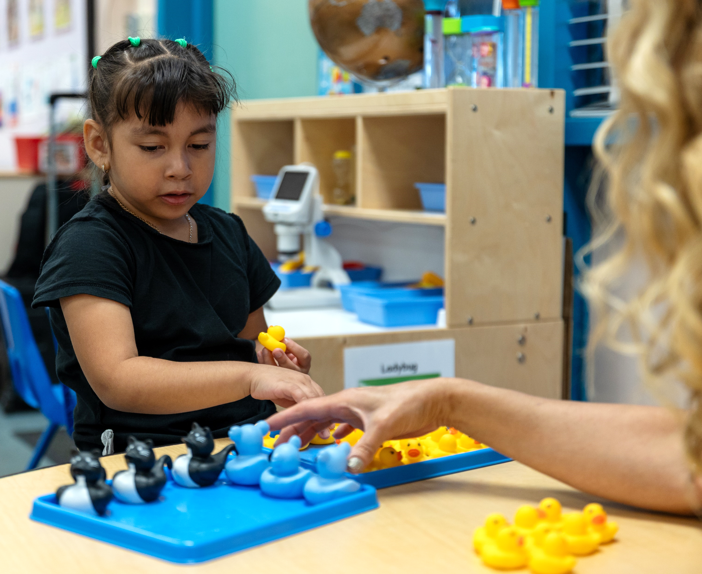
The California Preschool/TK Learning Foundations: Number Operations
Strand 2.0: Operations and Algebraic Thinking
Sub-strand: Number Operations
Adding makes more, and taking away makes less.
Numbers can be put together (composed) and taken apart (decomposed).
There are different ways to solve addition and subtraction problems.
California Department of Education (2024)
Notes:
Talking Points
Let’s review how addition and subtraction is described in the Preschool/Transitional Kindergarten Learning Foundations (California Department of Education, 2024).
There are three Preschool/TK foundations that describe what children learn about addition and subtraction.
These foundations are within Strand 2.0 Operations and Algebraic Thinking, within the sub-strand Number Operations.
These foundations describe children’s ability to demonstrate the following:
Adding makes more and taking away makes less.
Numbers can be put together (composed) and taken apart (decomposed).
There are different ways to solve addition and subtraction problems.
Facilitator Notes
Note: Place this slide featuring California Preschool/TK Learning Foundations, and slide 7 featuring Kindergarten Common Core Standards, where they work best for your participants’ needs.
Consider providing participants with copies of the relevant California Preschool/TK Learning Foundations: OA.2.1–2.3.

Slide 8
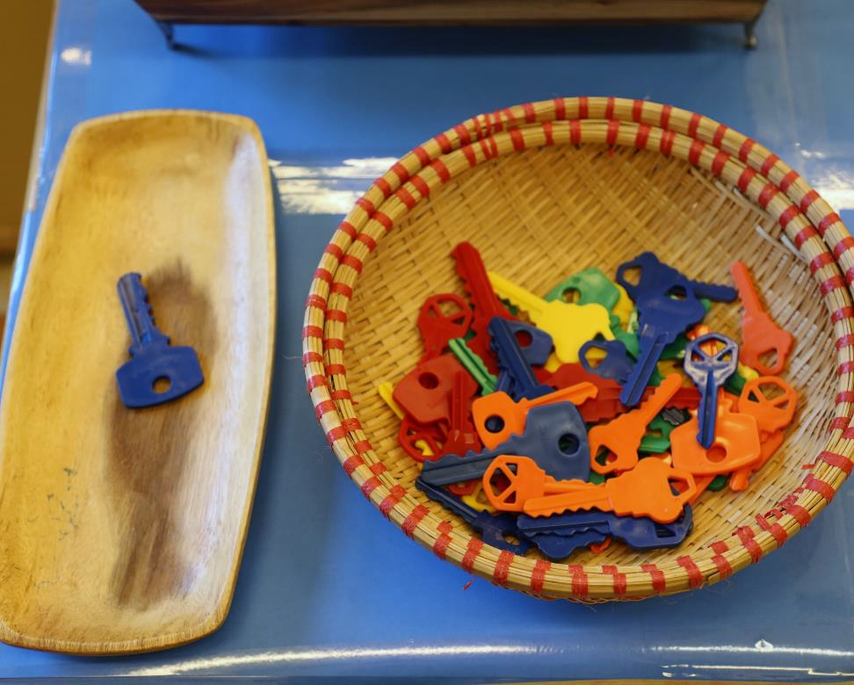
California Common Core—Kindergarten
Operations and Algebraic Thinking (K.OA)
solve word problems using a variety of materials and strategies
solve problems within 20, demonstrating greater fluency within 10
express addition and subtraction problems using written equations
Number and Operations in Base Ten (K.NBT)
understand place value by composing and decomposing two-digit numbers
California Department of Education (2013)
Notes:
Talking Points
Let’s review how addition and subtraction is represented in the California Common Core State Standards (California Department of Education, 2013).
A variety of Kindergarten standards describe what children learn about addition and subtraction.
Standards under the “Operations and Algebraic Thinking” strand describe children’s ability to:
Solve word problems using a variety of materials and strategies. For example, the standards highlight counting on, making ten, and decomposition strategies.
Solve problems within 20, demonstrating greater fluency within 10.
Express their addition and subtraction problems using written equations.
The “Number and Operations in Base Ten” strand also includes a standard related to addition and subtraction.
This standard describes how children understand place value by composing and decomposing two-digit numbers. For example, children learn eleven is composed of ten and one.
Facilitator Notes
Consider providing participants with copies of the relevant California Common Core State Standards: K.OA.1–5 and K.NBT.1.

Slide 9
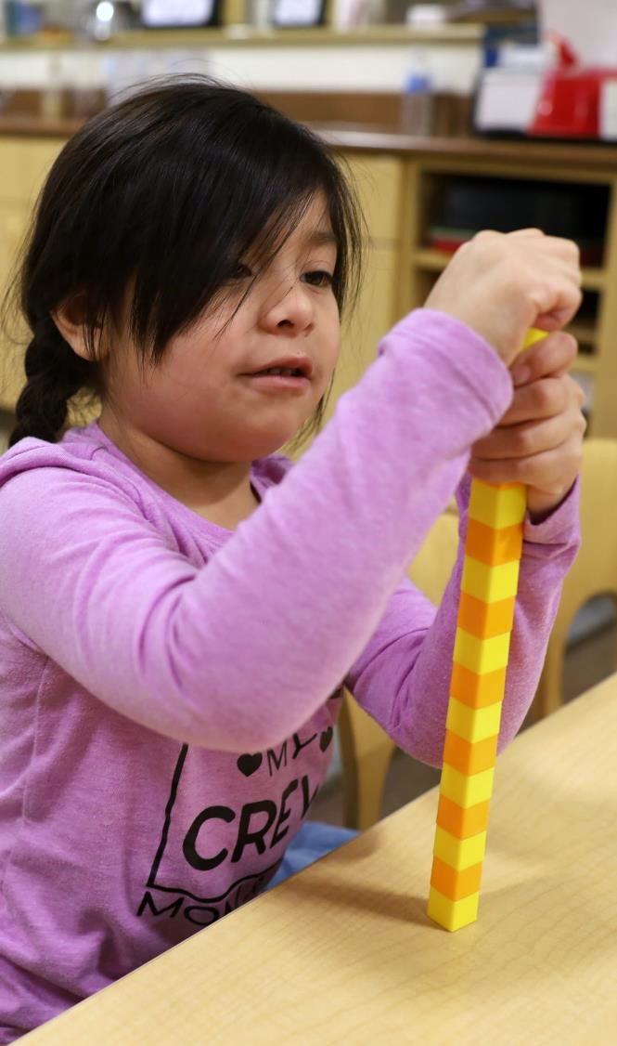
What Children Understand About Addition and Subtraction
Adding makes more, and taking away makes less.
Numbers can be put together (composed) and taken apart (decomposed).
Numbers can be added in any order (commutative).
Addition and subtraction are opposites (inverse).
Notes:
Talking Points
We will start by reviewing what children understand about addition and subtraction. From infancy and into early elementary, children will develop understandings, such as
Adding makes more and taking away makes less.
Numbers can be put together (composed) and taken apart (decomposed).
Numbers can be added in any order (commutative).
Addition and subtraction are opposite (inverse).
In today’s session, we will focus on the first two concepts and how children’s understanding of these concepts creates a foundation for solving addition and subtraction problems in preschool, TK, and K.
Facilitator Notes
More information on these concepts, as well as additional ways to engage adult learners, can be found in PPT 1 “Introduction to Addition and Subtraction: Birth—8 Years.”

Slide 10
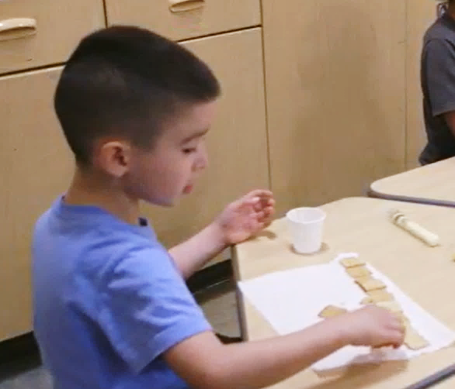
Adding Makes More, and Taking Away Makes Less
Children in Preschool and TK:
begin to communicate more accurately about changes in quantity using number words and gestures
solve some addition and subtraction problems during daily routines and learning experiences For example,
in the context of a shared story
during snack time
Clements & Sarama (2020)
Notes:
Talking Points
Infants and toddlers understand that adding makes more and taking away makes less (McCrink & Wynn, 2004).
In preschool, children can begin to communicate more accurately about changes in quantity using number words (for example “three”) and gestures (for example, holding up three fingers). They might communicate using their home language, English, or both.
They explore the concepts of adding more and taking away as they solve addition and subtraction problems during daily routines, and playful experiences (Clements & Sarama, 2020).
For example, when reading Pete the Cat and his Four Groovy Buttons by Eric Litwin, children make predictions about how many buttons Pete has left after he loses some. They understand that losing a button means there will be less buttons and might be able to communicate a quantity that is less than what he had before.
When adding crackers to their plate, children understand this results in more and they might predict how many they have in all.
Facilitator Notes
For more information about what infants and toddlers understand about adding to make more and taking away to make less, review PPT 1 “Introduction to Addition and Subtraction: Birth—8 Years.”

Slide 11
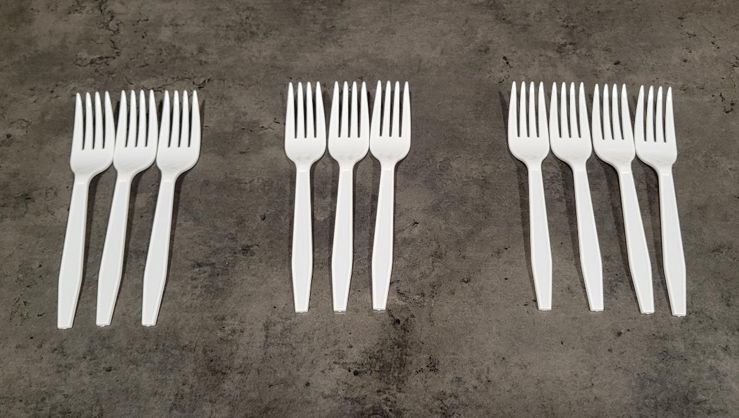
Different Ways to Make 10
Find different ways to make a set of 10.
Notes:
Time: 5–10 minutes
Materials: Collections of small objects (for example, paperclips, shells, cotton balls, counting chips)
Talking Points
We reviewed the concept of adding makes more and taking away makes less. Let’s explore a different concept that is a part of adding and subtracting.
[Select a facilitation strategy from the Facilitator Notes.]
Using the materials at your table, find different ways to make 10.
For example, I can make a set of 10 by combining sets of three, and three, and four!
You might record the different sets you make.
[Provide time for participants to work.]
[Invite a few participants to share their experience and the different ways they created a set of 10 objects.]
This activity explored the idea that numbers can be put together and taken apart. Sets of objects can be combined to create a set of 10.
Similarly, a group of 10 objects can be broken apart into smaller sets in different ways.
Facilitator Notes
Adjust the way you organize the activity based on group size, session length and format, and participants’ needs. For example,
For longer sessions, invite participants to work individually and share their experiences with their tables before discussing as a larger group.
For shorter sessions, invite participants to work with a partner and share with the larger group.

Slide 12
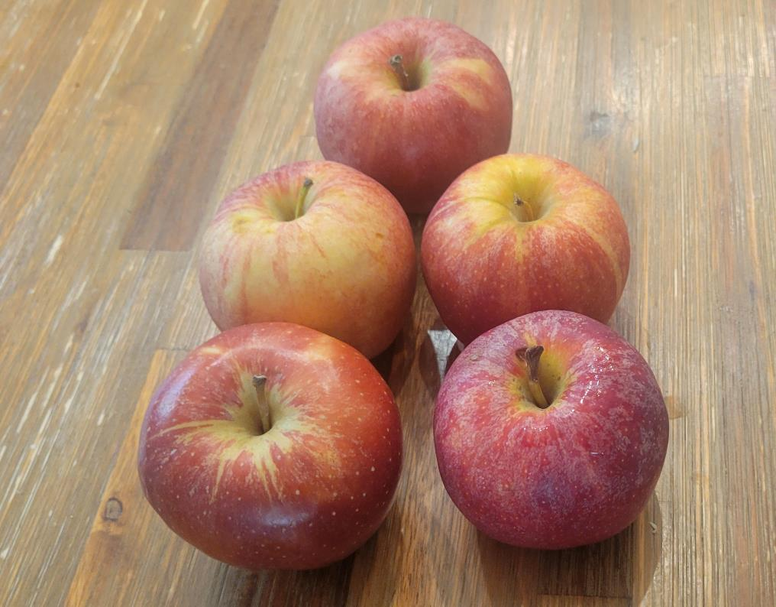
Number Composition
Children combine two sets of objects to make a larger set.
Clements & Sarama (2020)
Notes:
Talking Points
In preschool, children begin to explore the idea that numbers can be put together and taken apart. Children combine two sets of objects to make a larger set (Clements & Sarama, 2020). Through experiences of combining sets, they learn about number composition.
For example, three carrots and two bananas can be combined to make a set of five foods.

Slide 13
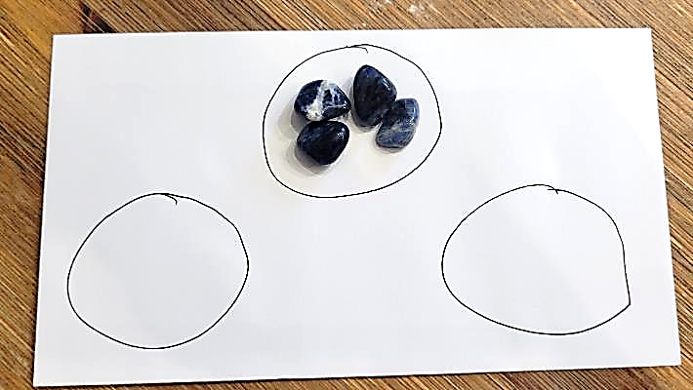
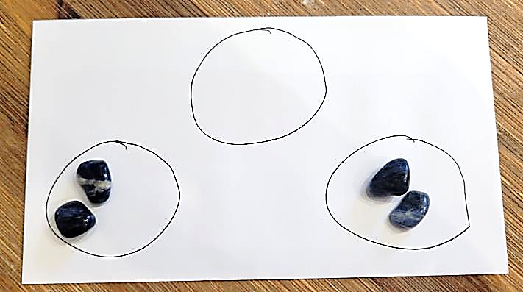
Number Decomposition
Children break numbers into sets of smaller numbers.
Clements & Sarama (2020); Fuson (1992)
Notes:
Talking Points
In preschool, children also explore ways to break a larger set into smaller sets (Clements & Sarama, 2020; Fuson, 1992).
They build an understanding that there are many ways to decompose numbers or break larger sets into smaller sets.
For example, a set of five fruits can be broken into three carrots and two bananas. Or, ten paint brushes can be sorted into three large brushes and seven small brushes.

Slide 14
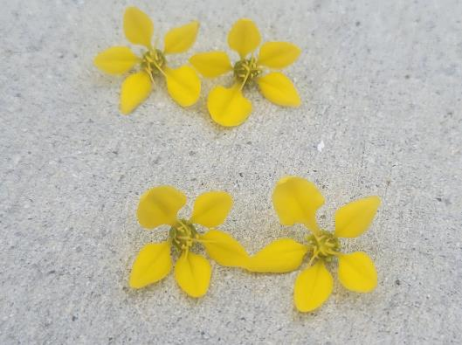
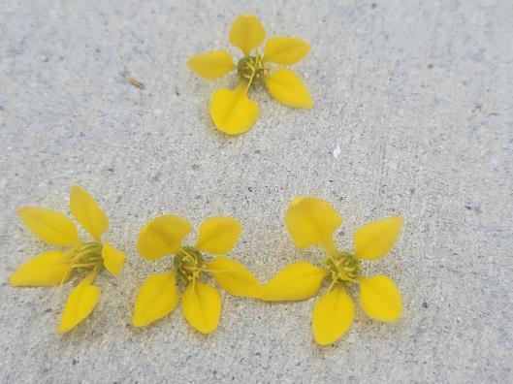
Composing and Decomposing Numbers in Preschool, TK, and K
Most four- and five-year-olds can decompose numbers less than five into sets of smaller numbers in more than one way.
By the end of kindergarten, most children can decompose numbers less than 10 into sets in more than one way.
Clements & Sarama (2020)
Notes:
Talking Points
Most 4- and 5-year-olds can decompose numbers less than five into sets of smaller numbers in more than one way (Clements & Sarama, 2020). For example,
four leaves can be decomposed into a set of 2 leaves and a set of 2 leaves.
Four leaves can also be a set of three leaves and a set of one leaf.
By the end of kindergarten, most children can decompose numbers less than 10 into sets in more than one way (for example, decompose seven into three and four, or five and two).
Solving problems involving composing and decomposing numbers is more meaningful when the problems are related to children’s daily lives or cultures. Learning about children’s diverse experiences can support educators to offer problems and materials that might be most relevant and engaging for children.

Slide 15
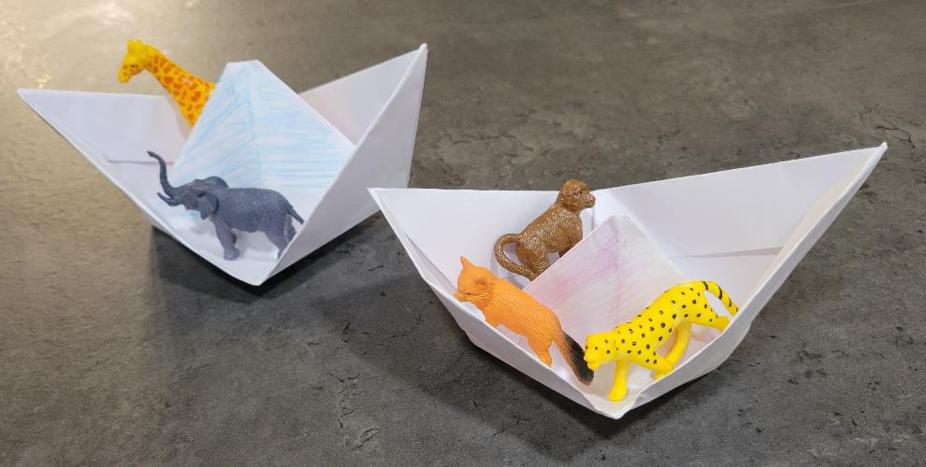
Explore: Composing and Decomposing Numbers
Activity for Children: “Animal Islands”
5 can be broken into a set of 3 and a set of 2
Notes:
Time: 10–20 minutes
Materials: Animal Island handout, materials to play “Animal Island” (optional)
Talking Points
We can support children’s understanding of addition and subtraction through meaningful investigations and activities that encourage children to add and subtract in different ways.
Let’s explore a playful activity that can encourage children to compose and decompose numbers.
Take out the “Animal Island” activity for children.
This handout describes how to play “Animal Islands” with children.
With a partner, review the handout together. Then, discuss how you might use this activity in your settings.
Consider the children in your setting. Use the ideas at the end of the handout to brainstorm ways to modify this activity to meet the interests and needs of the children in your learning setting.
Facilitator Notes
Provide 5–10 minutes for participants to review and discuss the handout.
You might invite participants to share, with the larger group, how they might use the activity in their setting.
Refer to the M5 section in the “Animal Islands” activity for examples of ways educators can modify this activity to respond to children’s interests, languages, cultures and lived experiences, abilities, and emerging skills.
For longer sessions, consider offering time for participants to do the activity. Be sure to prepare and bring the necessary materials. Encourage participants to discuss what they notice as they engage in the activity.

Slide 16
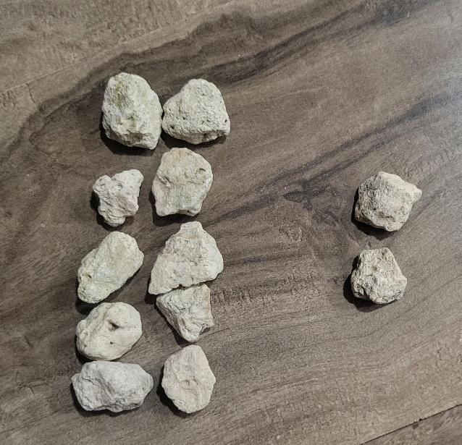
Composing and decomposing numbers supports understanding place value.
12 = 10 + 2
Composing and decomposing numbers up to 20 introduces children to tens and ones.
By the end of kindergarten, children compose and decompose numbers from 11 to 19 into tens and ones.
Notes:
Talking Points
As children learn to count beyond 10 and have experiences of composing and decomposing numbers, they grow their understanding that numbers between 10 and 20 are composed of ten and ones.
By the end of kindergarten, most children are able to compose and decompose numbers from 11–19 into tens and ones using objects, drawings, or equations.
For example, a set of ten grey rocks and a set of two white rocks can be composed to make a set of 12 rocks.
In another example, 15 can be decomposed into a group of 10 and a group of 5.
Composing and decomposing using tens and ones sets the foundation for children to understand place value and the base-10 number system in grades one and two.
For example, children will understand that the one in the two-digit numeral 12 represents a ten, and the 2 in 12 represents ones. Ten and two can be composed to make 12.
Facilitator Notes
More information on composing and decomposing numbers and place value is featured in PPT 2c “Addition and Subtraction: Early Elementary.”

Slide 17
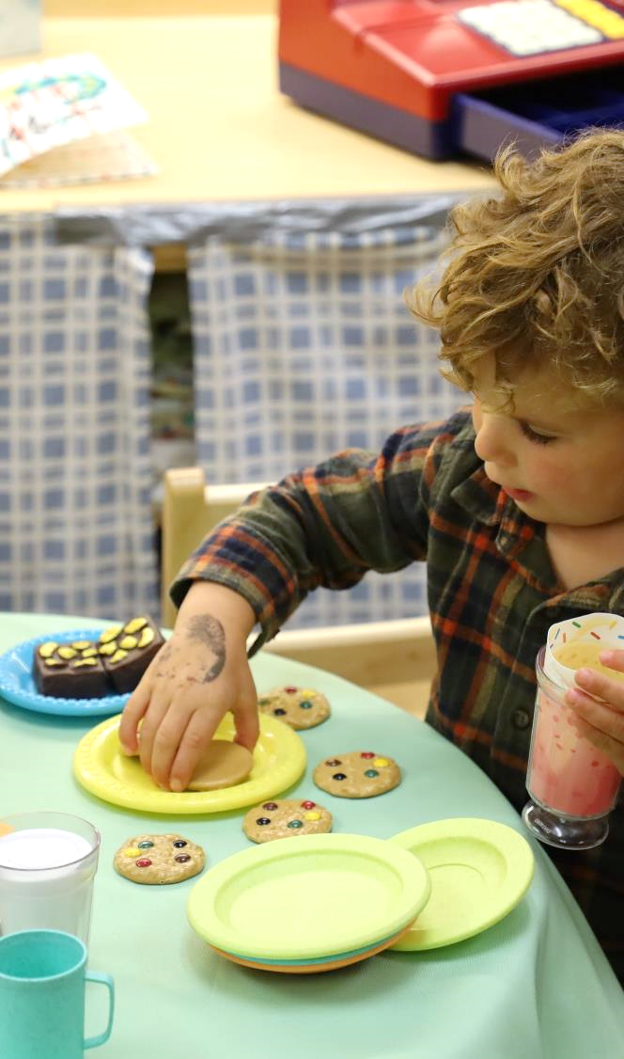
Solving Addition and Subtraction Problems
Counting
Composing, decomposing, and using the properties of addition and subtraction
Building on known facts
Notes:
Talking Points
We have discussed key understandings that children develop about addition and subtraction.
Now, we will examine different strategies children might use to solve addition and subtraction problems. This includes
Counting
Composing, Decomposing, and using Properties of Addition and Subtraction
Building on Known Facts
In this session, we will focus on children’s use of counting strategies.
Facilitator Notes
More information on other strategies children use to add and subtract is featured in PPT 2c “Addition and Subtraction: Early Elementary.”

Slide 18
Play: Alphabet Addition and Subtraction (Optional)
C + E = ?
Notes:
Time: 15–30 minutes (including debrief on next slide)
Materials: Alphabet Counting handout, small items to count, containers, paper, and pencils
Talking Points
Before we discuss ways that children solve addition and subtraction problems, let’s remember what it feels like to learn how to add and subtract.
We will play a game called alphabet counting.
Take out the “Alphabet Counting” handout.
The purpose of this activity is to experience what it feels like to learn how to add and subtract for the first time. [Use the instructions on the handout as talking points and guide the educators through the different sections.]
Facilitator Notes
The Alphabet Counting activity has multiple parts. Depending on the amount of time you have in your session, you may choose to engage in the entire activity or just the first and fourth part (“Learning About Alphabet World” and “Addition and Subtraction”).
Note: This activity is designed to help adult learners experience adding and subtracting as if it were the first time they were adding or subtracting. Using the alphabet, instead of numbers, introduces a system that adults do not typically associate with numerical values. This adds new challenges for them—similar to how adding and subtracting may initially be challenging for young children. The experience is not intended to draw parallels between the number system and the alphabet. Children learn the alphabet and number systems in different ways.
Math is playful. This principle is key to the Count Play Explore professional development approach. This activity invites adults to explore adding and subtracting through play.
Math mindsets matter. This experience may activate a variety of feelings for participants. Some may enjoy this experience, while others may find it stressful.
Allow participants to engage in ways that they feel most comfortable. Some may think through these problems independently, while others prefer to work in pairs or small groups.
The goal of this activity is to experience adding and subtracting as a beginner. This experience is likely to be challenging for participants. Remind them that it is okay if they do not get the correct answers.
When inviting participants to share, consider their comfort level. Some participants may not feel comfortable sharing with the whole group. Adapt how you facilitate this activity based on participant needs and session length.

Slide 19
Discuss: Alphabet Addition and Subtraction (Optional)
What strategies or materials did you use to solve the alphabet math problems?
How did you feel while learning to add and subtract using this new counting system?
How might this experience affect your engagement with children as they learn to add and subtract?
Notes:
Time: 15–30 minutes (including the activity on previous slide)
Materials: Small items to count, containers, paper, and pencils
Talking Points
Let’s discuss this experience of learning the alphabet counting system to add and subtract.
[Select a facilitation approach and use the prompts in the facilitator notes to support a discussion.]
Thank you for discussing your experiences.
This activity demonstrated that learning to add and subtract can be challenging. Children need to learn many things at once. For example, they have to learn number words, number order, and how adding and subtracting works.
Facilitator Notes
Support participants to discuss the experience in pairs, table groups, or whole group based on group size, session length and format, and participant needs.
Use the prompts below to guide your discussion. Note: The prompts below include additional prompts and questions that do not appear on the slide.
What strategies or materials did you use to solve the alphabet math problems? In what ways did your knowledge of the alphabet help you when using the alphabet list to add or subtract? In what ways did the strategies you used resemble those that children use when they first learn to add and subtract?
How did you feel while learning to add and subtract using this new counting system? What can this tell us about how children feel when learning to add and subtract?
How could this experience affect your engagement with children as they learn to add and subtract? How does this experience relate to your work with multilingual learners who may be learning to add and subtract in more than one language?
Consider summarizing some key points. For example, “I noticed you used different strategies to solve these problems. Some of you used your fingers to add and subtract, others used small items, and some made an alphabet number line. These are the types of strategies and materials children often use when they learn to add and subtract.”
Note: This activity is also featured in the PPT 1 “Introduction to Number and Counting: Birth—8 Years” session. If using the activity in this session, “Addition and Subtraction: Preschool, Transitional Kindergarten, and Kindergarten,” adjust the experience and reflection questions to focus on addition and subtraction, instead of counting. For example, the reflection questions above have been adjusted to focus on adding and subtracting.

Slide 20
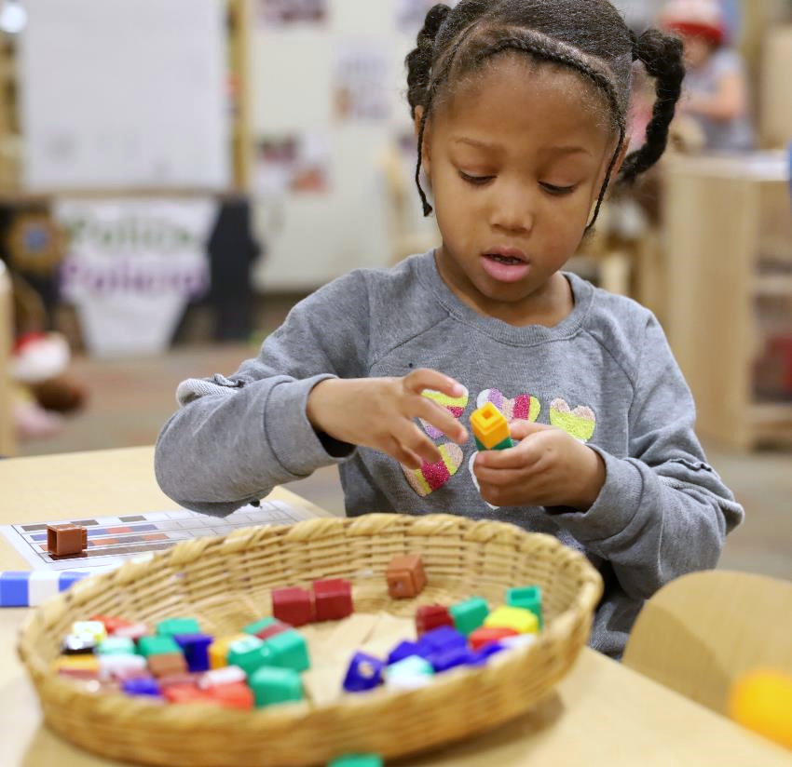
Counting Strategies
Children use different counting strategies when learning to add and subtract.
count all
count on
count down
Notes:
Talking Points
We have just experienced what it feels like to learn how to add and subtract.
When you used alphabet counting to add and subtract, you used different strategies to support you to add and subtract, just like children do.
One strategy you might have used was a counting strategy. You might have worked through the alphabet system, starting at “A” each time, to help you solve the problem.
Children use different counting strategies when learning to add and subtract. They might use counting all, counting on, and counting down strategies.

Slide 21
Counting All and Counting On: Addition
“Five plus six more” (5 + 6)
Counting all
“One, two, three, four, five.”
Counting on
“One, two, three, four, five ...”
“One, two, three, four, five, six.”
“… six, seven, eight, nine, ten, eleven—eleven!”
“One, two, three, four, five, six, seven, eight, nine, ten, eleven—eleven!”
Carpenter & Moser (1982); Clements & Sarama (2020)
Notes:
Talking Points
The count all strategy is the first strategy children use to add and subtract numbers (Carpenter & Moser, 1982; Clements & Sarama, 2020).
Children combine sets of objects together and then count them all to find out how many there are in all.
For example, a child has a set of five blue sticks and a set of six red sticks. To add these sets together, a child might count the blue sticks, “One, two, three, four, five,” and then count the red sticks, “One, two, three, four, five, six.” To add these sets, the child might physically push the two sets together and then count them all, “One, two, three, four, five, six, seven, eight, nine, ten, eleven—eleven!”
As children get more practice with counting, adding, and subtracting, they might may use counting on strategies. This means they start at one of the addends—one of the numbers in the addition problem—and count up from that number to find a new total.
For example, a child counts the first set of blue sticks, “One, two, three, four, five…” and then add six more to their set, “…six, seven eight, nine, ten, eleven—eleven!”
Counting on is a more advanced strategy because it requires children to start counting from numbers other than one.
As children gain more experience with the count sequence and a deeper understanding of counting, they might make the transition from count all to count on.
Children might count in the home language, English, or both. Support children to use the language that is most effective for them when using counting strategies to add and subtract.

Slide 22
Counting On from Larger
“Two plus nine more” (2 + 9)
Counting on from larger
“Nine … ten, eleven—eleven!”
Carpenter & Moser (1982); Clements & Sarama (2020)
Notes:
Talking Points
Eventually, children will discover the “counting on from larger” strategy. This is related to the commutative property—children understand that the order in which numbers are added doesn’t matter. They will start counting on from the larger number.
For example, in adding nine sticks to a group of two, it is faster and easier to start counting on from nine.
A child might say, “Nine…ten, eleven—eleven!”

Slide 23
Counting All and Counting Down: Subtraction
“Seven take away three” (7 – 3)
Counting all
“One, two, three, four, five, six, seven!”
Counting down
“Seven, six, five—four!”
“Take away three; one, two, three.”
“… six, seven, eight, nine, ten, eleven—eleven!”
“Now there are one, two, three, four—four left!”
5, 6, 7
Carpenter & Moser (1982); Clements & Sarama (2020)
Notes:
Talking Points
Children might use similar counting strategies to subtract.
They might use a counting all strategy—counting a total number in a set, counting the items taken out of the set, and then counting all the remaining items to figure out how many are left (Carpenter & Moser, 1982; Clements & Sarama, 2020).
Let’s use the example of seven take away three.
A child counts a set of sticks to determine that there are seven sticks. The child then removes three sticks (subtract three) and counts the set again to learn that taking three away from a set of seven results in four sticks.
Another strategy children might use to subtract is the counting down strategy. This means that a child starts at a number and then counts backward by the number that is being subtracted.
Let’s use seven take away three again.
Children count down starting at seven, “Seven, six, five,” and say, “four!” [Model this with gestures: hold up seven fingers. When you count backward, put three fingers down to result in four fingers.]
Counting down is challenging because it requires children to know how to count backward, and to hold in memory how many fingers or objects they are removing.
It takes time and a lot of practice for children to comfortably transition from counting all to counting on or counting down strategies. While some children make this transition in preschool, others may only make this transition in kindergarten or first grade. Some children might discover this strategy on their own as they explore adding and subtracting. Others might benefit from more explicit support from educators and families.
Facilitator Notes
If you used the “Alphabet Counting” activity on slide 17, ask participants to explain why the count on strategy could be challenging as it relates to their experience using the alphabet. For example, it might have been difficult to begin counting by starting at “E.” Some participants may have had to start at “A” each time.

Slide 24
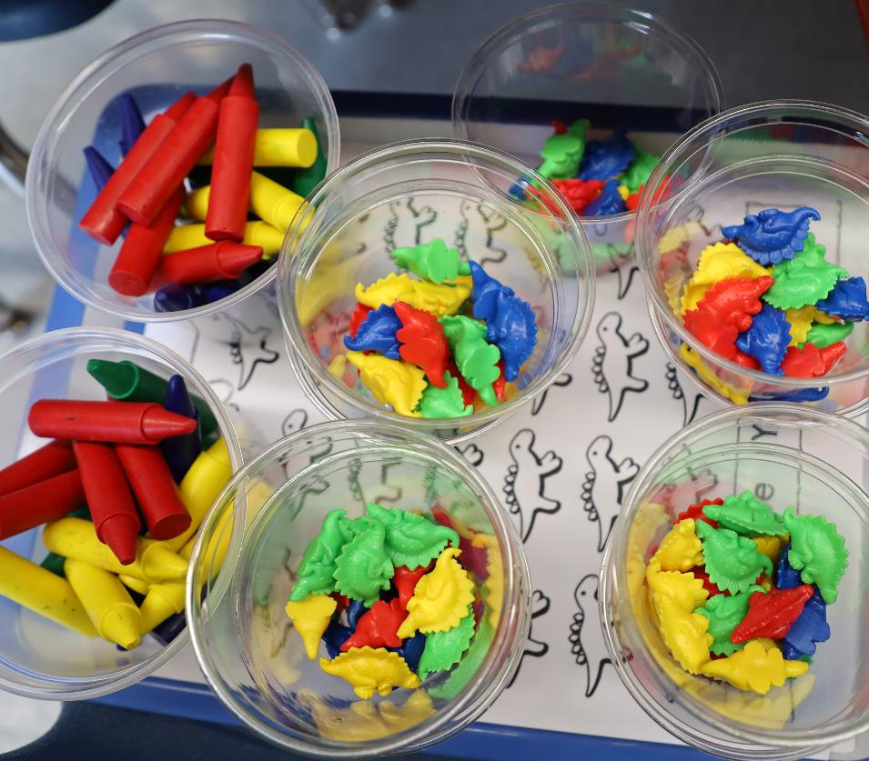
Supporting Children to Use Counting Strategies
Educators can support children to:
use concrete objects and containers
count with understanding and proficiency
use their fingers
invent and explain different strategies
Notes:
Time: 5 minutes
Materials: Collections of small objects (for example, paperclips, shells, cotton balls, counting chips)
Talking Points
Educators can support children to use counting strategies in different ways. For example, educators can support children to
Use concrete objects and containers. Physical containers can help reinforce ideas related to combining to make a larger set or separating to make smaller sets.
Count with understanding and proficiency. Counting with understanding and proficiency enhances children’s ability to use different counting strategies to solve addition or subtraction problems. Encourage children to count often through daily routines and meaningful experiences that encourage children to count to find out how many.
Invent their own strategies.
For example, counting all of the objects after adding to or taking away from a set or counting on fingers, adding more fingers as they count.
Use their fingers to support adding and subtracting processes (Polleti et al., 2025).
Explain their approaches and strategies. For example,
Educators might ask, “How might we figure out how many we have in all if we add four more to our set of eight?” or, “What did you do to figure that out? Can you tell me or show me?”
Facilitator Notes
The “Number and Counting” suite provides more information on how to support children’s understanding of number and counting.

Slide 25
Supporting Children to Add and Subtract
Notes:
Talking Points
We explored what children come to understand about addition and subtraction and strategies children might use to solve addition and subtraction problems. We also discussed some ways educators can support children to use counting strategies to add and subtract. Now, let’s discuss more ways we can support children to add and subtract.

Slide 26
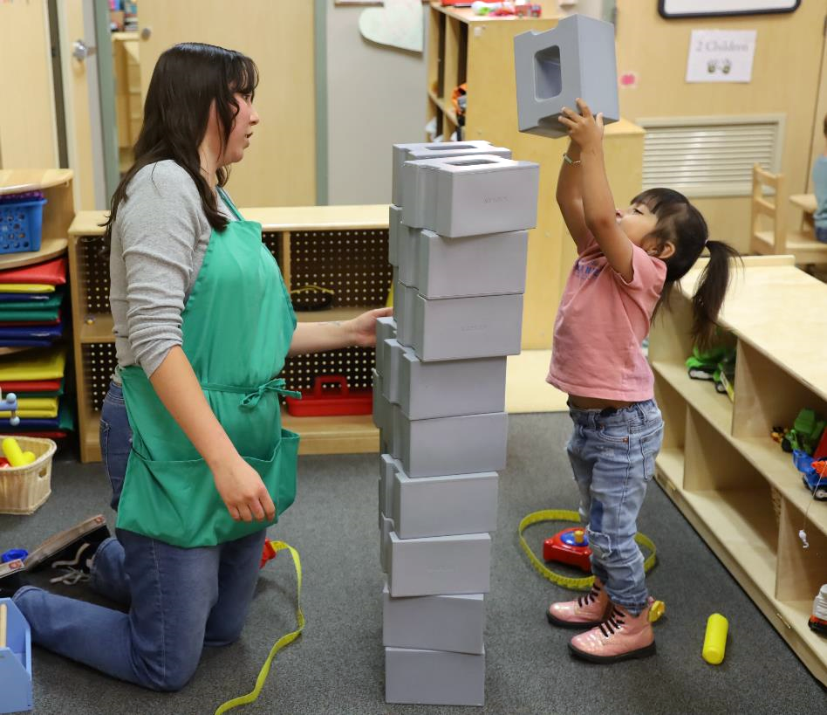
How to Support Understanding of Addition and Subtraction
use authentic problems
provide concrete objects
invite children to share their thinking
Belenky & Nokes (2009)
Notes:
Talking Points
Educators can support children’s understanding of addition and subtraction by:
Noticing or identifying problems of interest that are meaningful to a child or group of children and offer concrete objects to support children to add and subtract.
Building on children’s interests and lived experiences can enhance engagement and motivate children to solve addition and subtraction problems.
Supporting children to use concrete objects to add and subtract can also enhance conceptual understanding of addition and subtraction. Children of all ages should be offered concrete objects to support math learning, even after they begin using more abstract representations such as written equations (Belenky & Nokes, 2009). It is not until later in the kindergarten year that children use written equations to represent addition and subtraction.
Inviting children to explain their thinking.
Now, we will explore more teaching practices that support children to add and subtract.

Slide 27
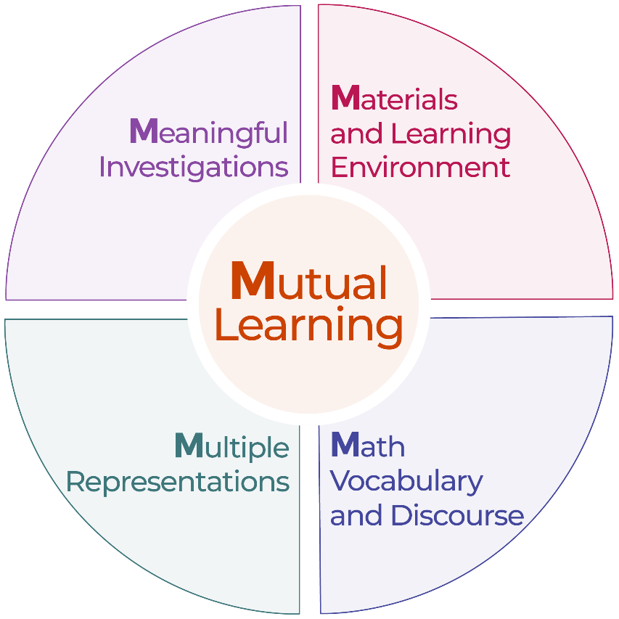
Explore: M⁵ Early Math Approach
Mutual Learning
Meaningful Investigations
Materials and Learning Environment
Math Vocabulary and Discourse
Multiple Representations
Notes:
Time: 15 minutes
Materials: M5 Overview handout
Talking Points
We refer to five early math teaching practices as the M5 Early Math Approach. These practices include:
Mutual Learning
Meaningful Investigations
Materials and Learning Environment
Math Vocabulary and Discourse
Multiple Representations
Let’s explore the M5 practices. Then, we will consider ways to use M5 to support children to add and subtract.
Facilitator Notes
Consider your participants and their prior experiences with M5.
For groups that have significant experience with M5, you might offer a few minutes for participants to share with a partner their areas of strength and what practices they are working on. Use this slide to briefly revisit the M5 practices and move to the next slide.
For groups that have less experience with M5, offer more time for participants to explore each practice. For example, allow time for them to review the practices on their own. Invite them to make a square over practices that they have “squared away” (practices they understand and use), a circle over “what’s still going around in their heads” (practices they still have questions about), and a triangle over three ideas that they will use in their settings. For more ideas on how to provide a comprehensive review, visit the M5 Early Math Approach suite.

Slide 28
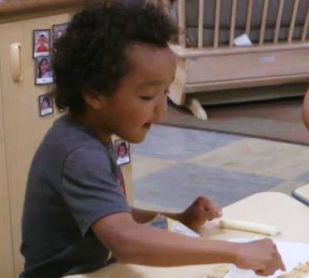
Observe: M⁵ in Action
Adding and Subtracting During Snack (3–5 years)
Adding and Subtracting During Snack (3–5 years) - Audio Descriptive Version
Notes:
Time: 5–7 minutes (not including debrief)
Materials: Observing M5 in Action: Addition and Subtraction handout, Preschool, TK, or K addition and subtraction video clip, chart paper, markers
Talking Points
Now, we are going to observe a video that shows how educators use M5 to help children use addition and subtraction.
Take out the “Observing M5 in Action: Addition and Subtraction” handout.
[Choose a strategy for facilitating this observation. Adapt the talking points to reflect this strategy.]
Facilitator Notes
Choose a video clip that shows children learning about and using addition or subtraction. This may be the same clip used for observing children adding and subtracting.
We provide the following video clips (you may use other videos):
Adding and Subtracting During Snack (3–5 years) [https://youtu.be/ZWGM-y_tL4k]
Composing and Decomposing the Number 5 (3–5 years) [https://youtu.be/_FRjbFN8TNo]
Adding During Storytime (3–5 years) [https://youtu.be/kntorkBEnVA]
Counting and Adding While Reading (3–5 years) [https://youtu.be/MHszjwzaVOY]
Note: Sample answers are provided for the video “Adding and Subtracting During Snack (3–5 years)” in the Facilitator Notes on the next slide.
Invite participants to take out the Observing M5 in Action: Addition and Subtraction handout.
For larger groups or shorter sessions, use a jigsaw approach. Before playing the video clip, assign each table one practice to focus on during the video. [If there are more than five tables, assign more than one table to focus on each practice.]
For smaller groups or longer sessions, consider showing the video clip two to three times, inviting participants to focus on specific practices each time. Encourage them to record observations on the handout.

Slide 29
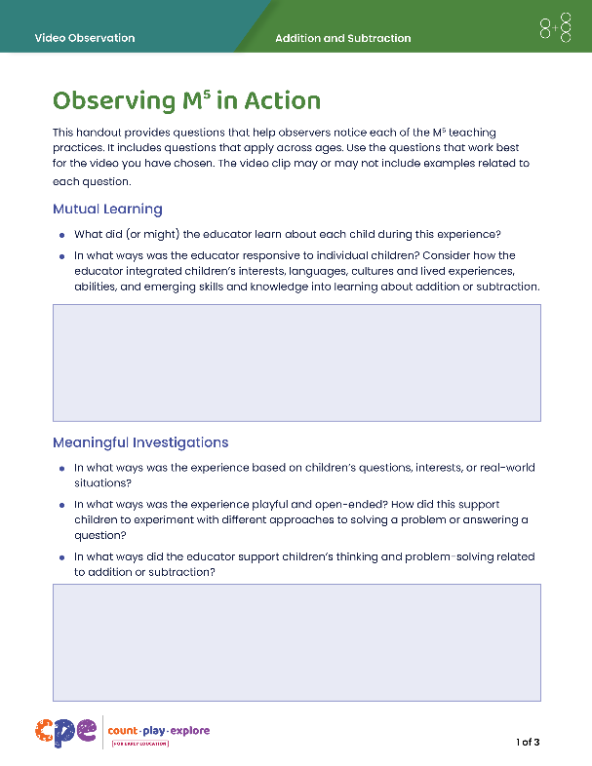
Discuss: M⁵ in Action
Mutual Learning
Meaningful Investigations
Materials and Learning Environment
Math Vocabulary and Discourse
Multiple Representations
Notes:
Time: 20–30 minutes (varies based on session goals)
Materials: Observing M5 in Action: Addition and Subtraction handout, Preschool, TK, or K addition and subtraction video clip, chart paper (optional), markers (optional), dice (optional)
Talking Points
Let’s unpack your observations of each M5 practice.
Facilitator Notes
Use the Answer Key for Observing M5 in Action: Addition and Subtraction for examples of ways M5 was used in the clip, “Adding and Subtracting During Snack.”
For larger groups, shorter sessions: After observing the video clip, ask each table group to discuss what they noticed about their assigned practice. Then, invite each group to share their observations with the larger group. As each group shares, paraphrase, affirm, and add to their responses as needed.
For smaller groups, longer sessions: Encourage participants to use addition and subtraction as a playful way to find a partner (or partners). Participants will discuss the handout once they find their partners.
Each person will roll a die and get a number. Using that number, they will find one or more people that, together, and using addition or subtraction, can make the number 5. For example, a person who rolled a 2 might find someone who rolled a 1, and someone who rolled a 2. Together, 2, plus 1, plus 2, makes 5. Invite small groups to share with the larger group.
Consider recording participants’ observations to make the practices visible. As participants share, paraphrase, affirm, and add to their responses as needed.

Slide 30
Explore: Using M⁵ to Support Learning About Addition and Subtraction
Identify one practice you would like to focus on.
How might you use this practice in a way that is responsive to children’s lives?
Notes:
Time: 20–30 minutes (including debrief on the next slide)
Materials: Using M5 to Support Learning About Addition and Subtraction
Talking Points
We discussed the M5 Early Math Approach. Let’s consider ways to use M5 to support children’s understanding of addition and subtraction.
Take out “Using M5 to Support Learning About Addition and Subtraction”
Review the ideas on how to use M5 to support the understanding of addition and subtraction in Preschool, TK, and K children. As you review, consider the children in your learning setting. Think about how you might adapt ideas on using M5 in ways that are responsive to the children in your learning setting. How might you adjust your approach based on children’s interests, cultures, abilities, and languages?
You might make notes, circle, or highlight as you review.

Slide 31
Discuss: Using M⁵ to Support Learning About Addition and Subtraction
Discuss the practice you might try in your learning setting. How might you use that practice in a way that is responsive to children’s:
interests
cultures
lived experiences
abilities
languages
Notes:
Time: 20–30 minutes (including exploring the handout on the previous slide)
Materials: Using M5 to Support Learning About Addition and Subtraction, dice (optional)
Talking Points
Now, we will discuss the handout.
Discuss the practice you might try in your learning setting. Consider children’s individual abilities, interests, cultures, and languages.
[Select a facilitation strategy to support participants’ discussion of the handout.]
Thank you for sharing ways you might use M5 to support children to add and subtract in your learning setting.
Facilitator Notes
Adjust the way participants discuss the handout based on your group size, session length and format, and participant needs. For example,
For shorter sessions, invite a few volunteers to share with the larger group or encourage participants to discuss the handout with their table group.
For longer sessions, encourage participants to use addition and subtraction as a playful way to find a partner (or partners). Participants will discuss the handout once they find their partners.
Each person will roll a die and get a number. Using that number, they will find one or more people that, together, and using addition or subtraction, can make the number 7. For example, a person who rolled a 2 might find someone who rolled a 1, and someone who rolled a 4. Together, 2, plus 1, plus 4, makes 7.

Slide 32
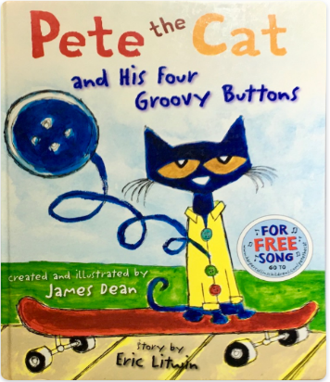
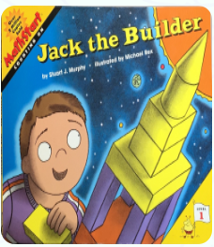
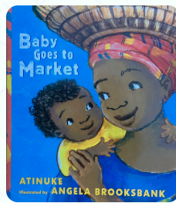
Explore: Adding and Subtracting with a Story
Review a children’s book. What are some ways you might use the book to support children in adding and subtracting?
Casey et al. (2004); Hassinger-Das et al. (2015)
Notes:
Time: 15–20 minutes
Materials: Using Children’s Literature to Support Addition and Subtraction handout, children’s books that include opportunities to add or subtract (see suggested titles in the facilitator notes), collections of objects that participants might use to add or subtract, Book Guides (optional).
Talking Points
We can support children’s understanding of addition and subtraction when sharing stories with children (Casey et al., 2004; Hassinger-Das et al., 2015).
Stories can provide meaningful problems, rooted in the story’s plot, that make adding or subtracting purposeful.
Stories can also connect adding and subtracting to real-life situations.
Finally, stories can provide visuals that children can use to support them to add or subtract (for example, using a counting all strategy to find out how many).
Let’s explore a few children’s books that might encourage children to add or subtract.
After reviewing the book, plan for ways you might encourage children to add and subtract as it relates to the story.
Use the “Using Children’s Literature to Support Addition and Subtraction” handout to guide your planning.
Explore the materials at your table to test out some of your ideas.
[Choose a facilitation strategy to support participants’ engagement. Adapt talking points as needed.]
Facilitator Notes
We have included a few books to consider using. However, you may find other books on the Count Play Explore website:
A Chair for My Mother (Una silla para mi madre in Spanish) by Vera B. Williams
Baby Goes to Market (Bebé va al mercado in Spanish) by Atinuke
Jack the Builder (Jacobo el constructor in Spanish) by Stuart J. Murphy
Select a facilitation strategy that meets your session goals. For example,
Use a jigsaw approach, assigning different books to different groups. Encourage groups to plan together using the questions on the handout. Then, small groups can share with the larger group.
Encourage participants to work in pairs. Invite them to choose a book they would like to review (you might need more than one copy of each book). Invite participants to use the handout to guide their planning. Then, ask a few volunteers to share with the larger group.
The Count Play Explore Website also provides Book Guides for each of the books listed above, as well as other books you could select. The book guides provide ideas on how educators might use the book to support children’s math learning. Consider printing and distributing the book guides for educators to use to support their planning.

Slide 33
Reflection and Planning
What is something you already do to support children in adding and subtracting?
What is something new you want to try to further support children in adding and subtracting?
Notes:
Time: 5–7 minutes
Talking Points
Today, we discussed how children develop their understanding of addition and subtraction and the strategies they might use to solve addition and subtraction problems. We also discussed ways educators can support children to add and subtract.
Think about your learning setting and the practices you already use.
What is something you already do to support children to add and subtract?
What is something new you might want to try to further support children to add and subtract?
You might record your ideas.
[Allow three to four minutes for participants to think and record their reflections. Consider inviting participants to share with a partner or the larger group.]
Thank you for your time, attention, and engagement. It’s been wonderful working with you.
Facilitator Notes
As participants discuss their reflections, note the questions that they still have and what they would like to try. You might use this information to identify topics for future training, coaching, or communities of practice.

